Slide 1
Estimation Improvements
August 8, 2024

Slide 2
Agenda
Background – how it works right now
Estimation mode performance enhancements
Usability improvements

Slide 3
Current Estimation Procedure

Slide 4
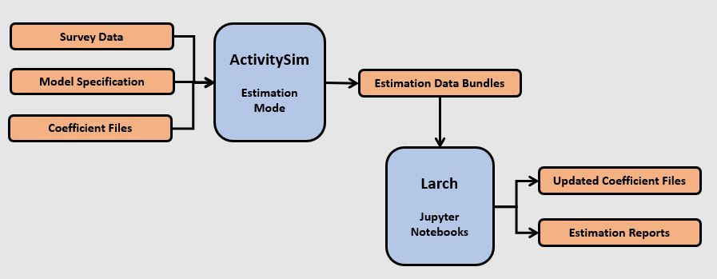
Estimation
Survey Processing
ActivitySim Formatting & Cleaning
Infer.py
Raw Survey Data
Estimation is an iterative process
Need the data to be consistent within ActivitySim
Need desired terms in your Estimation Data Bundle (EDB)
Iterate
Iterate

Slide 5
Estimation Case Study: Work From Home
Variable names and definitions vary between surveys
Survey Processing
ActivitySim Formatting & Cleaning
Infer.py
Raw Survey Data
Iterate
Nothing done to work_from_home in infer.py
(alternative numbers, etc. do not apply for this model)
Iterate

Slide 6
Estimation
Survey Processing
ActivitySim Formatting & Cleaning
Infer.py
Raw Survey Data
Specific to survey data and model
Iterate
Maintained by consortium
Iterate

Slide 7
Estimation Case Study: Work From Home
Survey Processing
ActivitySim Formatting & Cleaning
Infer.py
Raw Survey Data
Description | Expression
Constant for Working from home | 1
Full time worker (1 if true) | @df.pemploy==PEMPLOY_FULL
Female Worker | @df.female
Female worker with a Preschool Child in Household | @df.female & other_than(df.household_id, df.ptype == PTYPE_SCHOOL)
Accessibility to workplaces of the home mgra | @df.workplace_location_accessibility
Presence of Non Working Adult in the Household | @other_than(df.household_id, df.ptype == PTYPE_NONWORK)
Education Level Bachelors or higher degree | @df.has_college_degree
Household income Less than 30K | @df.income < 30000
Age Group - Less than 35 years | @df.age < 35
Age Group - 35 yrs to 45 yrs | @df.age.between(35, 45)
Age Group - 45 yrs to 55 yrs | @df.age.between(45, 55)
Age Group - 55 yrs to 65 yrs | @df.age.between(55, 65)
Age Group - Older than 65yrs | @df.age > 65
Set the desired spec
Iterate
Iterate

Slide 8
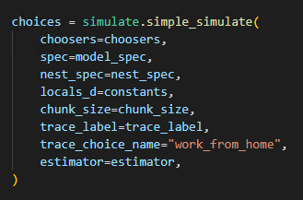
Estimation Case Study: Work From Home
1. Write model spec
Survey Processing
ActivitySim Formatting & Cleaning
Infer.py
Raw Survey Data
Run in Estimation Mode
2. Run the model like normal
Iterate
3. Overwrite modeled choice with survey choice
Iterate

Slide 9
Estimation Case Study: Work From Home
Survey Processing
ActivitySim Formatting & Cleaning
Infer.py
Raw Survey Data
Work From Home estimation data bundle:
work_from_home_model_settings.yaml
work_from_home_coeffs.csv
coefficient name, value, and constrain flag
work_from_home_SPEC.csv
the utility expressions file
work_from_home_values_combined.csv
chooser data & evaluated expressions
Iterate
Iterate

Slide 10
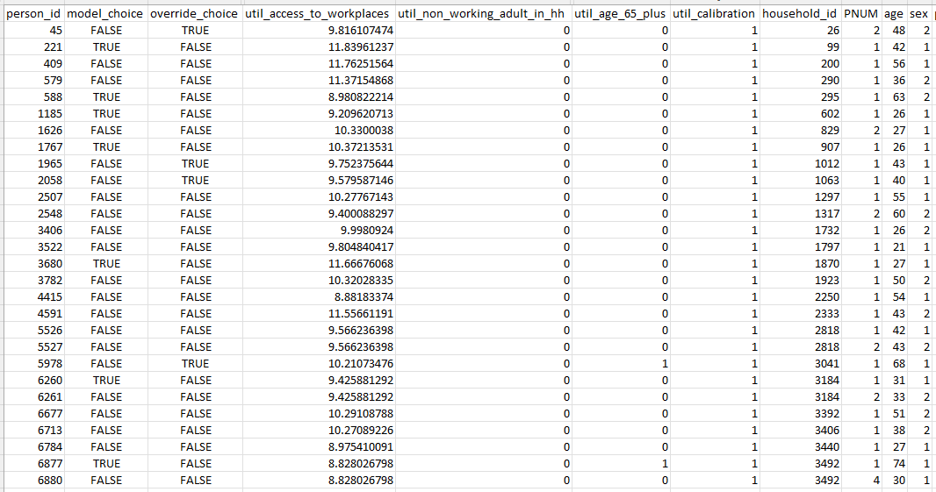
Estimation Case Study: Work From Home
work_from_home_values_combined.csv

Slide 11
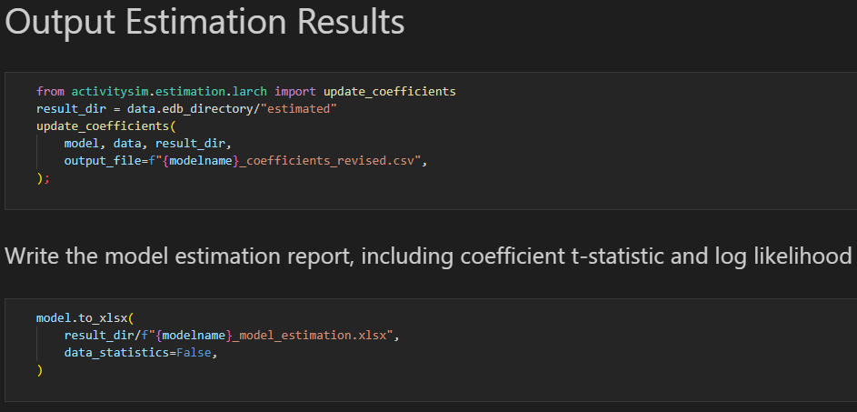
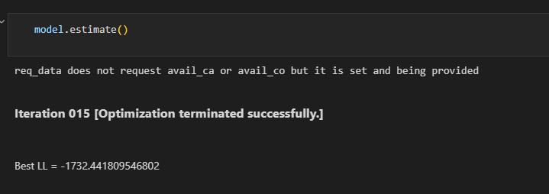
Estimation Case Study: Work From Home
Use Jupyter notebooks to load data into Larch and estimate
Review output statistics and use newly estimated coefficients

Slide 12
Estimation Case Study: Work From Home
Survey Processing
ActivitySim Formatting & Cleaning
Infer.py
Raw Survey Data
Description | Expression
Constant for Working from home | 1
Full time worker (1 if true) | @df.pemploy==PEMPLOY_FULL
Female Worker | @df.female
Female worker with a Preschool Child in Household | @df.female & other_than(df.household_id, df.ptype == PTYPE_SCHOOL)
Accessibility to workplaces of the home mgra | @df.workplace_location_accessibility
Presence of Non Working Adult in the Household | @other_than(df.household_id, df.ptype == PTYPE_NONWORK)
Education Level Bachelors or higher degree | @df.has_college_degree
Household income Less than 30K | @df.income < 30000
Age Group - Less than 35 years | @df.age < 35
Age Group - 35 yrs to 45 yrs | @df.age.between(35, 45)
Age Group - 45 yrs to 55 yrs | @df.age.between(45, 55)
Age Group - 55 yrs to 65 yrs | @df.age.between(55, 65)
Age Group - Older than 65yrs | @df.age > 65
Household income more than 100K | @df.income > 100000
Update specification:
Add new terms
Remove insignificant terms
Iterate
Iterate

Slide 13
Runtime Performance Improvement Plan

Slide 14
Estimation Mode Runtime Improvements
Estimation mode runs in single-process only
Avoids having different processes trying to write to the same EDB files
Will write EDBs for each process and coalesce them together at the end
EDB writing is slow
Estimation data contains many columns necessary for estimation so file sizes can be quite large
Will increase speed by allowing for non-csv formats like parquet
Destination choice models store data for ALL alternatives…

Slide 15
Workplace Location EDB
All alternatives are listed in the file
This can be huge if you have 20,000+ MAZs!

Slide 16
Estimation Mode Runtime Improvements
Want to be able to sample destinations in estimation
Need to update interface with Larch to handle sampled EDB
Handle sample of alternatives correction factor
Demonstrate how to use Larch with sampled EDB
Expectations
See multiprocessing performance very similar to production mode
Reduce the disk size of estimation mode, particularly for 2-zone models
Should be pretty much invisible to the user

Slide 17
Estimation Usability Improvements

Slide 18
Estimating New Specification Is Currently Slow
Procedure:
Run ActivitySim in estimation mode with initial spec.
Estimate and review output coefficients
Modify Spec by adding new terms
Update coefficient file with new coefficients
Repeat
Want to remove the loop with ActivitySim
Want coefficients to be automatically created
Just update the spec and re-estimate

Slide 19
Removing ActivitySim Loop
Description | Expression
Constant for Working from home | 1
Full time worker (1 if true) | @df.pemploy==PEMPLOY_FULL
Female Worker | @df.female
Female worker with a Preschool Child in Household | @df.female & other_than(df.household_id, df.ptype == PTYPE_SCHOOL)
Accessibility to workplaces of the home mgra | @df.workplace_location_accessibility
Presence of Non Working Adult in the Household | @other_than(df.household_id, df.ptype == PTYPE_NONWORK)
Education Level Bachelors or higher degree | @df.has_college_degree
Household income Less than 30K | @df.income < 30000
Age Group - Less than 35 years | @df.age < 35
Age Group - 35 yrs to 45 yrs | @df.age.between(35, 45)
Age Group - 45 yrs to 55 yrs | @df.age.between(45, 55)
Age Group - 55 yrs to 65 yrs | @df.age.between(55, 65)
Age Group - Older than 65yrs | @df.age > 65
Household income more than 100K | @df.income > 100000
Implement functionality to evaluate utility expressions if they do not yet exist in EDB
Don’t have to re-run ActivitySim or otherwise modify EDB if new expression can be created from existing EDB
EDBs contain merged data, so even tour and trip EDBs have land use, household, and person variables
Create missing coefficients to have initial value of 0

Slide 20
Larch Reporting
Estimation fail for many reasons
Larch does some reporting, but we want to be more specific and point out potentially problematic terms
Common catches
Do you have a complete set of ASCs? – overspecified
Are availability conditions consistent with survey choices?
NaNs in dataset
Demonstrate this in ActivitySim example notebook and CI testing

Slide 21
Adding Larch Predict Functionality
Comparing how well the estimated model compares to the survey truth is very helpful
Can understand performance of model by demographic subset
Gives confidence that spec is complete and estimated correctly
EDB contains what ActivitySim predicted vs the survey choice, but ActivitySim must be re-run to repopulate
Adding functionality to Larch integration to predict based on the estimated coefficients

Slide 22
Summary
Task 1: Estimation Runtime Performance
Implement multiprocessing
Change the formatting and data written to EDBs
Task 2: Estimation Usability Improvements
Allow for quickly testing different specifications
Improve Larch reporting on estimated models
Add “predict” functionality in Larch

Slide 23
Questions / Comments?

Slide 24
Appendix

Slide 25
Estimation Case Study: Joint Tour Frequency Composition
1. Denote joint tours in from SPA output (only want fully joint tours)
SPA
ActivitySim Formatting & Cleaning
Infer.py
Raw Survey Data
Iterate
2. Create joint tour participants file
3. Ensure each tour has valid participants
Iterate

Slide 26
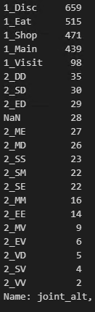
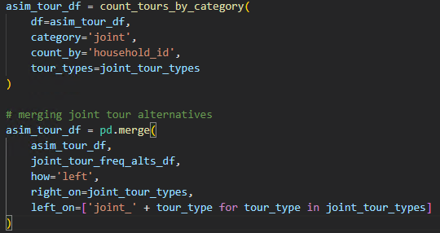
Estimation Case Study: Joint Tour Frequency Composition
4. Remove joint tours that do not fall within available alternatives
SPA
ActivitySim Formatting & Cleaning
Infer.py
Raw Survey Data
Iterate
Iterate

Slide 27
Estimation Case Study: Joint Tour Frequency Composition
Infer.py will determine which JTFC alternative the household belongs to
SPA
ActivitySim Formatting & Cleaning
Infer.py
Raw Survey Data
alt | purpose1 | purpose2 | party1 | party2
1 | 5 | 0 | 1 | 0
2 | 5 | 0 | 2 | 0
3 | 5 | 0 | 3 | 0
4 | 6 | 0 | 1 | 0
5 | 6 | 0 | 2 | 0
6 | 6 | 0 | 3 | 0
7 | 7 | 0 | 1 | 0
8 | 7 | 0 | 2 | 0
9 | 7 | 0 | 3 | 0
10 | 8 | 0 | 1 | 0
11 | 8 | 0 | 2 | 0
12 | 8 | 0 | 3 | 0
13 | 9 | 0 | 1 | 0
14 | 9 | 0 | 2 | 0
15 | 9 | 0 | 3 | 0
16 | 5 | 5 | 1 | 1
17 | 5 | 5 | 1 | 2
18 | 5 | 5 | 1 | 3
19 | 5 | 5 | 2 | 1
20 | 5 | 5 | 2 | 2
Iterate
Iterate
150 alternatives in joint_tour_frequency_alternatives.csv

Slide 28
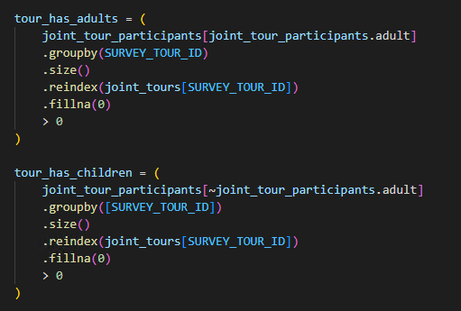
Estimation Case Study: Joint Tour Frequency Composition
1. Determine tour composition
SPA
ActivitySim Formatting & Cleaning
Infer.py
Raw Survey Data
Iterate
Iterate

Slide 29
Estimation Case Study: Joint Tour Frequency Composition
2. Code alternative variables
SPA
ActivitySim Formatting & Cleaning
Infer.py
Raw Survey Data
Iterate
3. Format and merge alternatives
Iterate
4. Set in households tables

Slide 30
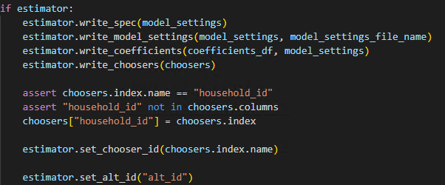
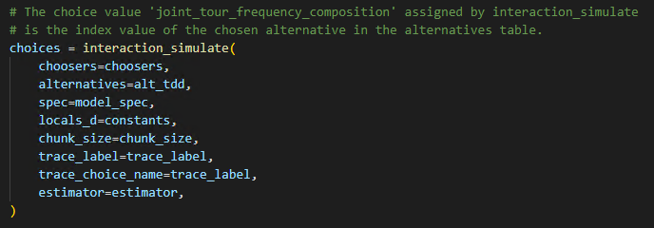
Estimation Case Study: Joint Tour Frequency Composition
1. Write model spec
SPA
ActivitySim Formatting & Cleaning
Infer.py
Raw Survey Data
Iterate
2. Run the model like normal
Iterate

Slide 31
Estimation Case Study: Joint Tour Frequency Composition
3. Set survey choices
SPA
ActivitySim Formatting & Cleaning
Infer.py
Raw Survey Data
Iterate
Iterate

Slide 32
Estimation Case Study: Joint Tour Frequency Composition
SPA
ActivitySim Formatting & Cleaning
Infer.py
Raw Survey Data
JTFC estimation data bundle:
jtfc_model_settings.yaml
jtfc_coeffs.csv
coefficient name, value, and constrain flag
jtfc_SPEC.csv
the utility expressions file
jtfc_choosers_combined.csv
Household & landuse data, survey choice
jtfc_interaction_expression_values.csv
Utility for each alternative
Iterate
Iterate

Slide 33
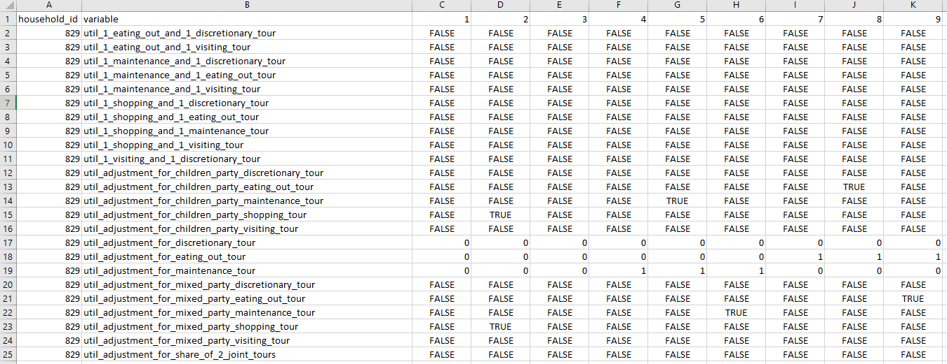
Estimation Case Study: Joint Tour Frequency Composition
Joint_tour_frequency_composition_interaction_expression_values.csv

