Slide 1
Updates from PLCT
qiuji@iscas.ac.cn

Slide 2
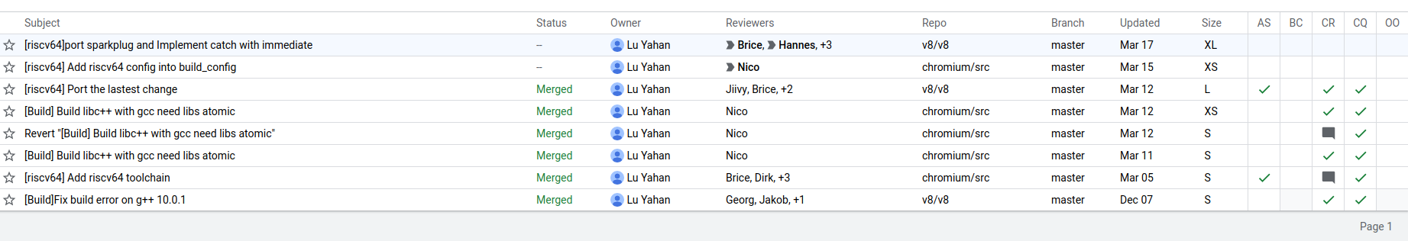
Upstreaming
V8 repo move to https://github/riscv/v8, CI needs to be fixed. Wiki links have been updated.
PRs status

Slide 3
Bug fix
#403: import/export testcases already have the expected behavior
#414: unaligned mem read, fixed
#297: constant_pool now is enabled
#431: just remove the TODO comments
#432: Simulator::FMaxMinHelper is correct as it is
#220: not fail now, close
#262: not fail now, close
#440: not fail now, close
#10: not fail now, close

Slide 4
Optimization
#455: Take advantage of the load/store offset field to reduce code size
Results on Release build
 | Delta of Static code size | Delta of Dynamic instrucrtion count
Builtins | 4.1%
Sunspider | 2.71% | 0.69%
Kraken | 2.55% | 0.32%
Octane | 1.92% | 0.28%

Slide 5
node.js support status
at March 12, update V8 to 9.0
now pass build for RISCV64
https://github.com/luyahan/nodejs-riscv64/tree/master

Slide 6
That’s all.
Thanks!

