Slide 1
Mapping Variants from Multiplexed Assays of Variant Effect (MAVEs) to Human Reference Sequences
Jeremy Arbesfeld
Wagner Lab
The Ohio State University/Nationwide Children's Hospital

Slide 2
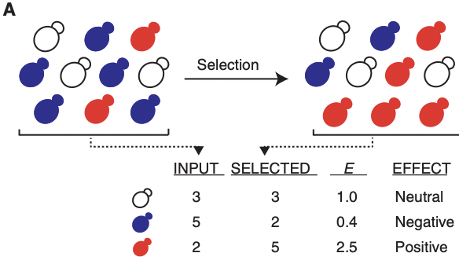
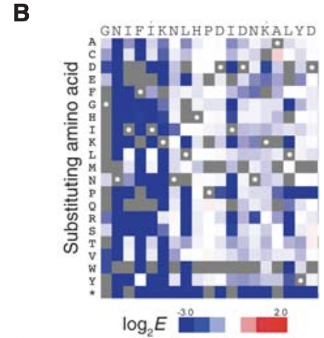
MAVEs Overview
MAVEs – Multiplexed Assays of Variant Effect
Examples: deep mutational scanning, massively parallel reporter assays
Allow for the functional effects of thousands of variants to be investigated in parallel
MAVE experiments yield a set of scores describing the functional effects of studied variants (Esposito et al. 2019)
Fig.1, Starita and Fields (2015),
Deep Mutational Scanning: A Highly Parallel Method to Measure the Effects of Mutation on Protein Function

Slide 3
Clinical Relevance
Formalize functional data
Interpret variants of unknown significance (VUS)
Table 3, Richards et al. (2015), Standards and guidelines for the interpretation of sequence variants: a joint consensus recommendation of the American College of Medical Genetics and Genomics and the Association for Molecular Pathology
Notes:
MAVE data can be used to classify variant pathogenicity.

Slide 4
MaveDB
Public repository for datasets from MAVE experiments
Metadata
Score Matrix
Variant | Score
p.Met1Arg | 1.0
p.Gln2Asp | 0.5
p.Ile3Glu | 2.5

Slide 5
MaveDB Data Breakdown

Slide 6
Objective

Slide 7
Mapping Methodology

Slide 8
Workflow

Slide 9
Workflow

Slide 10
Workflow

Slide 11
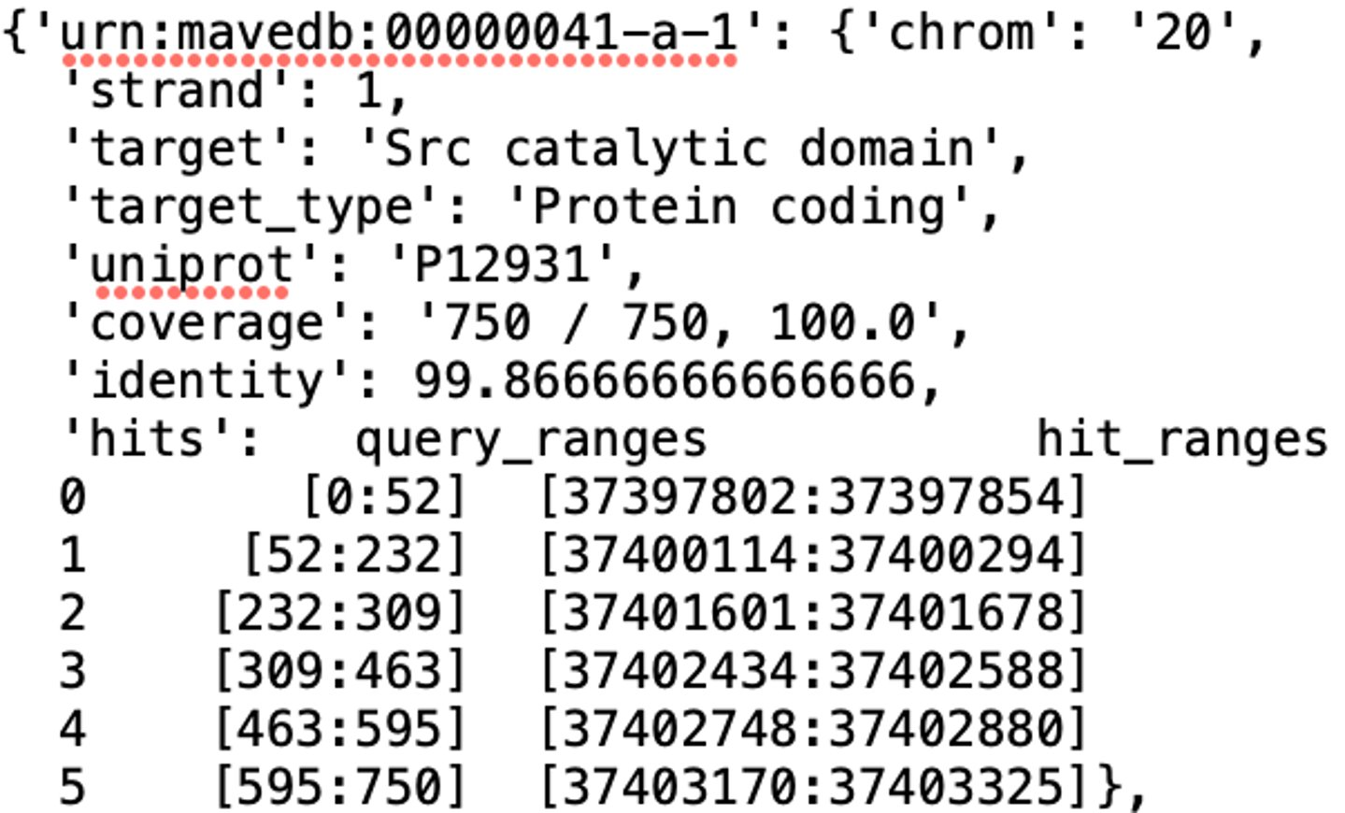
Step 1: Align Target Sequence to Human Genome
Align target sequence to GRCh38 using BLAT
Select best hit for score set, store in dictionary

Slide 12
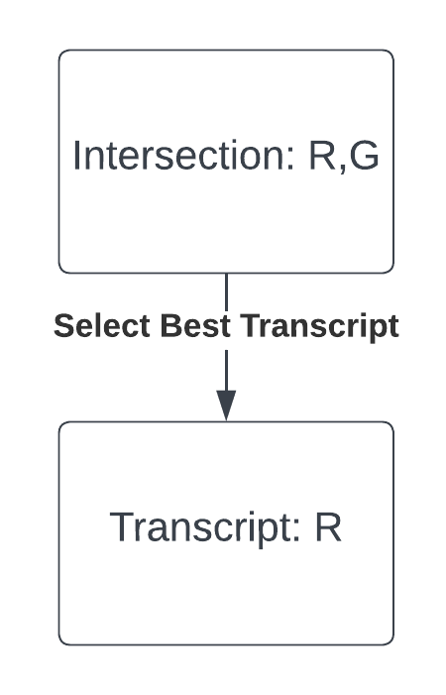
Step 2: Select Reference Sequence, Compute Offset

Slide 13
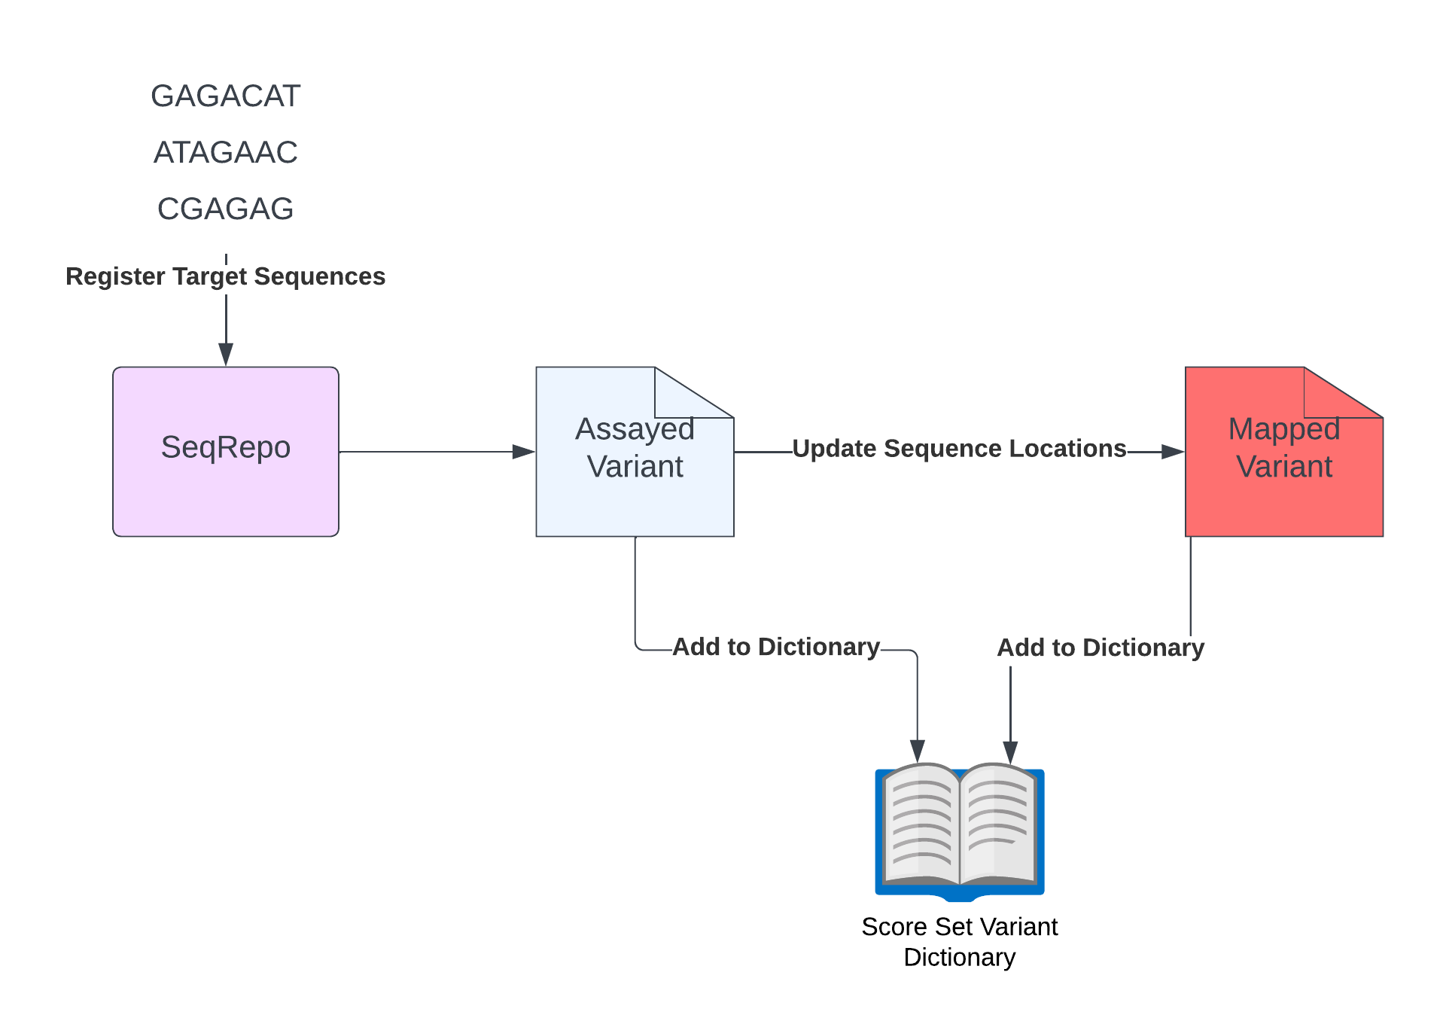
Step 3: Standardize MaveDB Variants

Slide 14
Data Summary
Mappings for 207 score sets
~ 2.5 million protein/genomic variants across examined score sets
How do we assess accuracy?
Do reference sequences match for each allele pair?

Slide 15
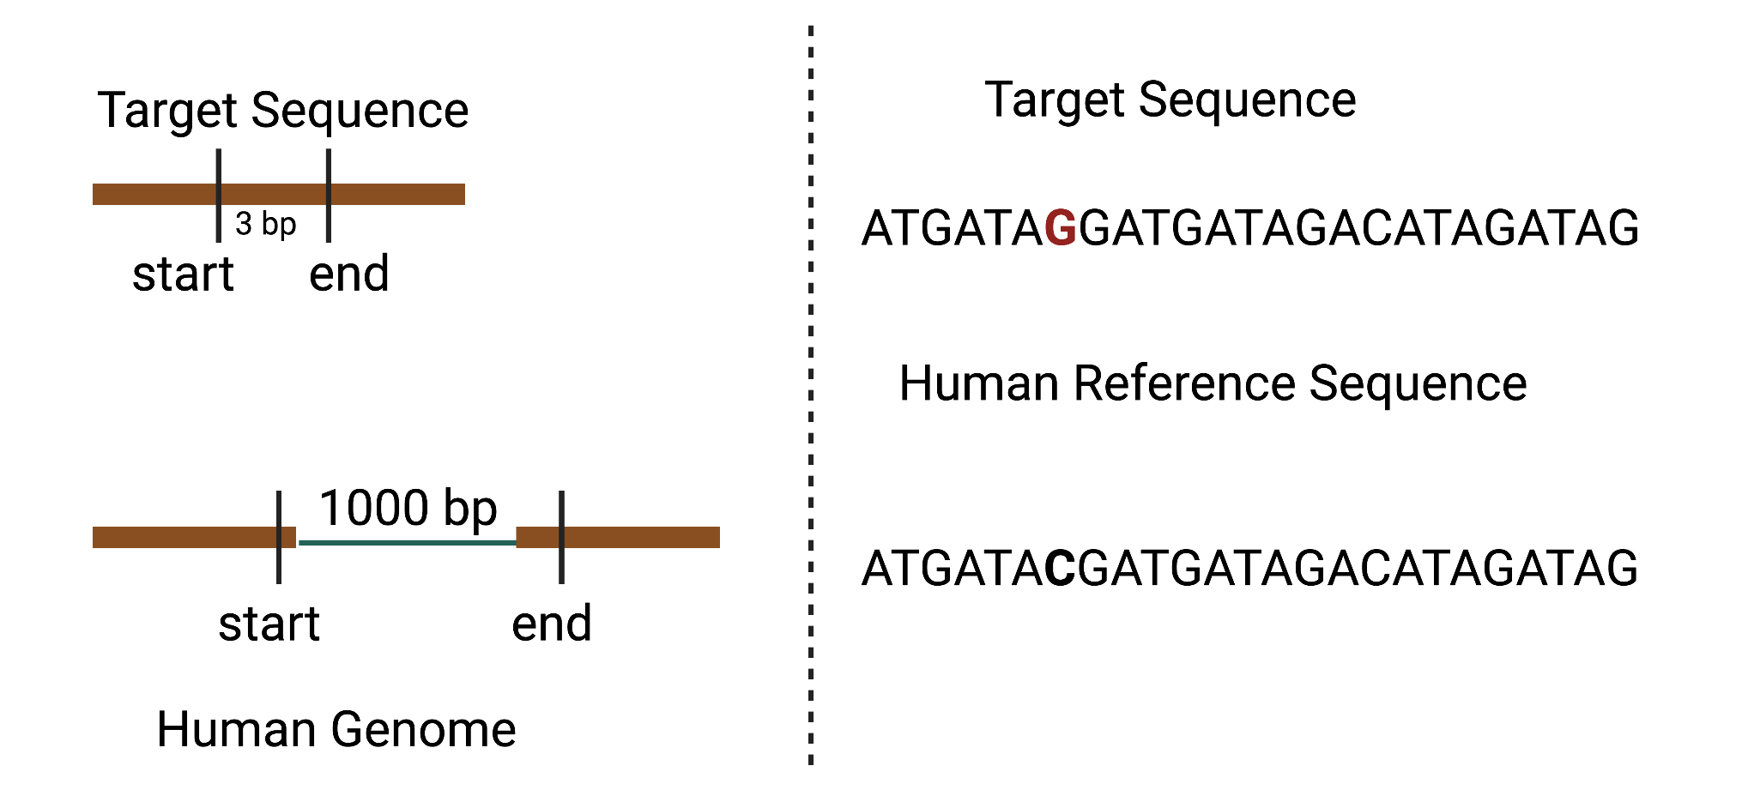
Reference Sequence Analysis
99.00% reference sequence match between pre-mapped and post-mapped variants (2,474,158 / 2,499,036 variant pairs)
Causes of Discordance:

Slide 16
MAVE Data Integration

Slide 17
Genomics 2 Proteins Portal

Slide 18
UCSC Genome Browser

Slide 19
Ensembl Variant Effect Predictor

Slide 20
MAVE Minimum Information Model

Slide 21
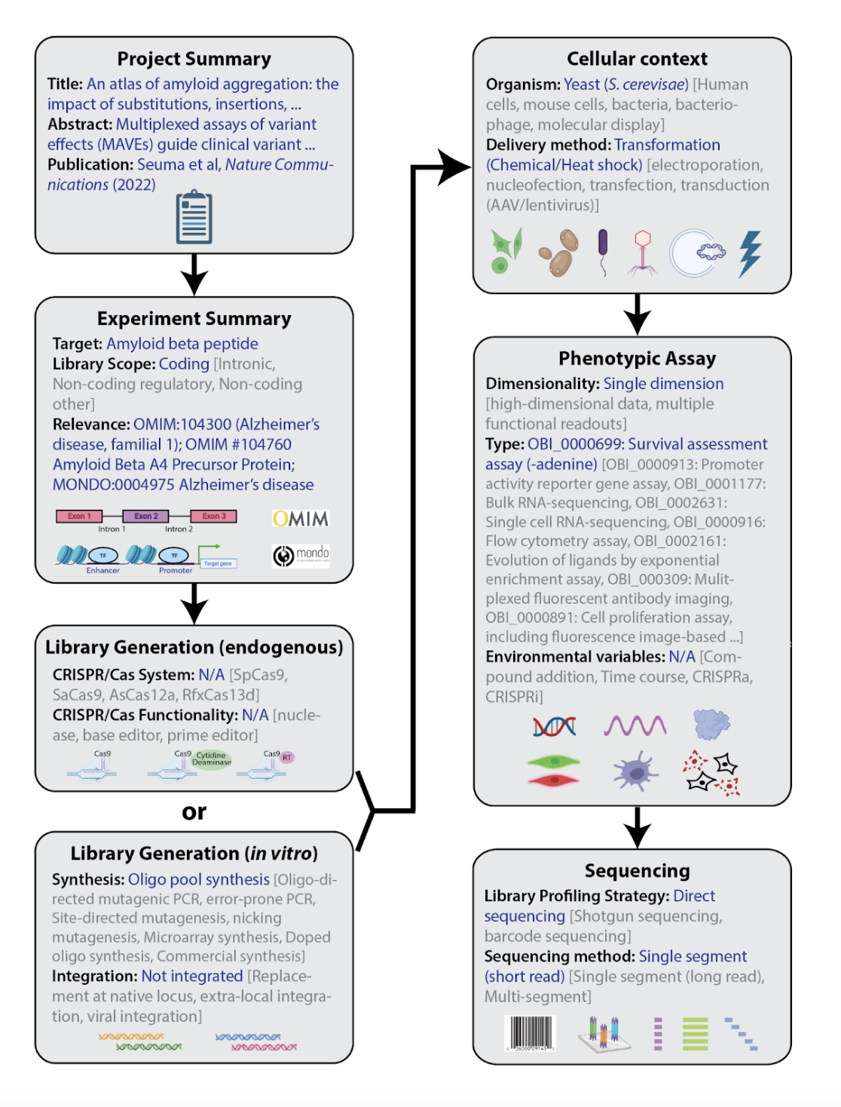
Fig. 1, Claussnitzer et al. (2023), Minimum information and guidelines for reporting a Multiplexed Assay of Variant Effect, arXiv

Slide 22
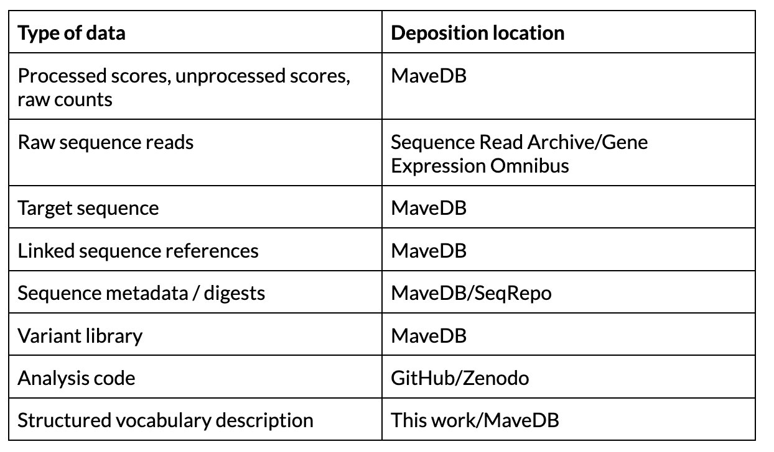
Table 1, Claussnitzer et al. (2023), Minimum information and guidelines for reporting a Multiplexed Assay of Variant Effect, arXiv

Slide 23
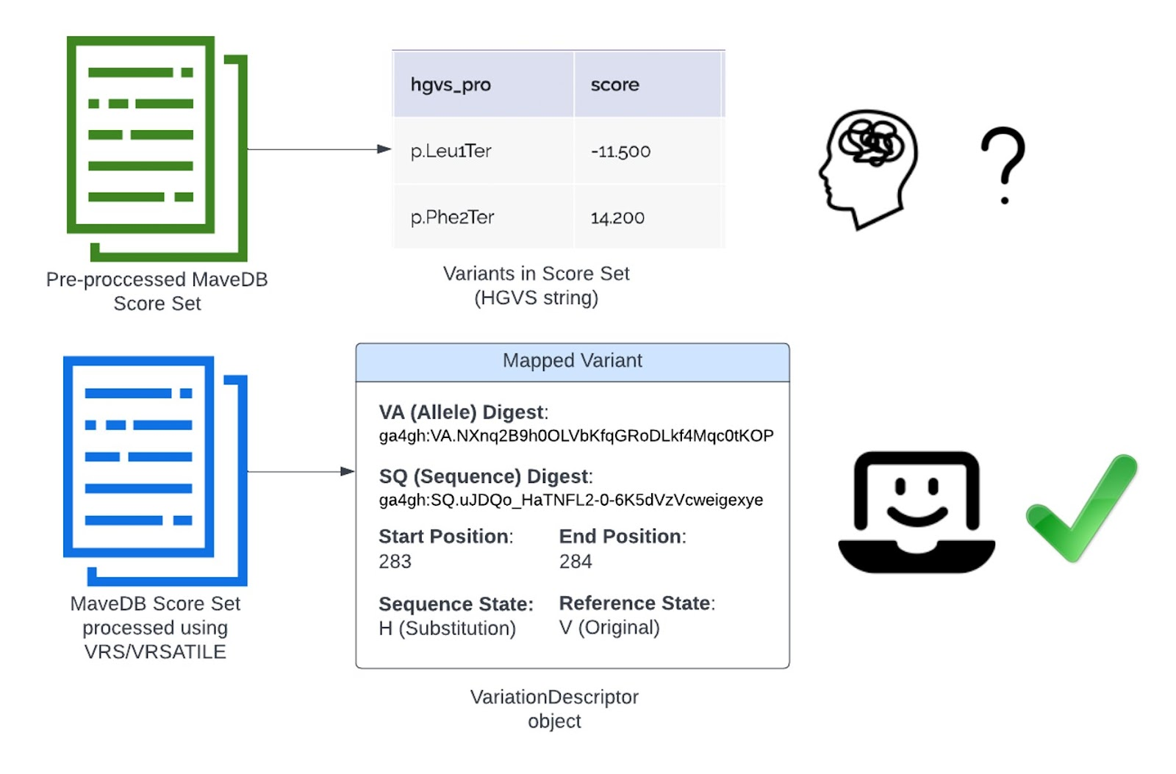
Conclusions/Next Steps
MAVE data can be mapped to human reference sequences
Calibration of MAVE assays needed for clinical interpretation
AVE CVI Workstream

Slide 24
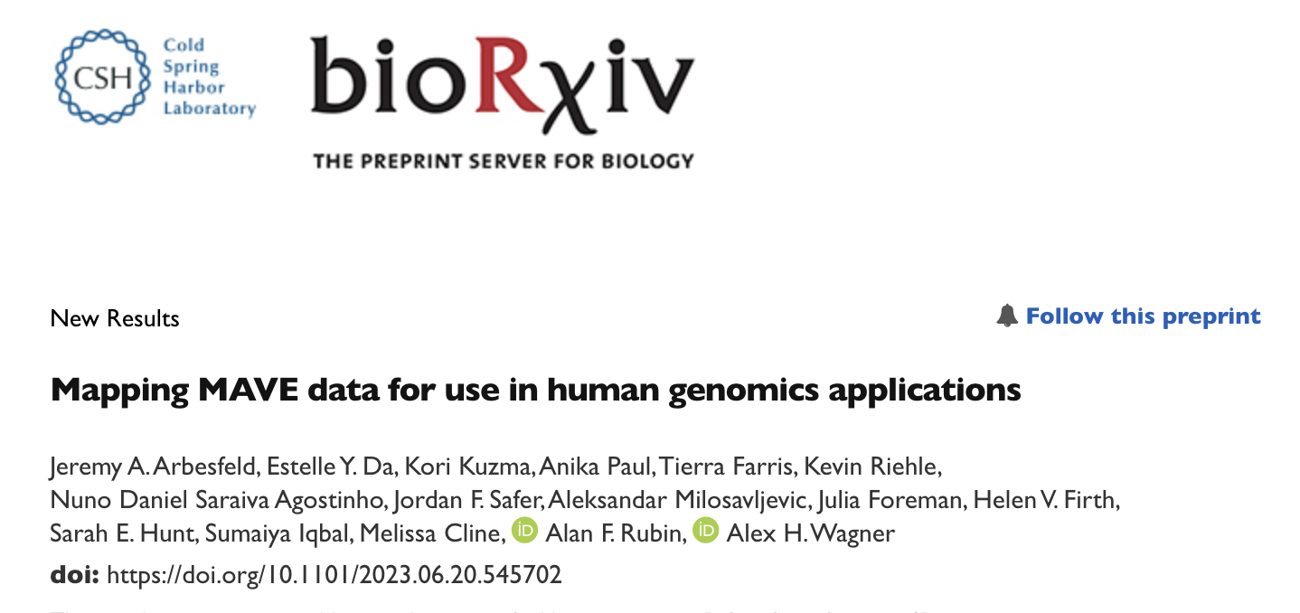

Slide 25
Acknowledgements
Wagner Lab
Anika Paul
James Stevenson
Kori Kuzma
Matthew Cannon
Wes Goar
Katie Stahl
Anastasia Bratulin
Daniel Puthawala
Alex Wagner
Atlas of Variant Effects Alliance
Alan Rubin
Melissa Cline
Sumaiya Iqbal
Kevin Riehle
Julia Foreman
Sarah Hunt
Helen Firth
This work is supported by NHGRI Award R35HG011949

Slide 26
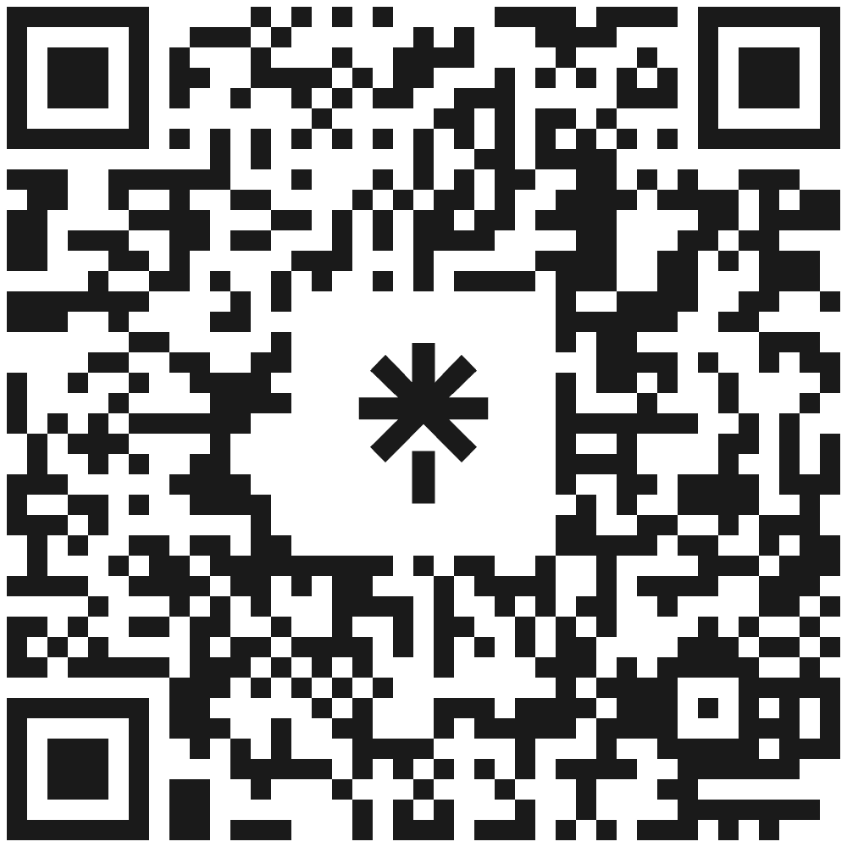
Questions?
Jeremy.Arbesfeld@nationwidechildrens.org

