Slide 1

Build your models with Azure Cognitive Services
By Haimantika Mitra

Slide 2
What is Azure Cognitive Services?
Cognitive Services bring AI within reach of every developer—without requiring machine-learning expertise. All it takes is an API call to embed the ability to see, hear, speak, search, understand and accelerate decision-making into your apps.

Slide 3
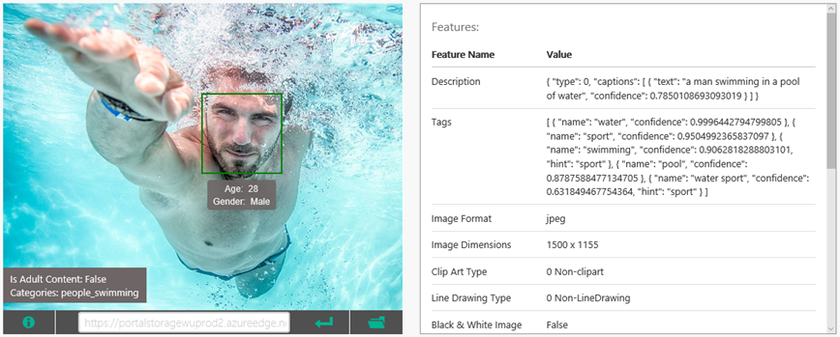
Use the Custom Vision API to analyze images for content, generate captions, and more ..

Slide 4
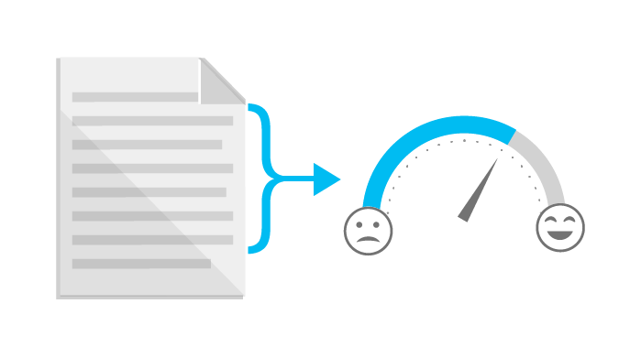

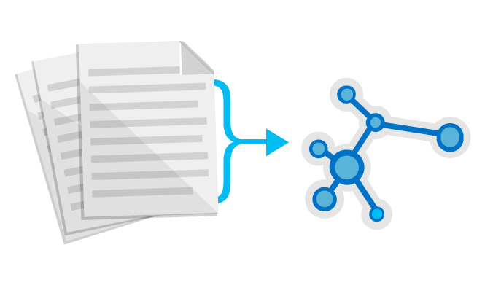

Use the Text Analytics API to identify sentiment expressed in text (e.g., Twitter feeds)
Sentiment Analysis
Key Phrase Extraction
Topic Detection
Language Detection

Slide 5
Demo: Azure cognitive services & Custom Vision! 😎
Visit: https://www.customvision.ai/

