Slide 1
Accounting for population structure
Nicola F. Müller
e-mail: nicola.mueller@ucsf.edu

Slide 2
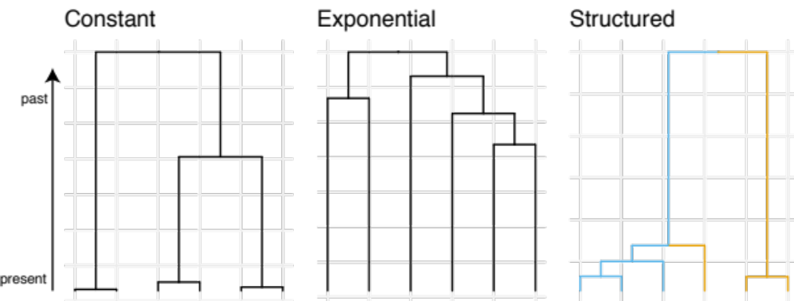
Phylogenetic trees are formed by population processes and contain information about them

Slide 3
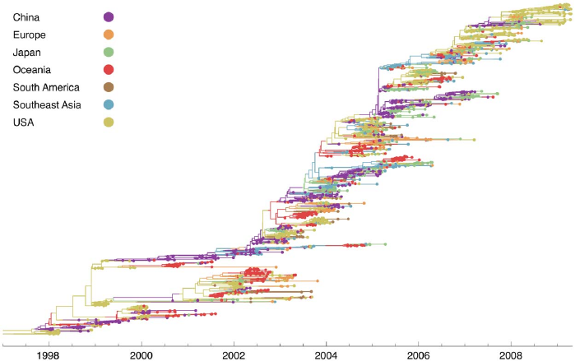
H3N2 sequences show spatial clustering
Bedford et al., 2010, PLoS Path.

Slide 4
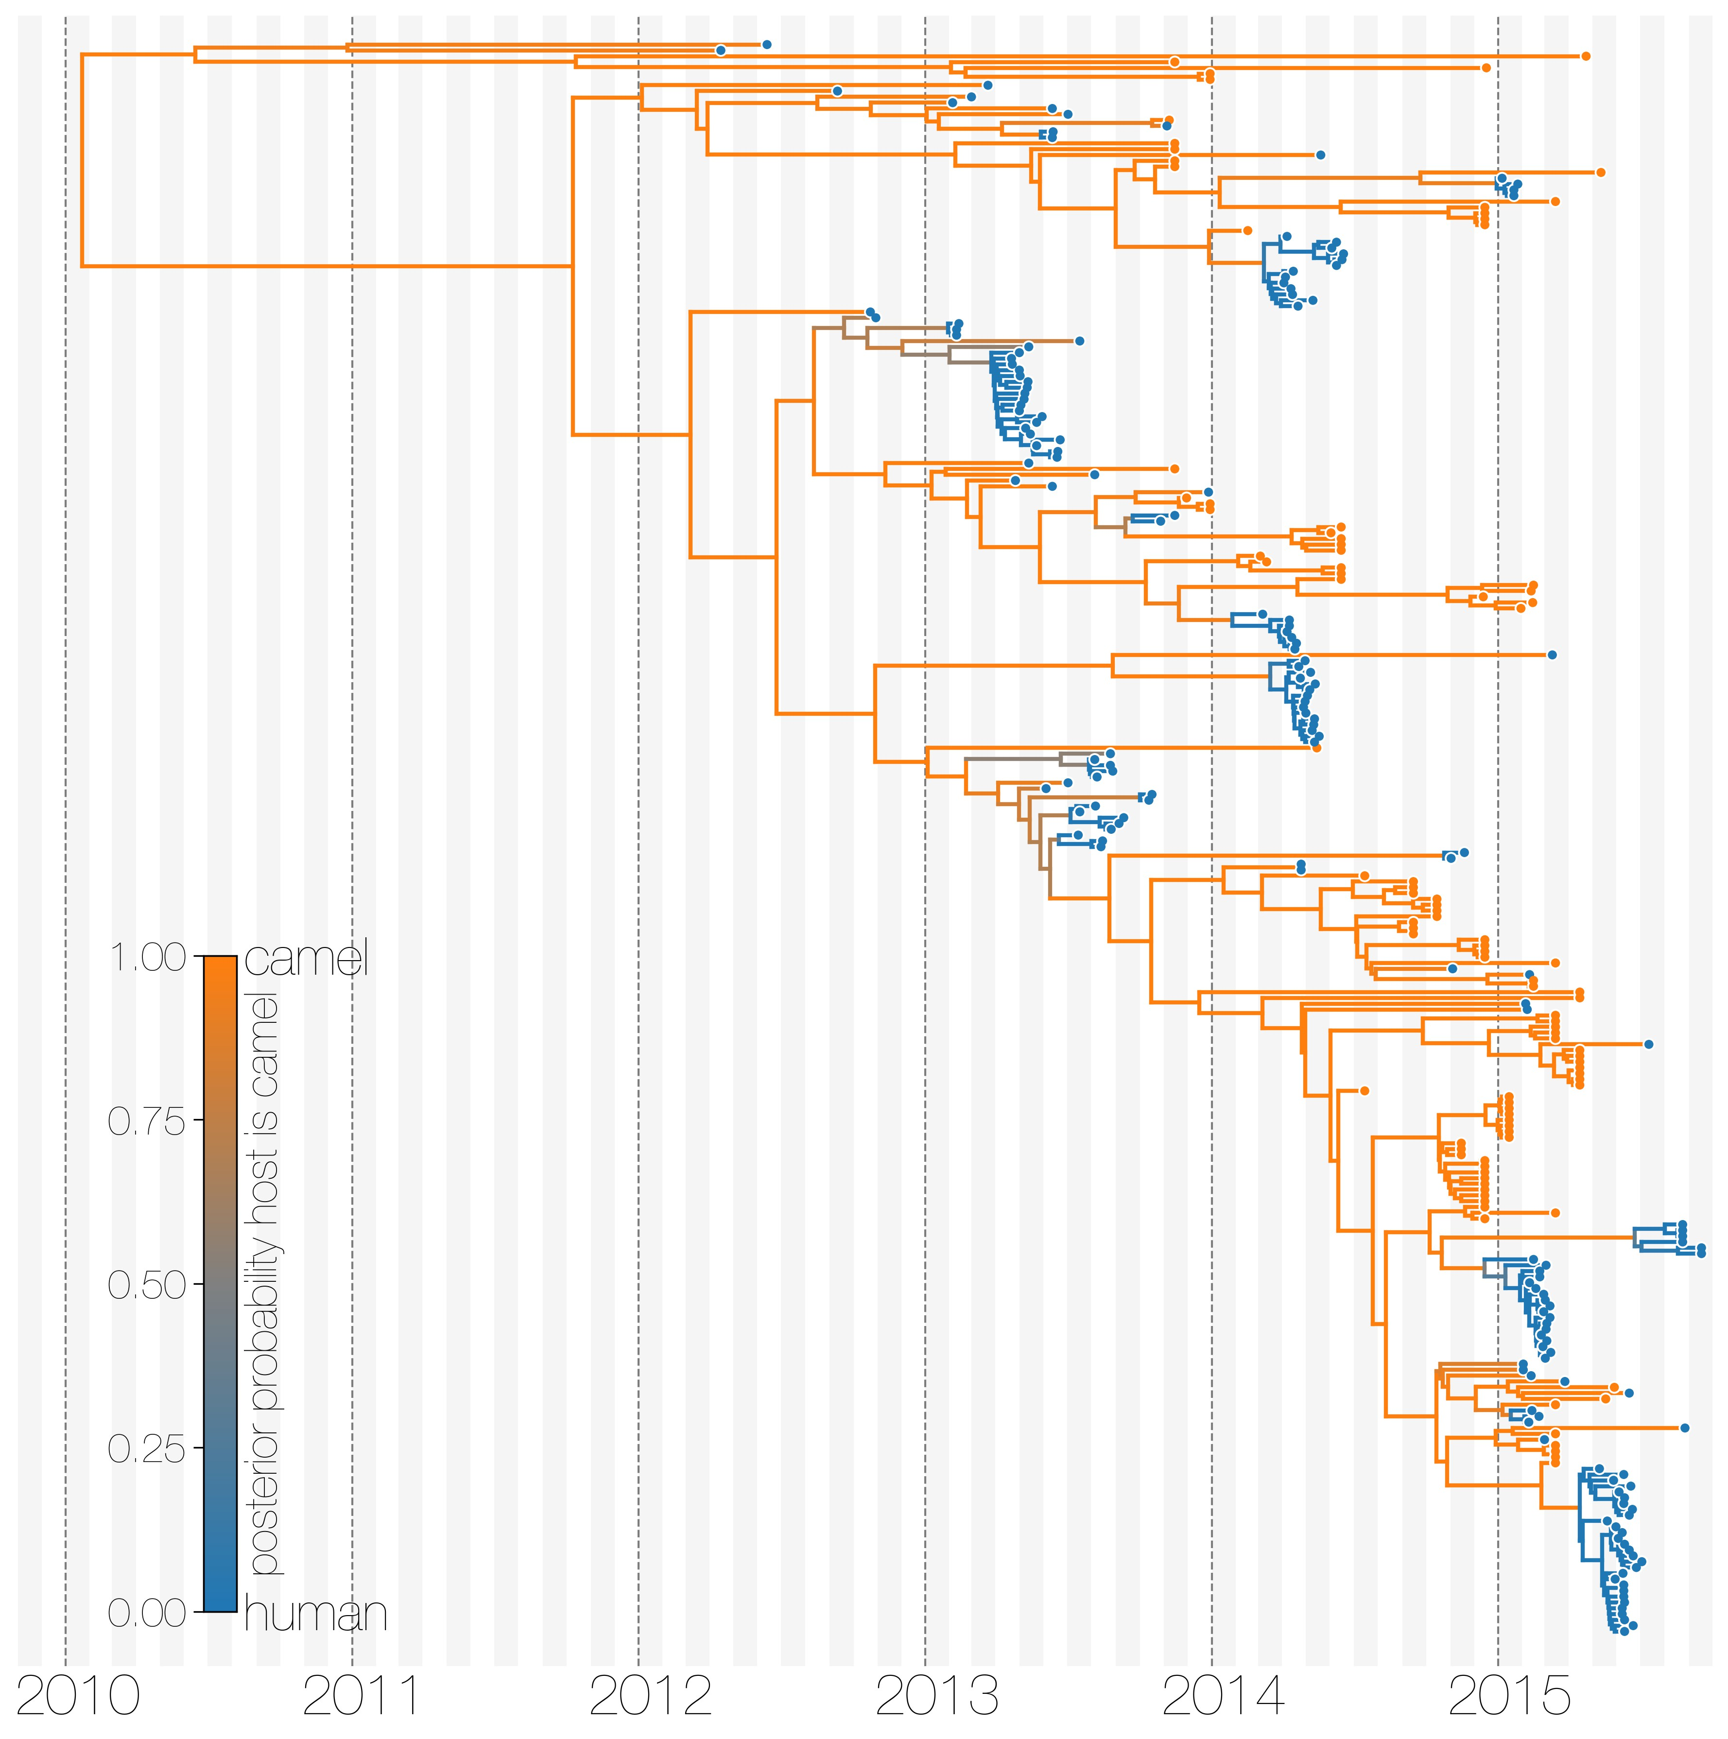
MERS sequences cluster by host of isolation
Dudas et al., 2018, eLife

Slide 5
In the posterior probability, modelling the population dynamics happens in the tree prior.
DuPlessis, L. et al. (2015),
Trends in Microbiology

Slide 6
Models to account for population structure:
DTA: Assumes structure to be a neutral trait evolving “on top” of a phylogenetic tree (Lemey 2009).
Structured Coalescent: Models how lineages coalesce within and migrate between discrete locations.
Multi-type Birth-death models: Models how lineages give birth to other lineage in the same and migrate between them.

Slide 7
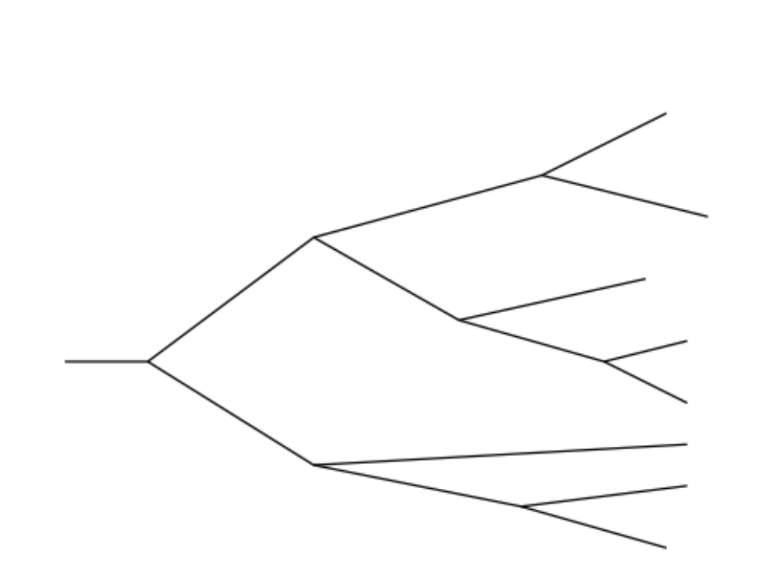
Tree was generated by a different process (e.g. a coalescent process).
Slide from Timothy Vaughan

Slide 8
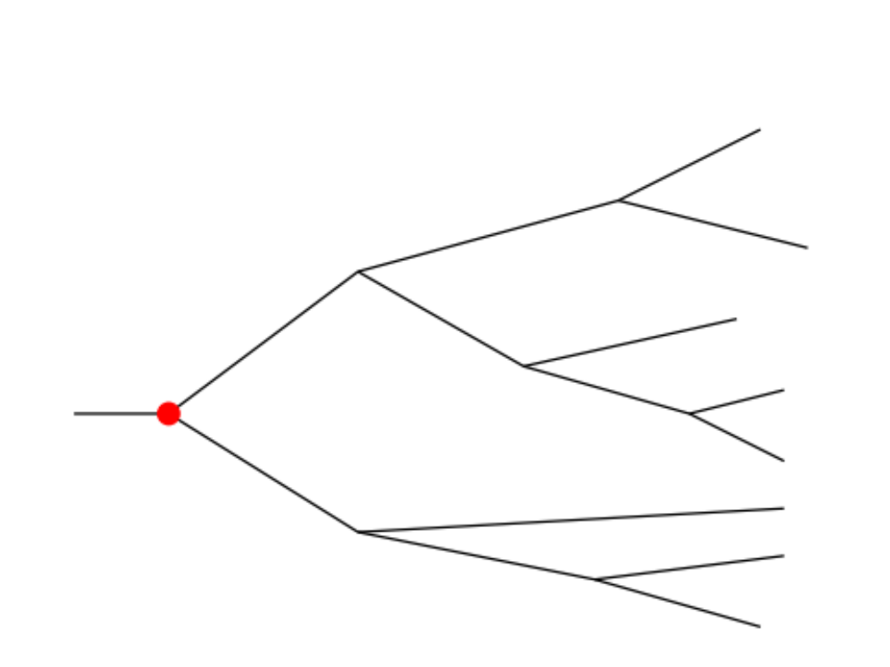
Root of the tree is in some location (here red)
Slide from Timothy Vaughan

Slide 9
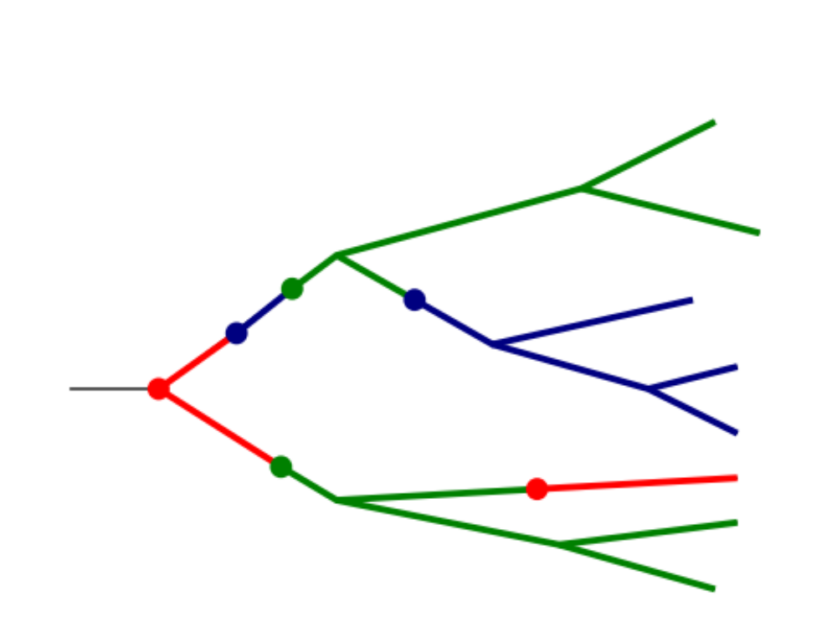
Then models the migration process on top of this tree from the root to the tips
Slide from Timothy Vaughan

Slide 10

Sampling locations are considered Data.
Slide from Timothy Vaughan

Slide 11
Discrete trait analyses treat geography the same way as substitutions are treated
Some number of states instead of the 4 nucleotides are considered, but only one position. The number of states corresponds to discrete locations.
Some transition model between states (can be asymmetric) which are the migration rates.
Is not a tree prior, as such, a separate tree prior is needed.

Slide 12
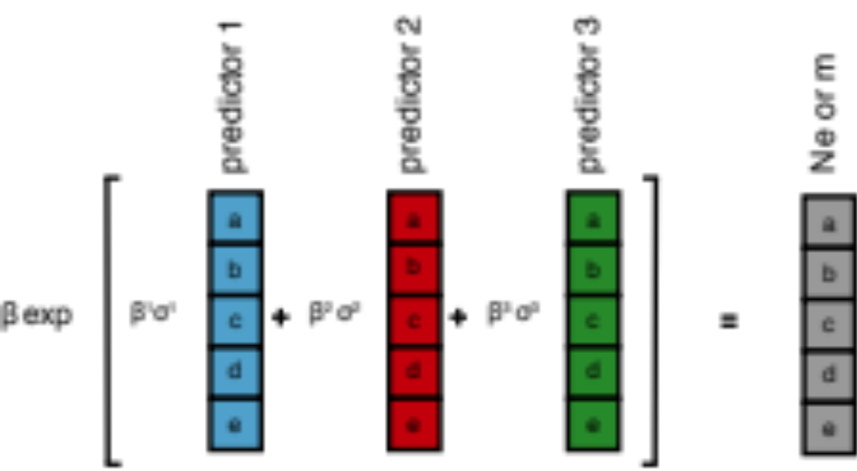
Migration rates can be informed using outside data in a GLM approach

Slide 13
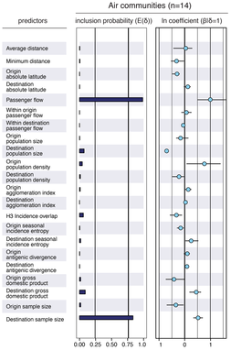
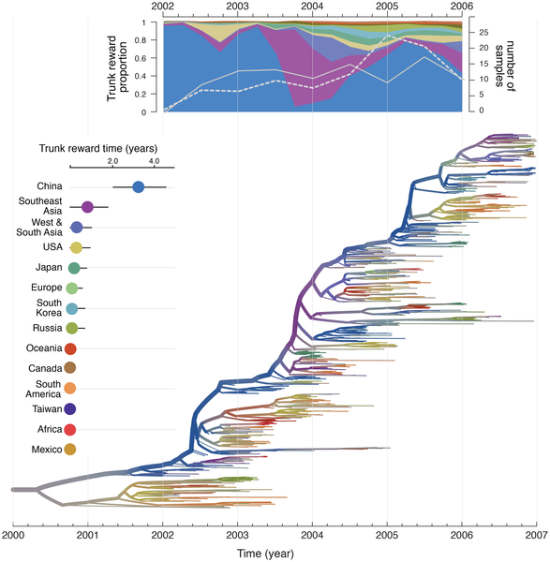
Migration rates in the DTA model can be informed by transportation Data
Lemey et al., 2014, PLoS Path.

Slide 14
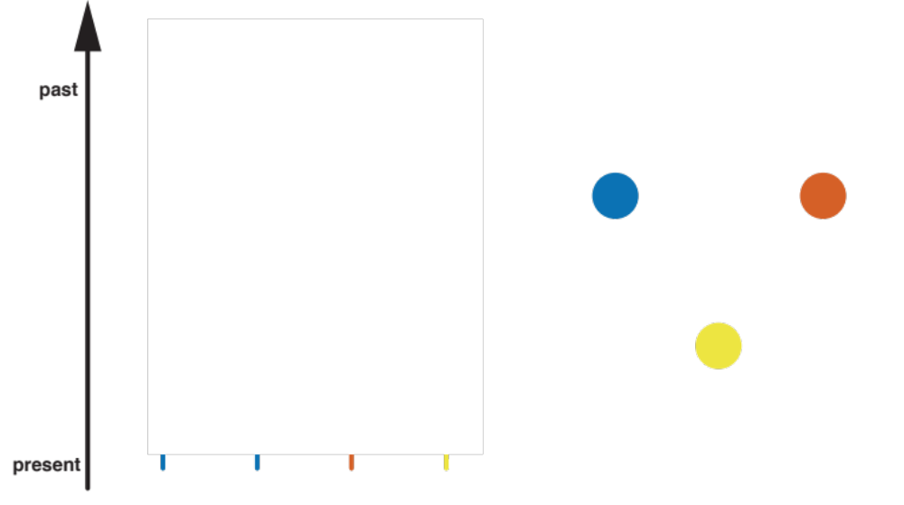
We track the ancestry of 4 viruses isolated from 4 people in 3 locations from present to past

Slide 15
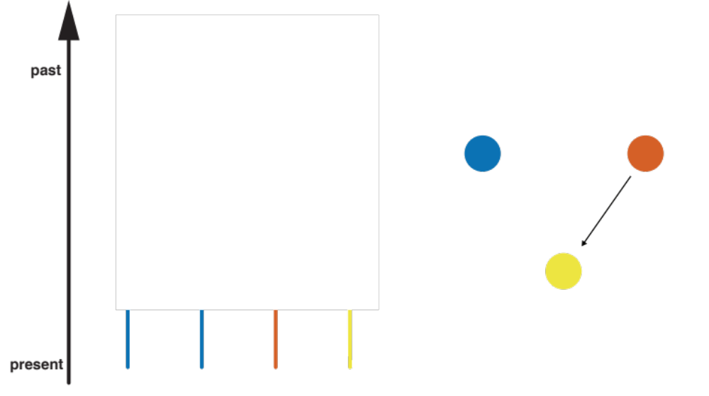
Lineages can have originated from a different location at a rate given by the migration rate.

Slide 16
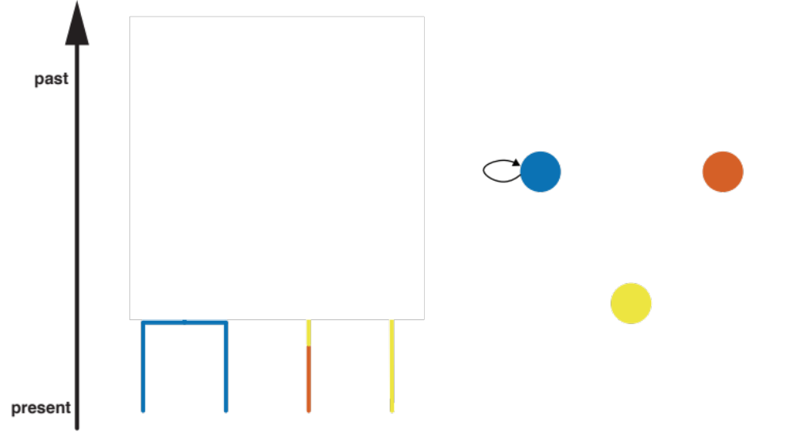
Two lineages can share a common ancestor at a rate inverse proportional to the Ne of location blue

Slide 17
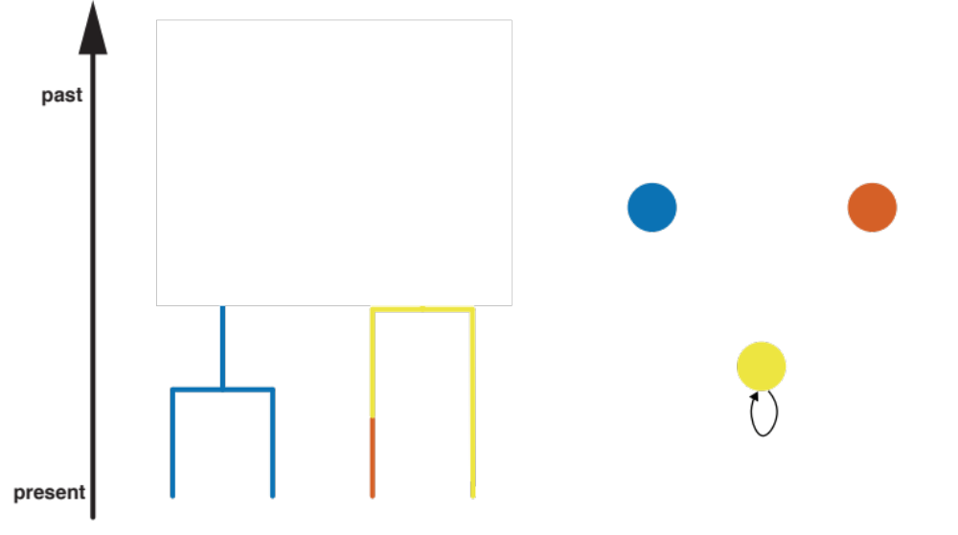
Two lineages can share a common ancestor at a rate inverse proportional to the Ne of location yellow

Slide 18
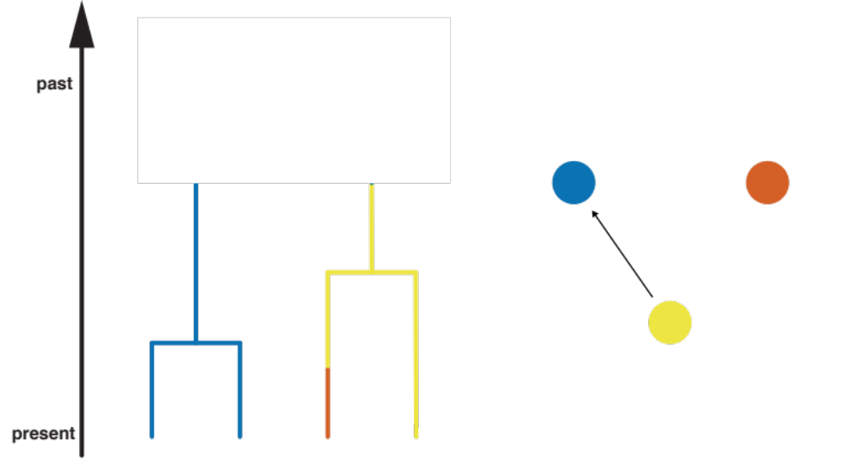
Lineages can have originated from a different location at a rate given by the migration rate.

Slide 19
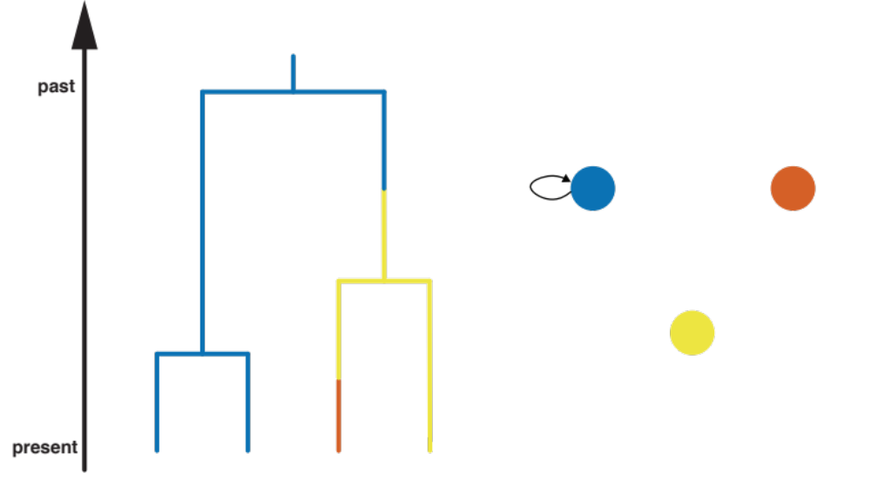
And then coalesce again in location blue, reaching the root of the tree

Slide 20
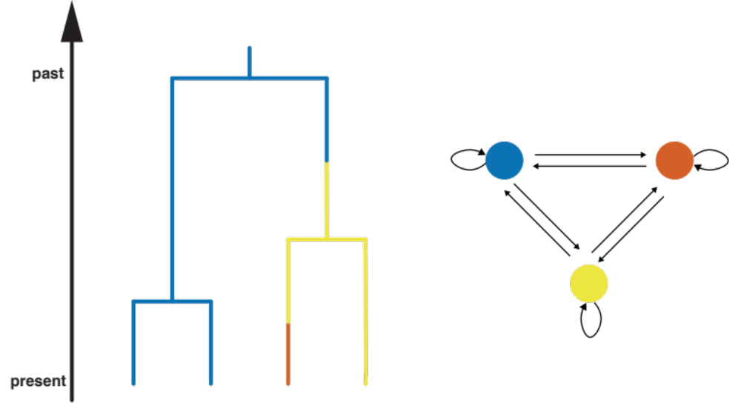
The structured coalescent models how lineages coalesce within and migrate between locations

Slide 21
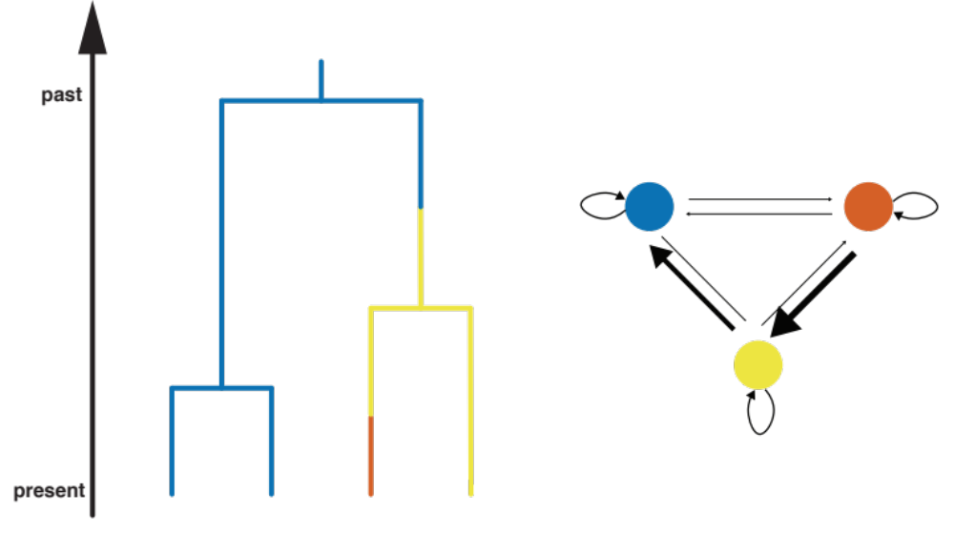
This allows us to estimate how migration rates between locations differ

Slide 22
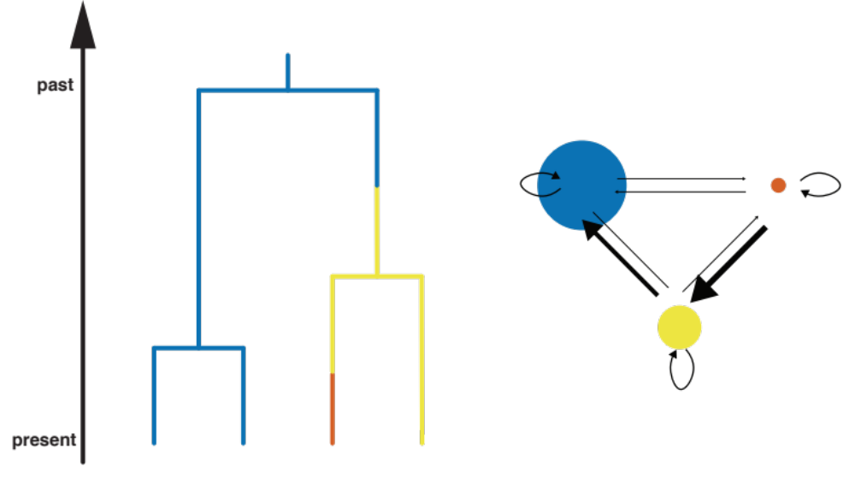
Or how the number of infected individuals differs between location

Slide 23
MERS sequences cluster by host of isolation
Dudas et al., 2018, eLife

Slide 24
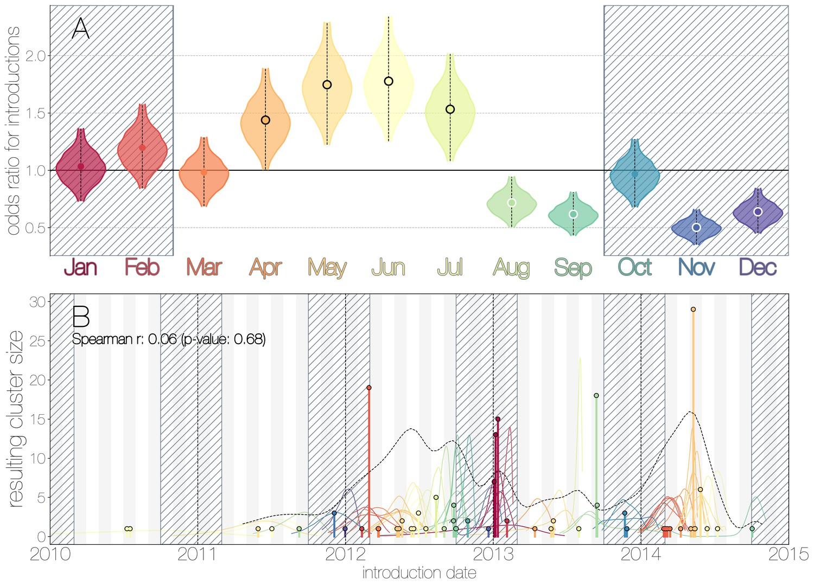
Seasonal trends in camel to human transmissions
Dudas et al., 2018, eLife

Slide 25
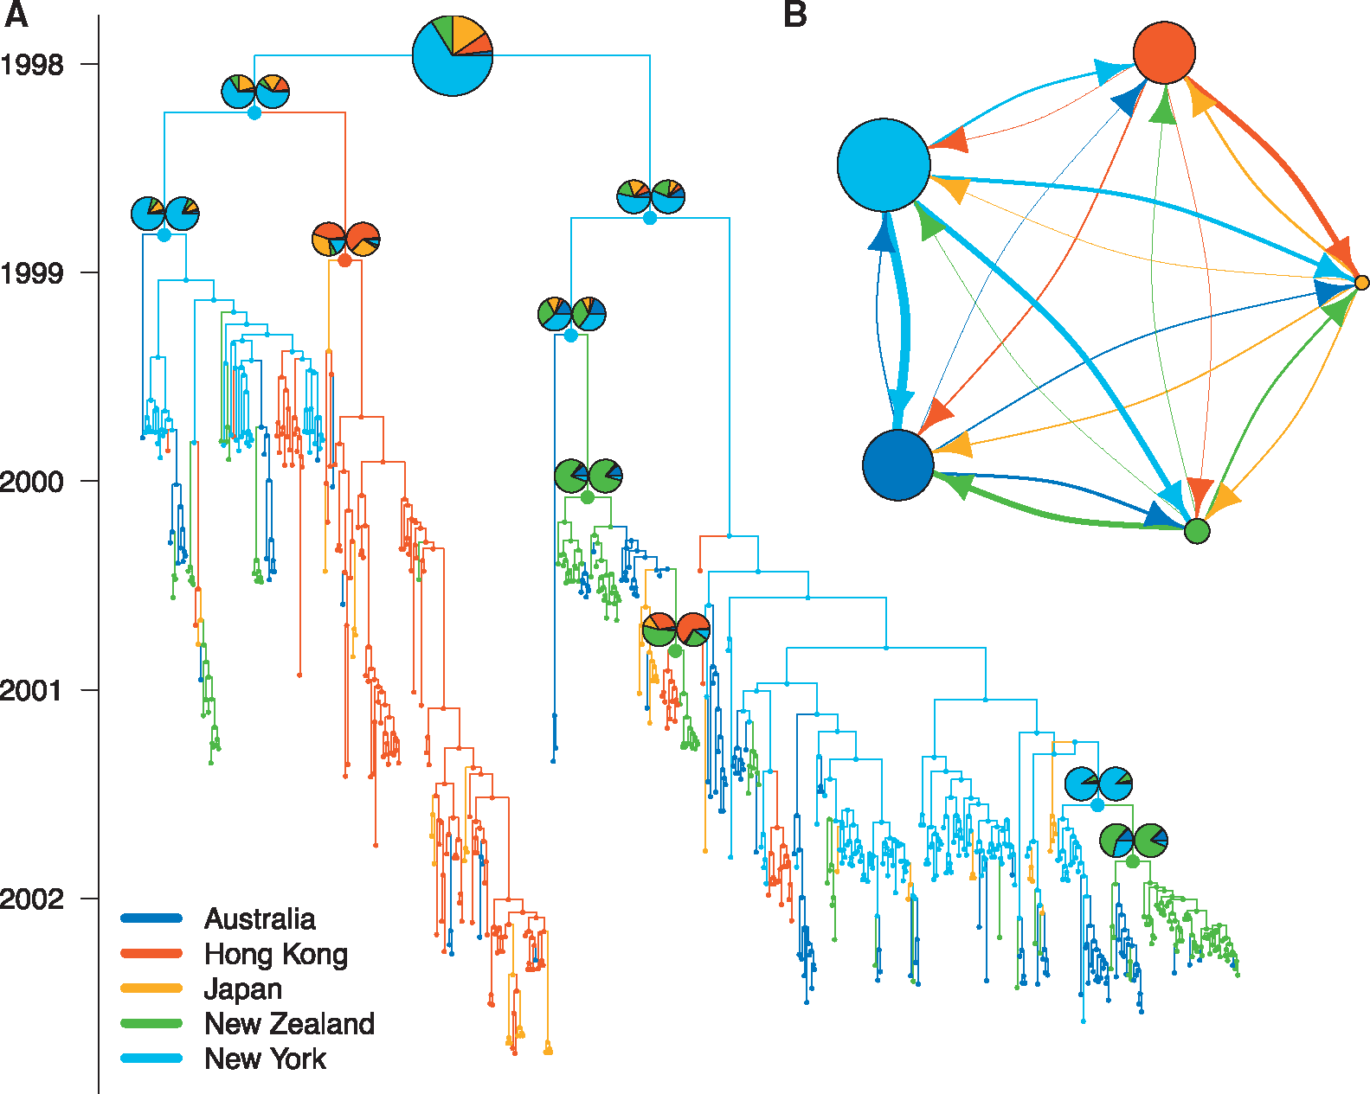
MASCOT approximates the structured coalescent to dramatically improve efficiency
Müller et al., 2018, Bioinf.

Slide 26
Migration rates and effective population sizes can be informed using outside data in a GLM approach

Slide 27
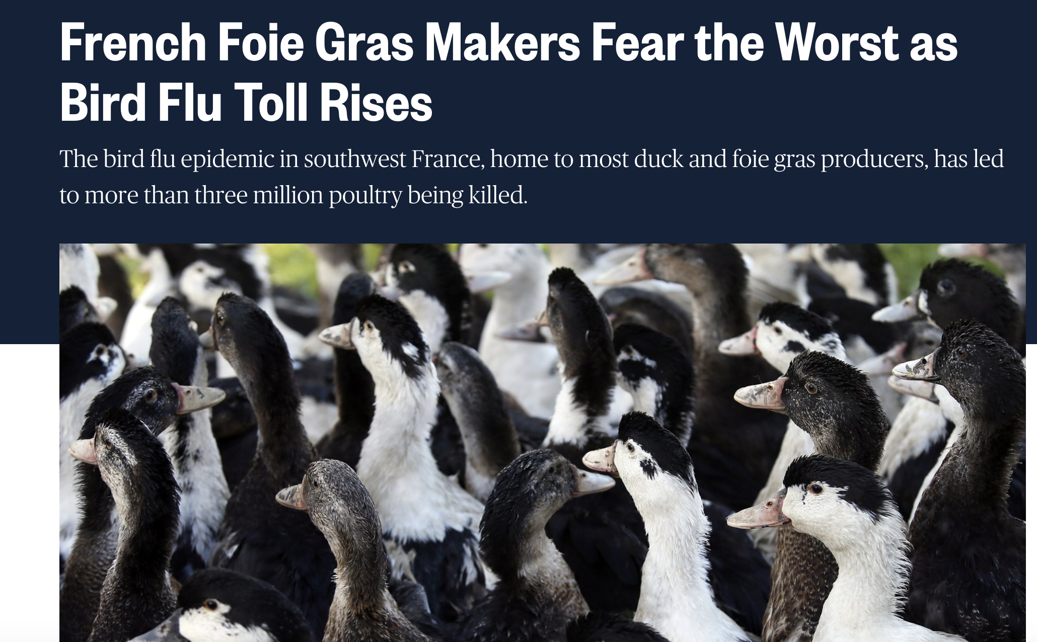
In 2016 and 2017, there was an Influenza A/H5N8 outbreak in France
https://www.nbcnews.com/news/world/french-foie-gras-makers-fear-worst-bird-flu-toll-rises-n721276
Notes:
In 2016 and 2017, there was an outbreak of influenza A/H5N8 in France.
This outbreak mainly took place in the fois gras growing region.
To study the spread of H5N8, influenza A/H5N8 sequences isolated from different farms in different department were sequenced.

Slide 28
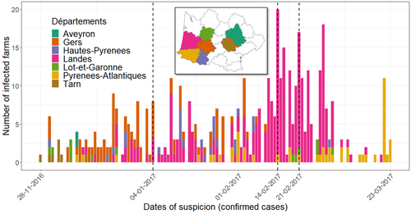
Cases first appeared in the department (state) of tarn and H5N8 was soon detected in other regions as well
Chakraborty et al., 2022, Transboundary and Emerging Diseases
Notes:
These sequences originated from different departments in the South of France.
They were first isolated in the department of tarn and then spread through the region.

Slide 29
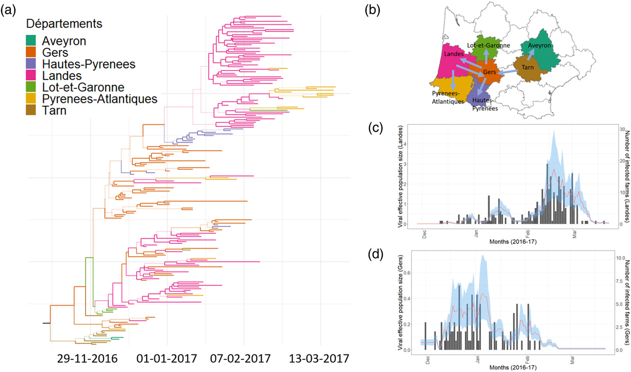
MASCOT-GLM reconstructs Tarn to be the most likely source, consistent with case data
Chakraborty et al., 2022, Transboundary and Emerging Diseases
Notes:
We then used the structured coalescent to infer how and between which departments H5N8 was spread.
Additionally, we inferred what predictors potentially correlated with these transmission dynamics.
In particular, there were different culling events that took place in order to reduced the spread of avian influenza A/H5N8.
We can use the timings of these events as potential predicts of how transmission dynamics changed between departements.

Slide 30
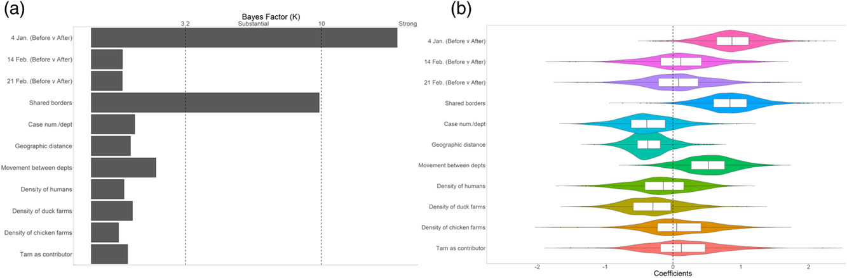
Evidence that the initial culling of birds reduced migration between location
Chakraborty et al., 2022, Transboundary and Emerging Diseases

Slide 31
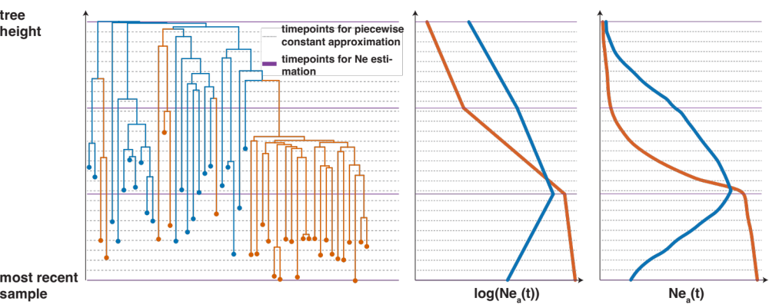
Effective population size dynamics can be modelled using MASCOT-Skyline
Müller et al. BioRxiv, 2024

Slide 32
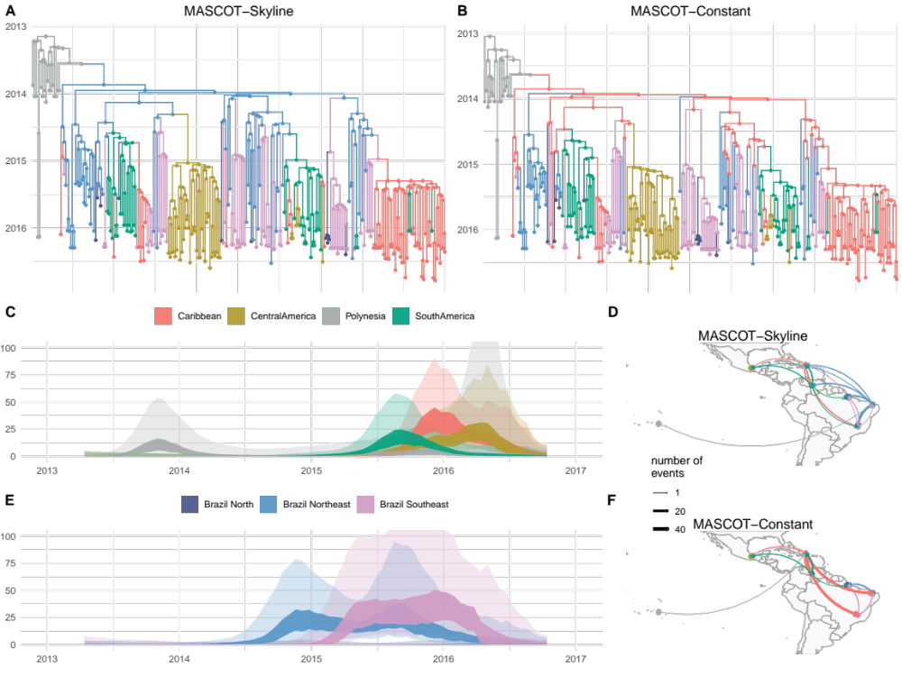
Accounting for population dynamics in structured coalescent can impact ancestral state reconstruction
Müller et al. BioRxiv, 2024

Slide 33
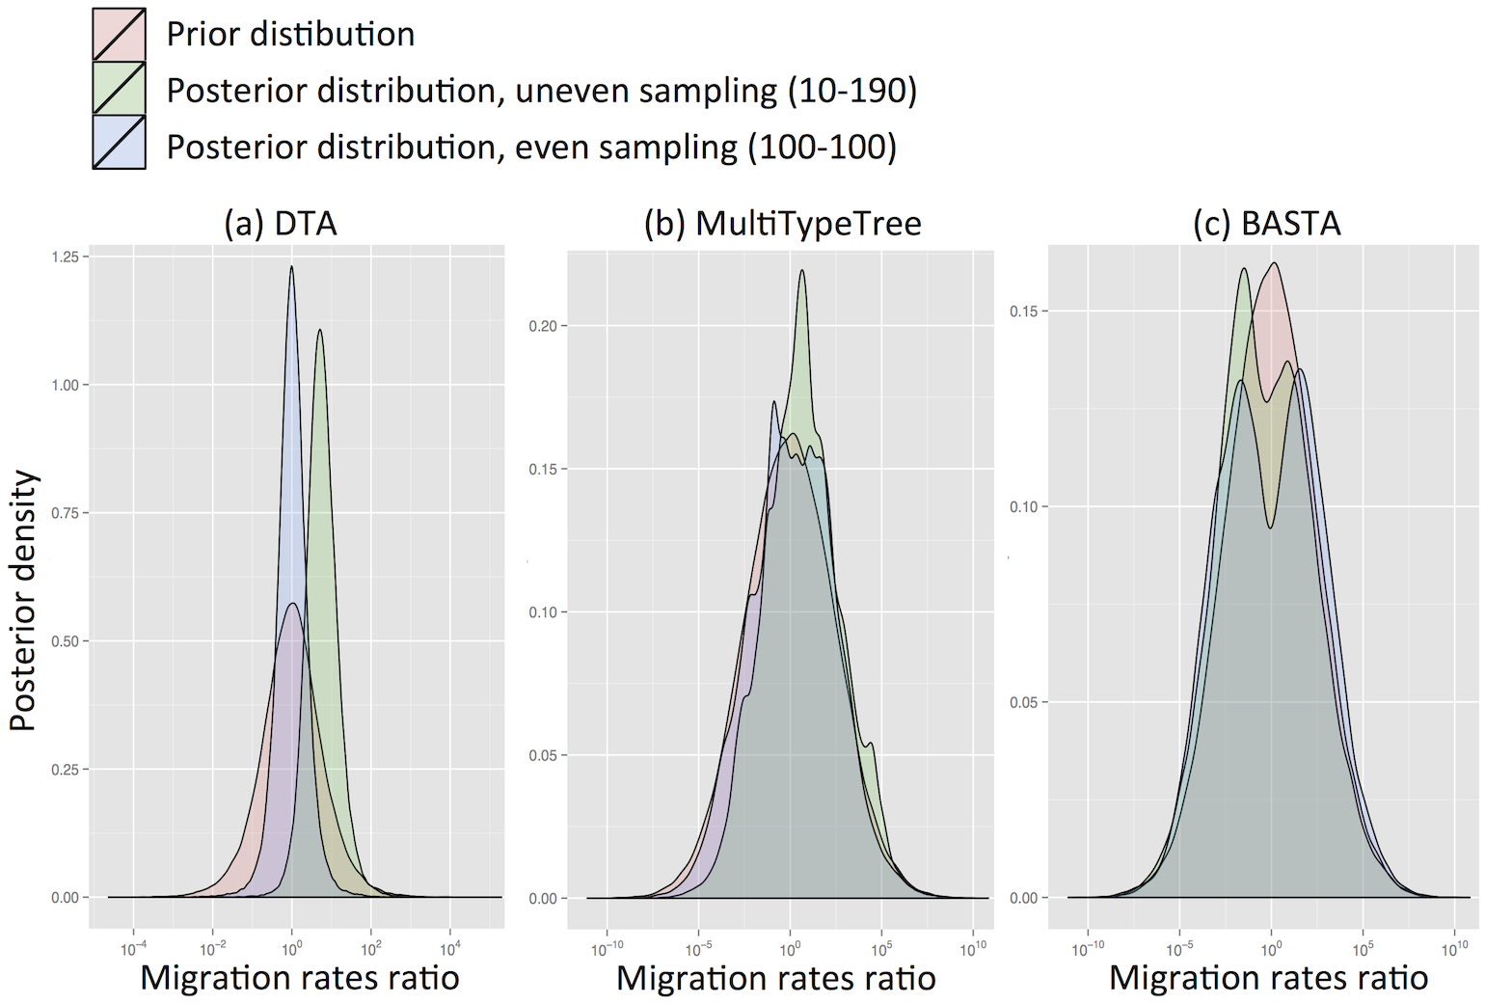
Biases in Structured phylodynamics
DeMaio et al. PLoS Biology, 2015

Slide 34
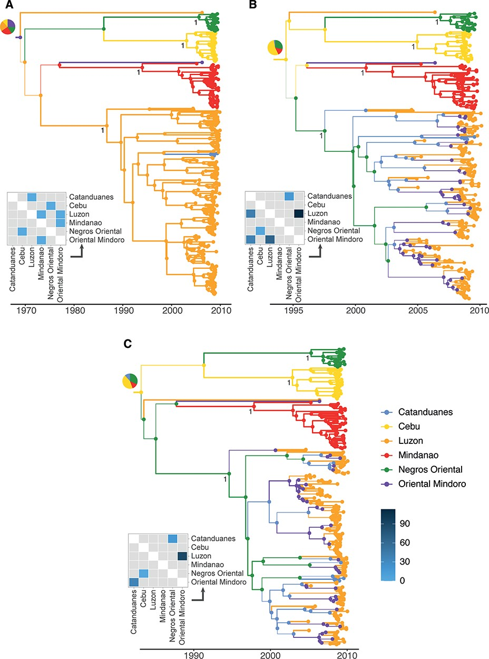
DTA typically returns a rather parsimonious ancestral state reconstruction
Layan et al. Virus Evolution, 2023

Slide 35
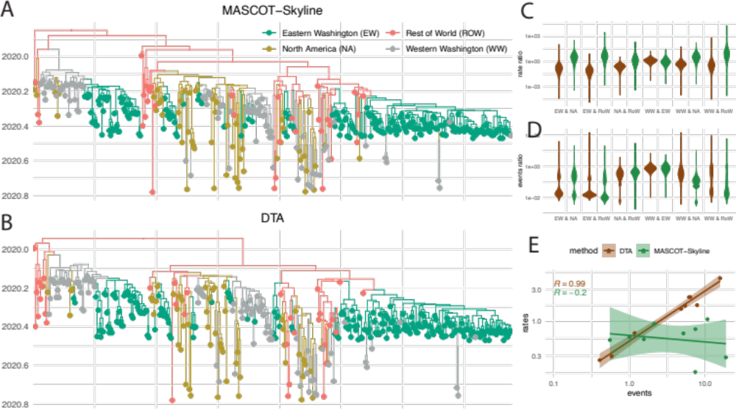
Different methods can interpret very similar observations differently
Müller et al. BioRxiv, 2024

Slide 36
Different methods can interpret very similar observations differently
Müller et al. BioRxiv, 2024

Slide 37
Variations
Typed or untyped trees, i.e. trees including the migration history or not (BDMM)
Fixed types at the tips (BDMM) or estimated (MSBD)
Extended multi-type birth-death model with birth rate between demes λ_{i,j} ∀ i ≠ j (BDMM, XML only)

Slide 38
Example: tuberculosis
Pečerska et al., 2021, Epidemics

Slide 39
Pros / Cons
Pro: parameter estimates map to biologically meaningful quantities (R₀, length of infectious period, etc)
Con: computational cost (BDMM) or approximations (MSBD)
Con: sensitive to unmodelled sampling discrepancies

Slide 40
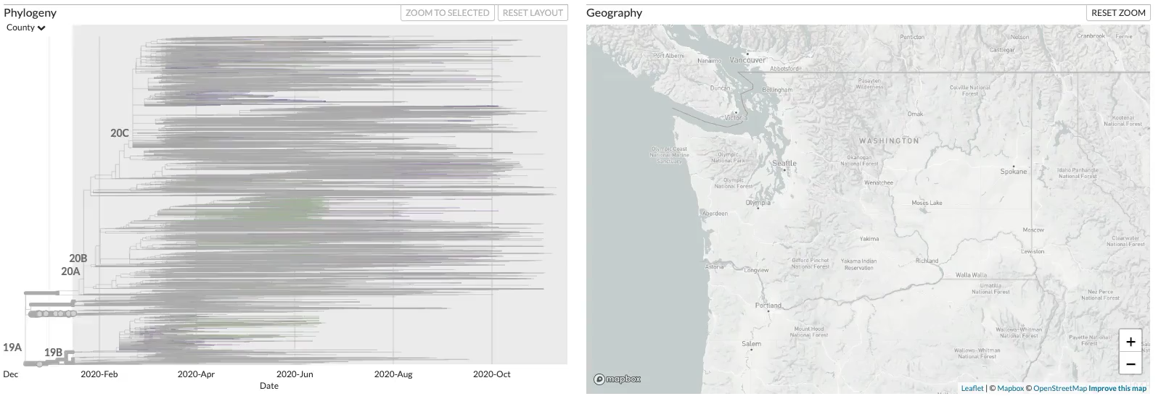
Phylogenetic tree of SARS-CoV-2 sequences isolated in Washington State reveal multiple introductions.
https://nextstrain.org/groups/blab/ncov/wa-phylodynamics?c=county
Notes:
Here, I show phylogenetic tree reconstructed from SARS-CoV-2 sequences isolated in Washington State and around to world, where samples from Washington State are colored based on the county they were isolated in.
After an initial introduction, SARS-CoV-2 spread mostly around Seattle, but more widespread around the state soon thereafter.
Viruses introduced early differed from those later, most notably by a amino acid substitution in the spike protein.
These two variants are referred to as 614D and 614G.

Slide 41
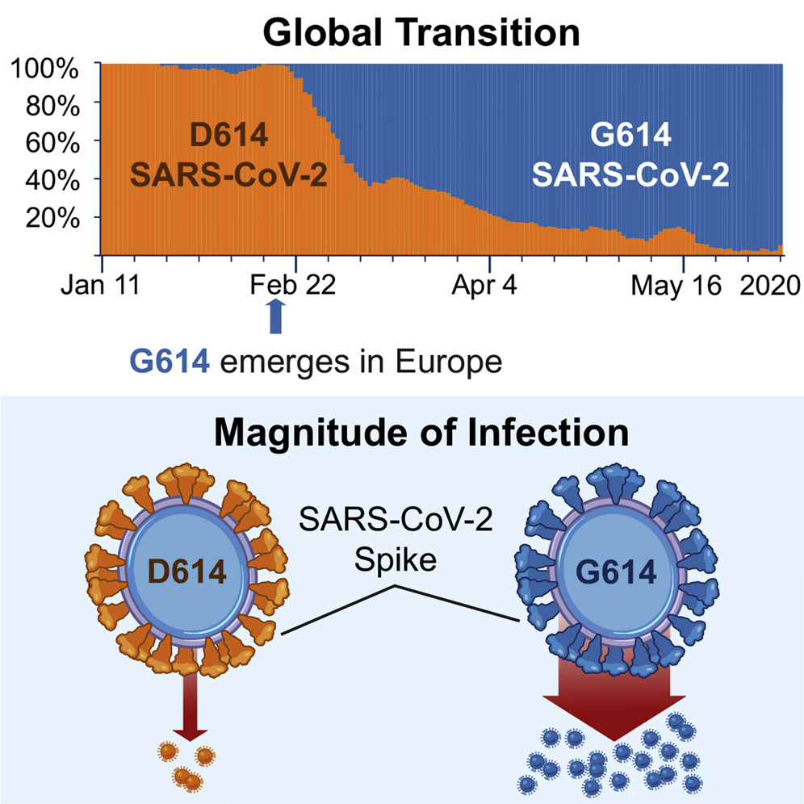
The two spike variants 614D and 614G were shown to differ in viral load and presumably transmission rate.
Korber et al. (2020), Cell
Notes:
The two spike variants 614D and 614G were shown to differ in viral load and presumably transmission rate.
614G emerged in Europe and soon became the dominant spike variant around the world.
The same pattern could be observed in Washington State, leading us to investigate why it took over here.

Slide 42
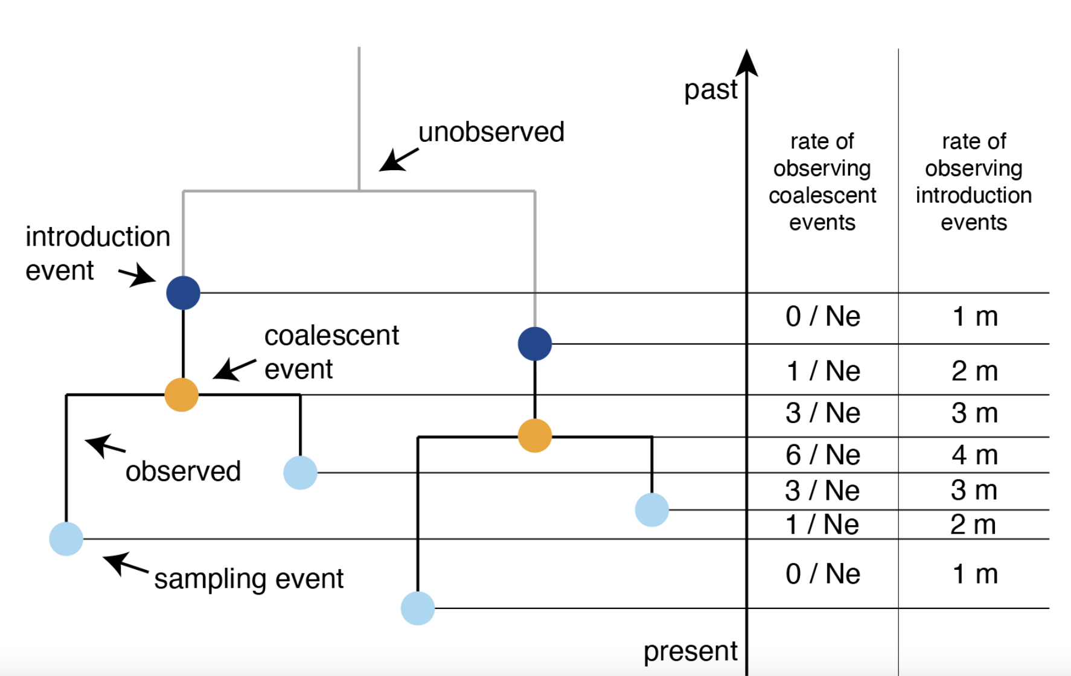
Migration histories can be conditioned on instead of estimated
Müller, Wagner, Frazar and Roychoudhury et al. (2021), BioRxiv

Slide 43
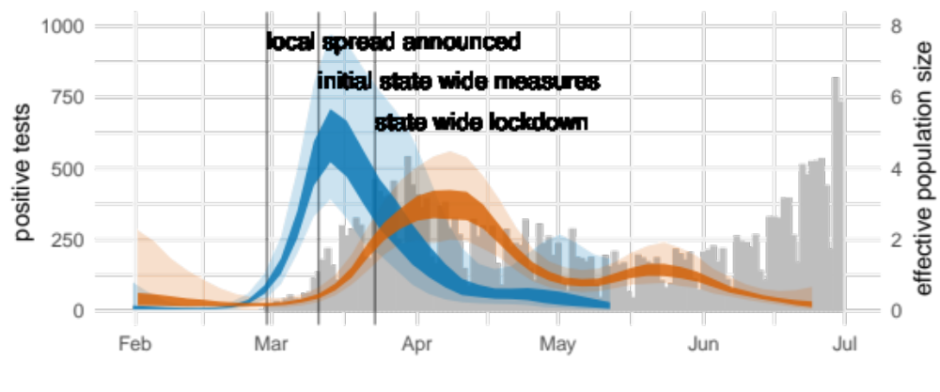
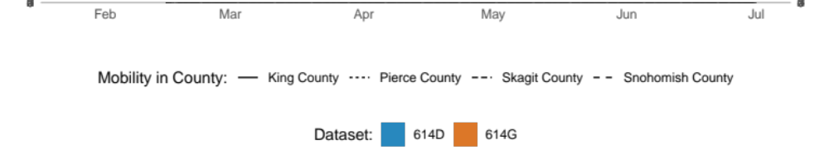
Reconstructing the effective population size of the spike variants reveals different temporal patterns
Müller, Wagner, Frazar and Roychoudhury et al. (2021), Sci. Trans. Med.
Notes:
We used phylodynamic approaches to study how the case load of the two different variants changed over time.
Reconstructing the effective population size, as measure proportional to the number of infected over time, of the spike variants reveals different temporal patterns.
614D dominated early, but soon declined, while 614G cases peaked much later.

Slide 44
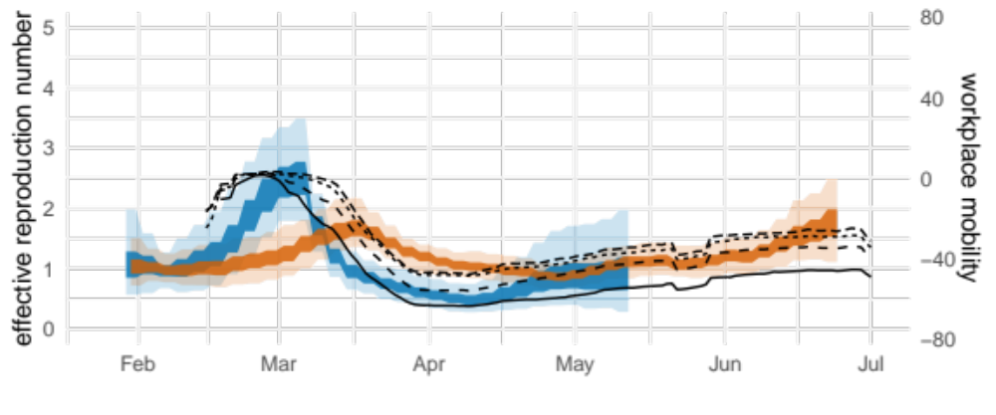

Changes in the reproduction rate of different spike variants reflect different mobility trends in the state
Müller, Wagner, Frazar and Roychoudhury et al. (2021), Sci. Trans. Med.
Notes:
We can also reconstruct how the reproduction number, that is the number of secondary infections per infected individual changed over time using phylodynamics.
This revealed that the transmission dynamics of 614D cases change with mobility patterns in King County while 614G cases are more consistent with mobility patterns outside of King County.

Slide 45
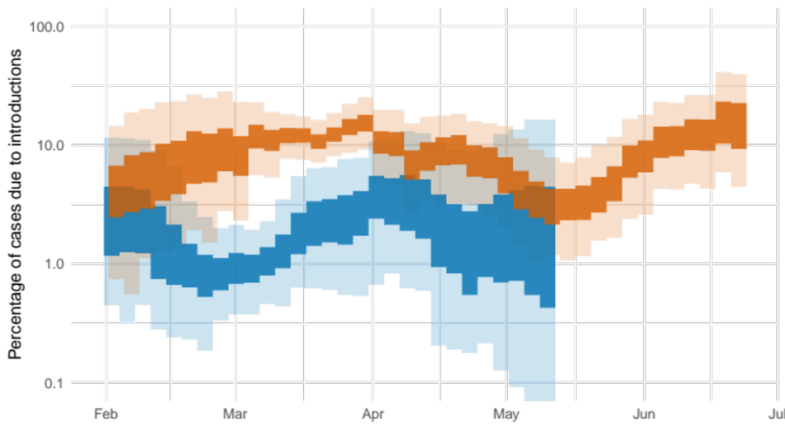
Introductions played different roles in the spread of different SARS-CoV-2 spike variants
Müller, Wagner, Frazar and Roychoudhury et al. (2021), Sci. Trans. Med.
Notes:
We can also use these phylodynamic methods to get an idea of how important introductions are in driving cases.
What we find is that introductions from outside the state played only a minor role (after the initial introduction) in driving cases of 614D, but played a major role in driving 614G cases, the dominant variant at that time in Europe and the North East of the US.
This suggest that the changes in local frequencies of the two different spike variants very driven by different timings of when local measure were introduced and by a large number of introductions of 614G viruses from outside the state.

Slide 46
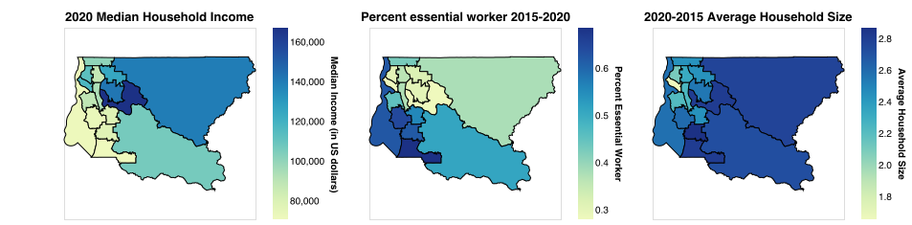
Higher incomes in North King County, fewer essential workers, smaller households
M. I. Paredes et al., “Local-Scale phylodynamics reveal differential community impact of SARS-CoV-2 in metropolitan US county” medRxiv. 2022

Slide 47
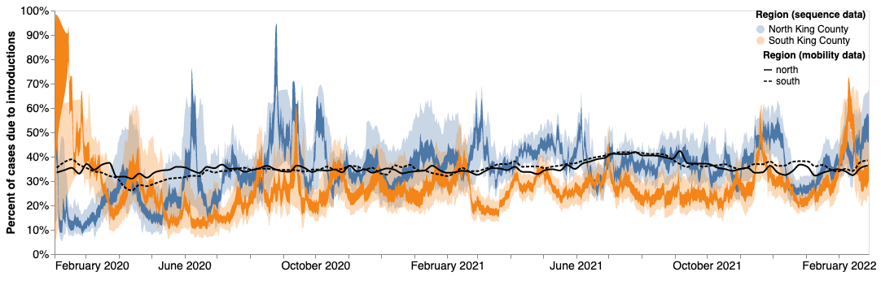
After measures around 30-40% of cases in North were from introductions, while only 20-30% of cases in South were
M. I. Paredes et al., “Local-Scale phylodynamics reveal differential community impact of SARS-CoV-2 in metropolitan US county” medRxiv. 2022

Slide 48
The multi-type birth-death process models how lineages give birth, die, are sampled or jump between states.

Slide 49
Multi-type birth-death process
N types, i = 1,…,N
N birth rates λ_{i}
N death rates μ_{i}
N sampling rates ψ_{i}
Migration rates m_{i,j} ∀ i ≠ j
Kühnert et al. MBE, 2016

Slide 50
QUESTIONS?

Slide 51
Some reading material
Paper on DTA: https://doi.org/10.1371/journal.pcbi.1000520
How do different structured coalescent methods compare: https://academic.oup.com/mbe/article-abstract/34/11/2970/3896419
Birth-death models with migration: https://doi.org/10.1093/molbev/msw064
GLM for DTA: https://doi.org/10.1371/journal.ppat.1003932
GLM for MASCOT: https://doi.org/10.1093/ve/vez030

