Slide 1
How does phylodynamics relate to transmission dynamics?
Nicola Felix Müller, PhD
e-mail: nicola.mueller@ucsf.edu

Slide 2
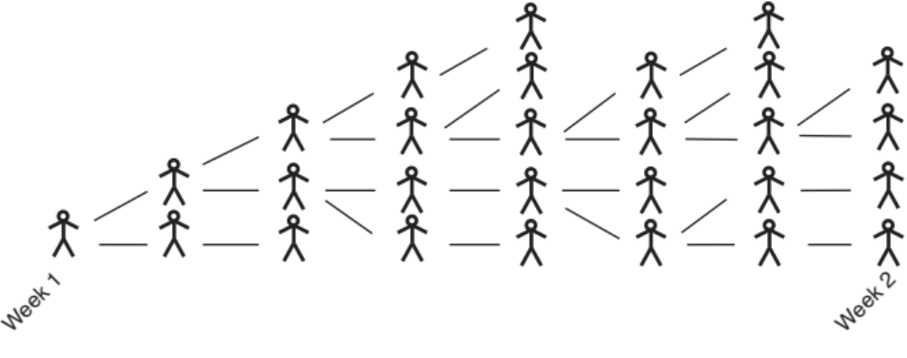
Genomics allows tracking the shared ancestry.

Slide 3
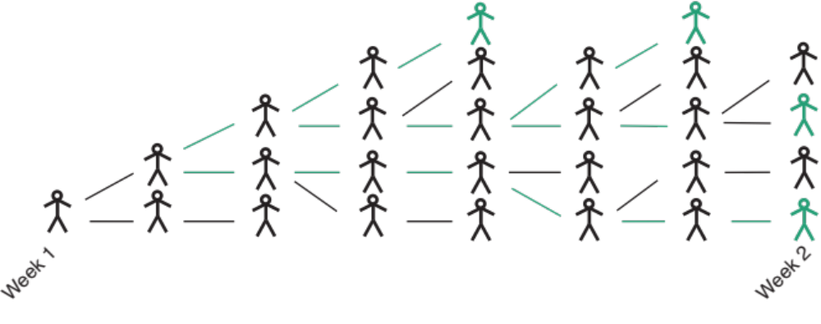
If we track the shared ancestry of the 4 sampled individuals, we will reach a common ancestor more quickly, the smaller the Ne.

Slide 4
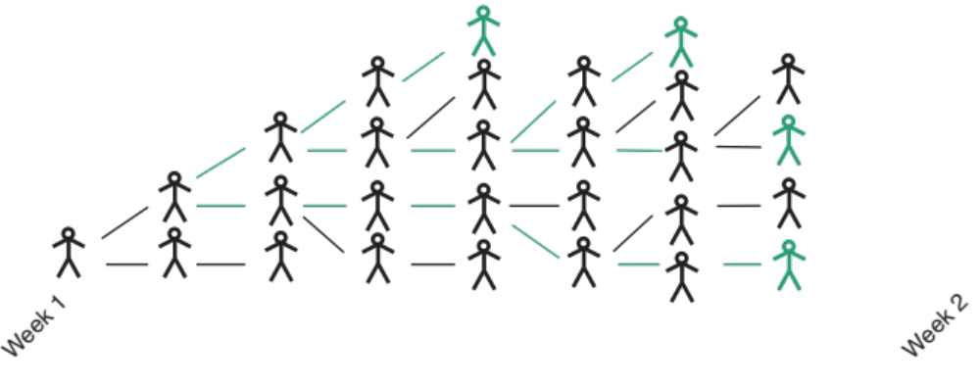
What happens if we have the same number of infected individuals, but higher turnover?

Slide 5
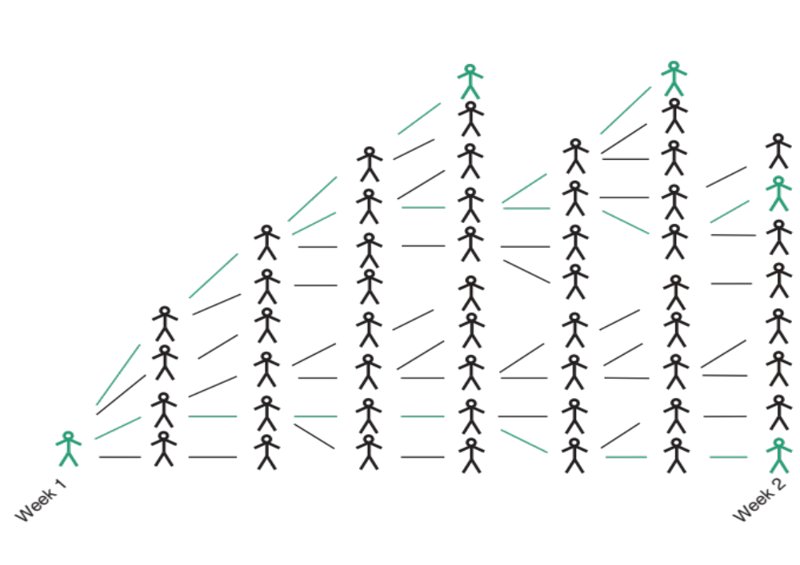
What happens if we have a higher number of infected individuals and higher turnover?

Slide 6
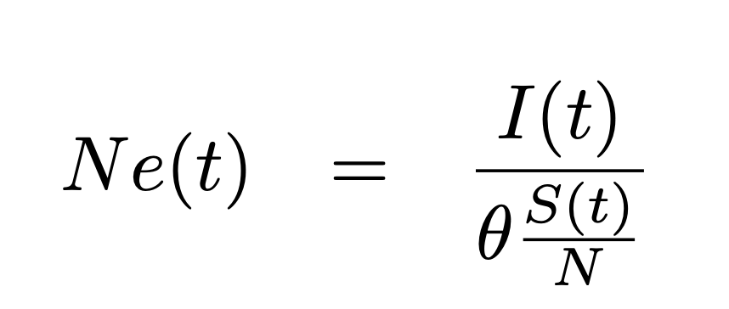
The effective population size (Ne) can be denoted as a function of epi-parameters for SIR models
Volz, E. M. (2012). “Complex Population Dynamics and the Coalescent Under Neutrality. Genetics,” 190(1), 187-201. https://doi.org/10.1534/genetics.111.134627

Slide 7
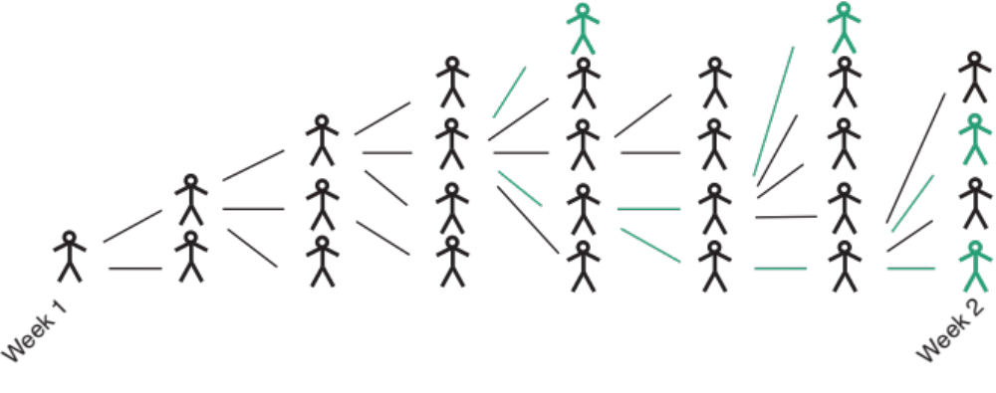
What happens if we have a skewed offspring distribution?

Slide 8
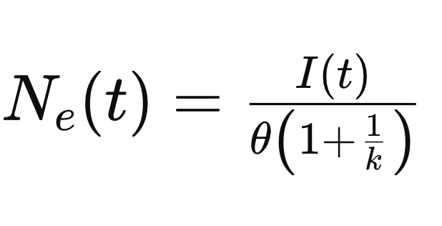
We can also account for some offspring distributions in the Ne
Li, L. M., Grassly, N. C., & Fraser, C. (2017). “Quantifying Transmission Heterogeneity Using Both Pathogen Phylogenies and Incidence Time Series.” Molecular Biology and Evolution, 34(11), 2982-2995. https://doi.org/10.1093/molbev/msx195
Notes:
R = effective reproduction number
N = Number of individuals
Tg = generation time
K = assuming neg binomial with mean R and variance R(1+1/k)

Slide 9
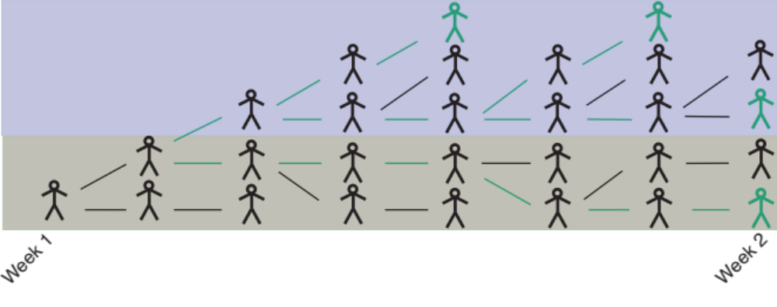
What happens if there is population structure?

Slide 10
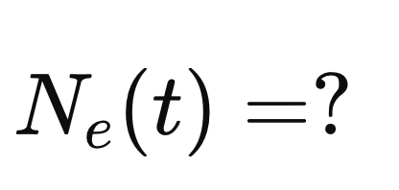
Once there is population structure, the meaning of the effective population size is not obvious

