Slide 1
Considerations when choosing priors
Nicola F. Müller
e-mail: Nicola.mueller@ucsf.edu

Slide 2
Priors denote our prior belief/expectations in certain parameter values
Tree Prior describes how a tree was formed by a population model
Prior belief of what the parameters should be
Posterior probability
Tree likelihood
Du Plessis et al., 2015, Trends M.

Slide 3
Practical example: Choosing priors on the evolutionary rates for SARS-CoV-2
What are related viruses (preferably in the same host)
  SARS
  MERS
What are their evolutionary rates

Slide 4
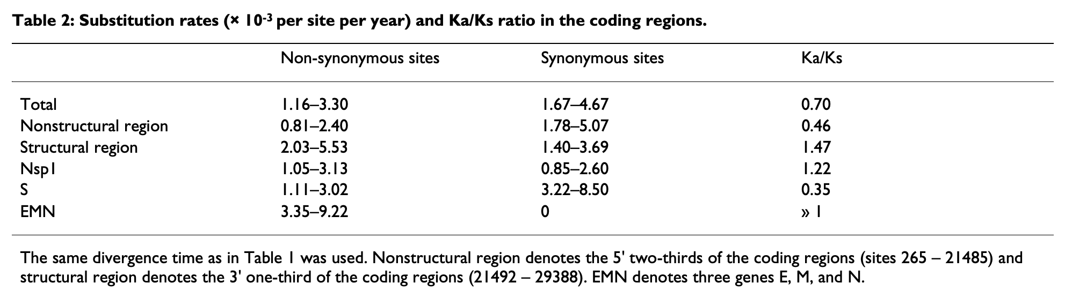
SARS evolutionary rate
Zhang et al., 2004, BMC Evol.

Slide 5
MERS evolutionary rate
Dudas et al., 2018, eLife

Slide 6
SARS-CoV-2 has an evolutionary rate similar to MERS-CoV-2
Duchene et al. (2019), Virus Evol. estimate the average rate to be 1.1 × 10⁻³ subs/site/year

Slide 7
Going wrong with the prior
NL63: 1.3 × 10−4 (CI 1.1 – 1.5 × 10−4)
229E: 2.5 × 10⁻⁴ (CI 2.2 – 2.7 × 10⁻⁴)
OC43: 2.1 × 10⁻⁴ (CI 1.9 – 2.3 × 10⁻⁴)
Müller et al., 2022, Nat. comm.

Slide 8
Posterior is the product of Prior and Likelihood
Tree Prior describes how a tree was formed by a population model
Prior belief of what the parameters should be
Posterior probability
Tree likelihood
Du Plessis et al., 2015, Trends M.

Slide 9
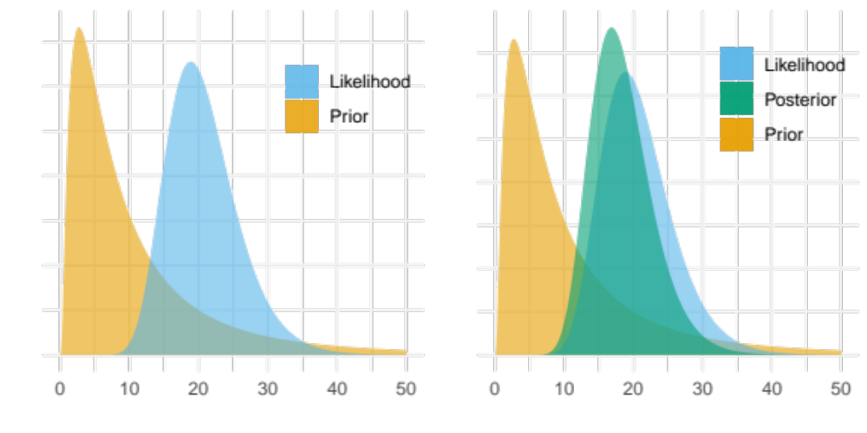
Posterior is the product of Prior and Likelihood

Slide 10
How do the Prior and Likelihood act together

Slide 11
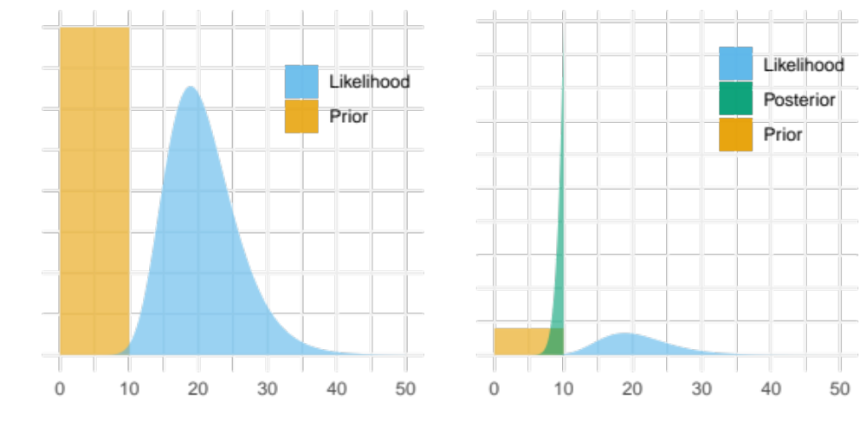
If the prior largely excludes the most likely values of the Likelihood

Slide 12
The so does the Posterior

Slide 13
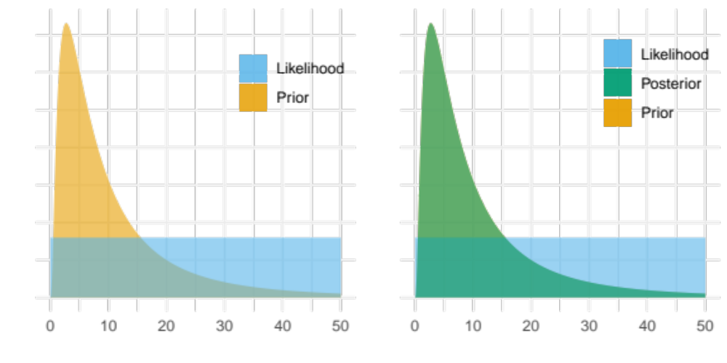
If the Likelihood provides no information

Slide 14
Then the Posterior will be equal to the prior

Slide 15
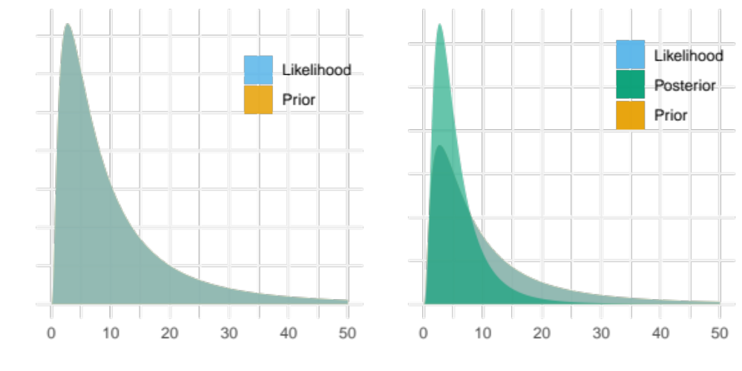
If the prior is equal to the likelihood

Slide 16
Then the posterior will be more ”peaked/narrower” than either Prior or Likelihood

Slide 17
Everything affects everything.

Slide 18
True prior distributions are revealed by sampling under the prior.

Slide 19
MCMC Convergence and troubleshooting

Slide 20
Failed initialization

Slide 21
Failed initialization
Check initial values
Check for incompatible priors
Increase number of initialization attempts
Talk to the developers / BEAST2 support group

Slide 22
MCMC theory guarantees convergence to the posterior distribution
=> but not when !
=> how do we know when our inference has converged ?
Convergence

Slide 23
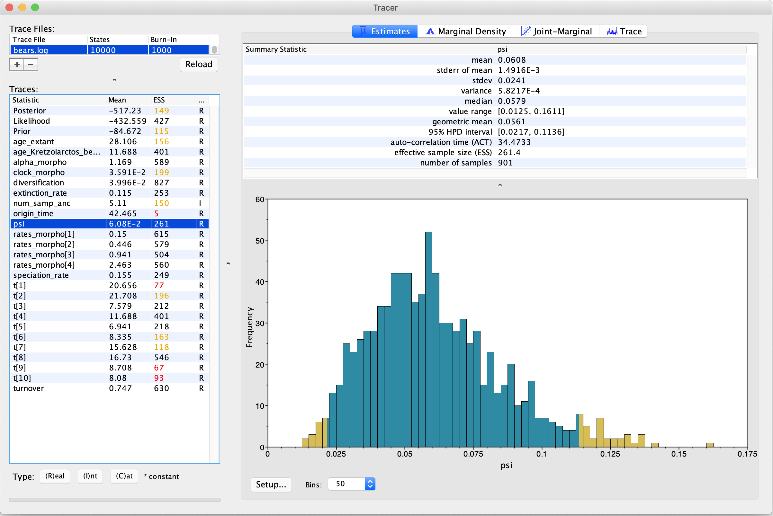

Slide 24
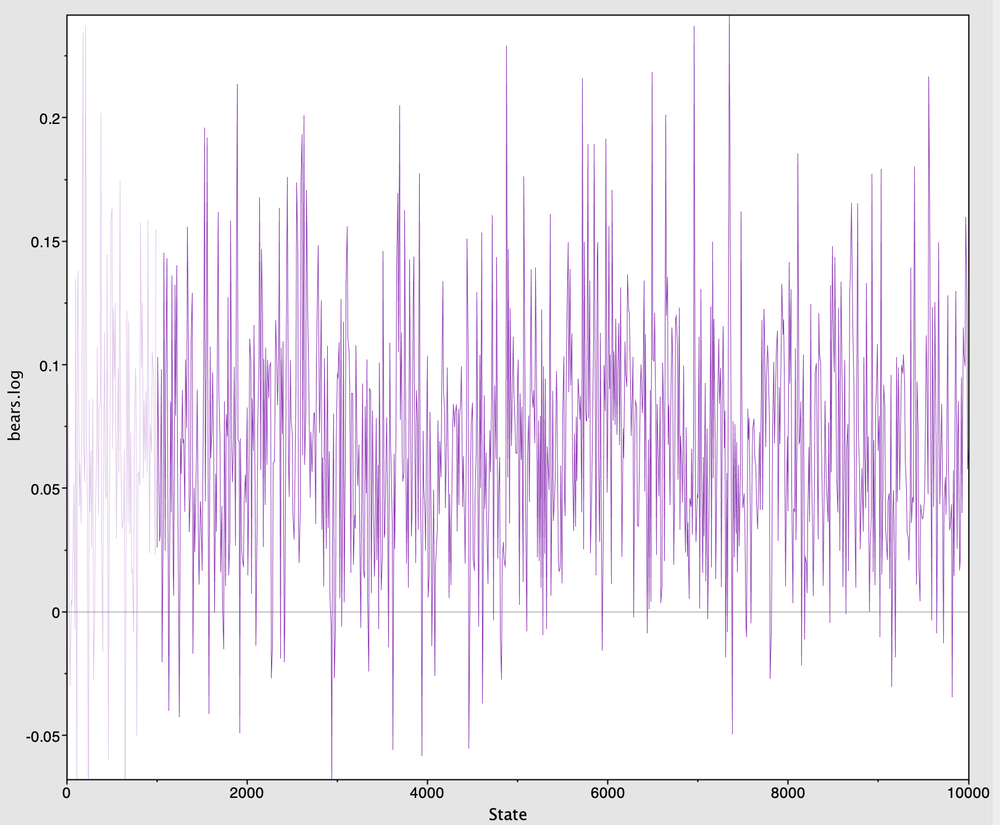

Slide 25
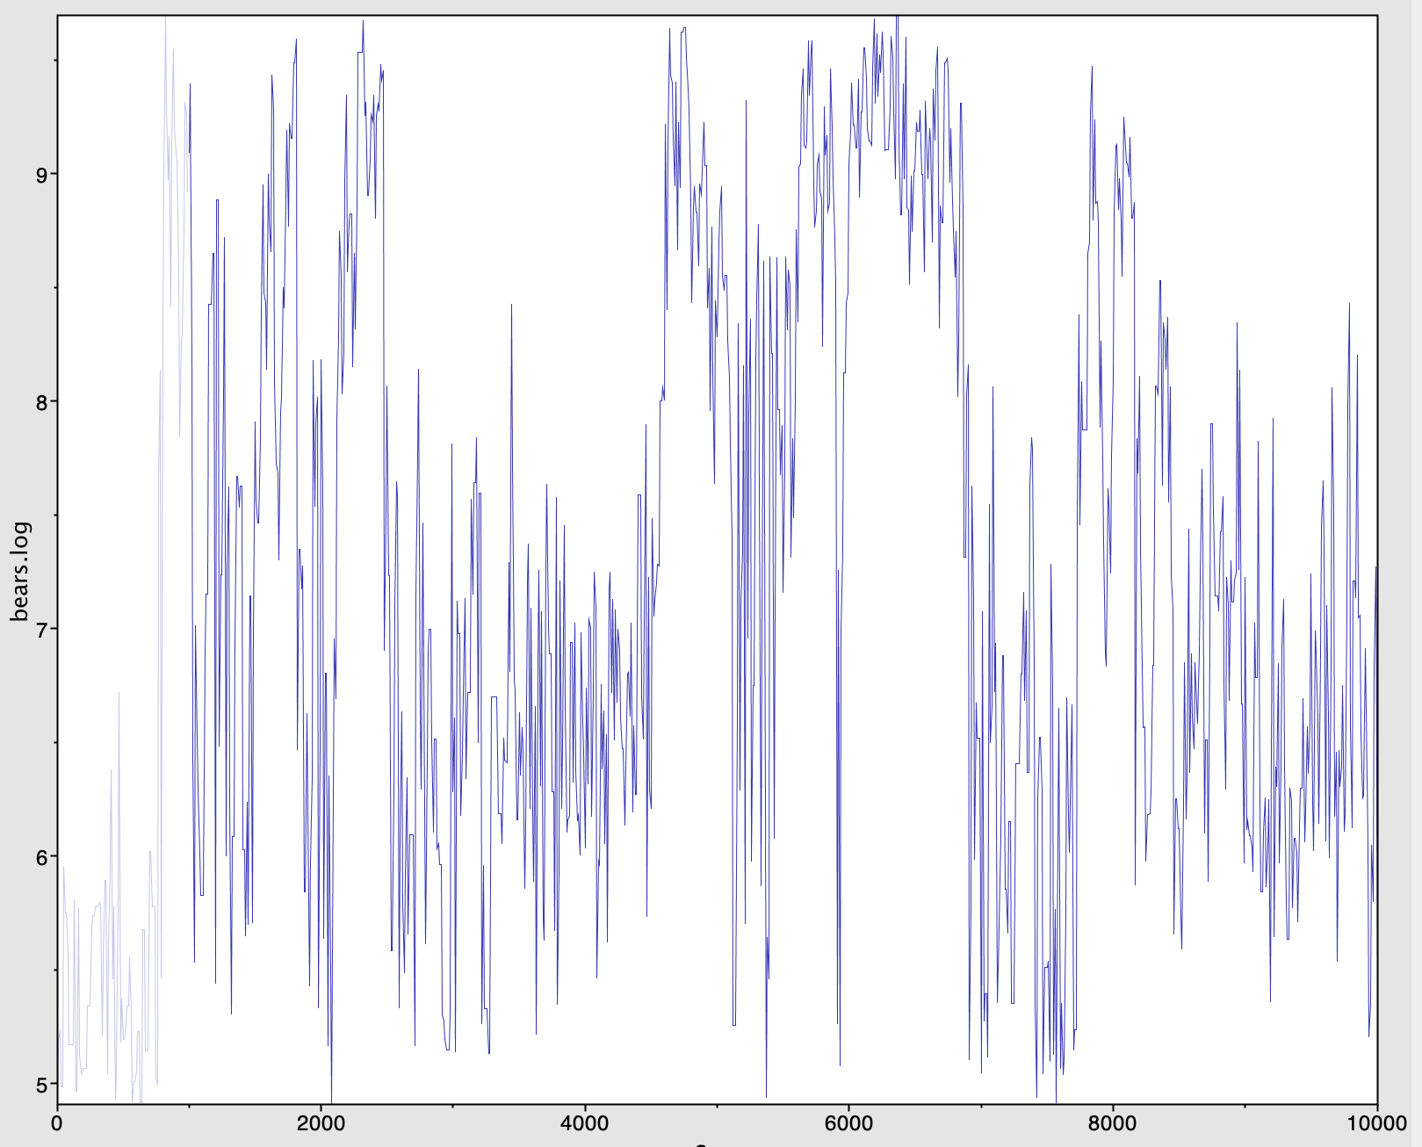

Slide 26
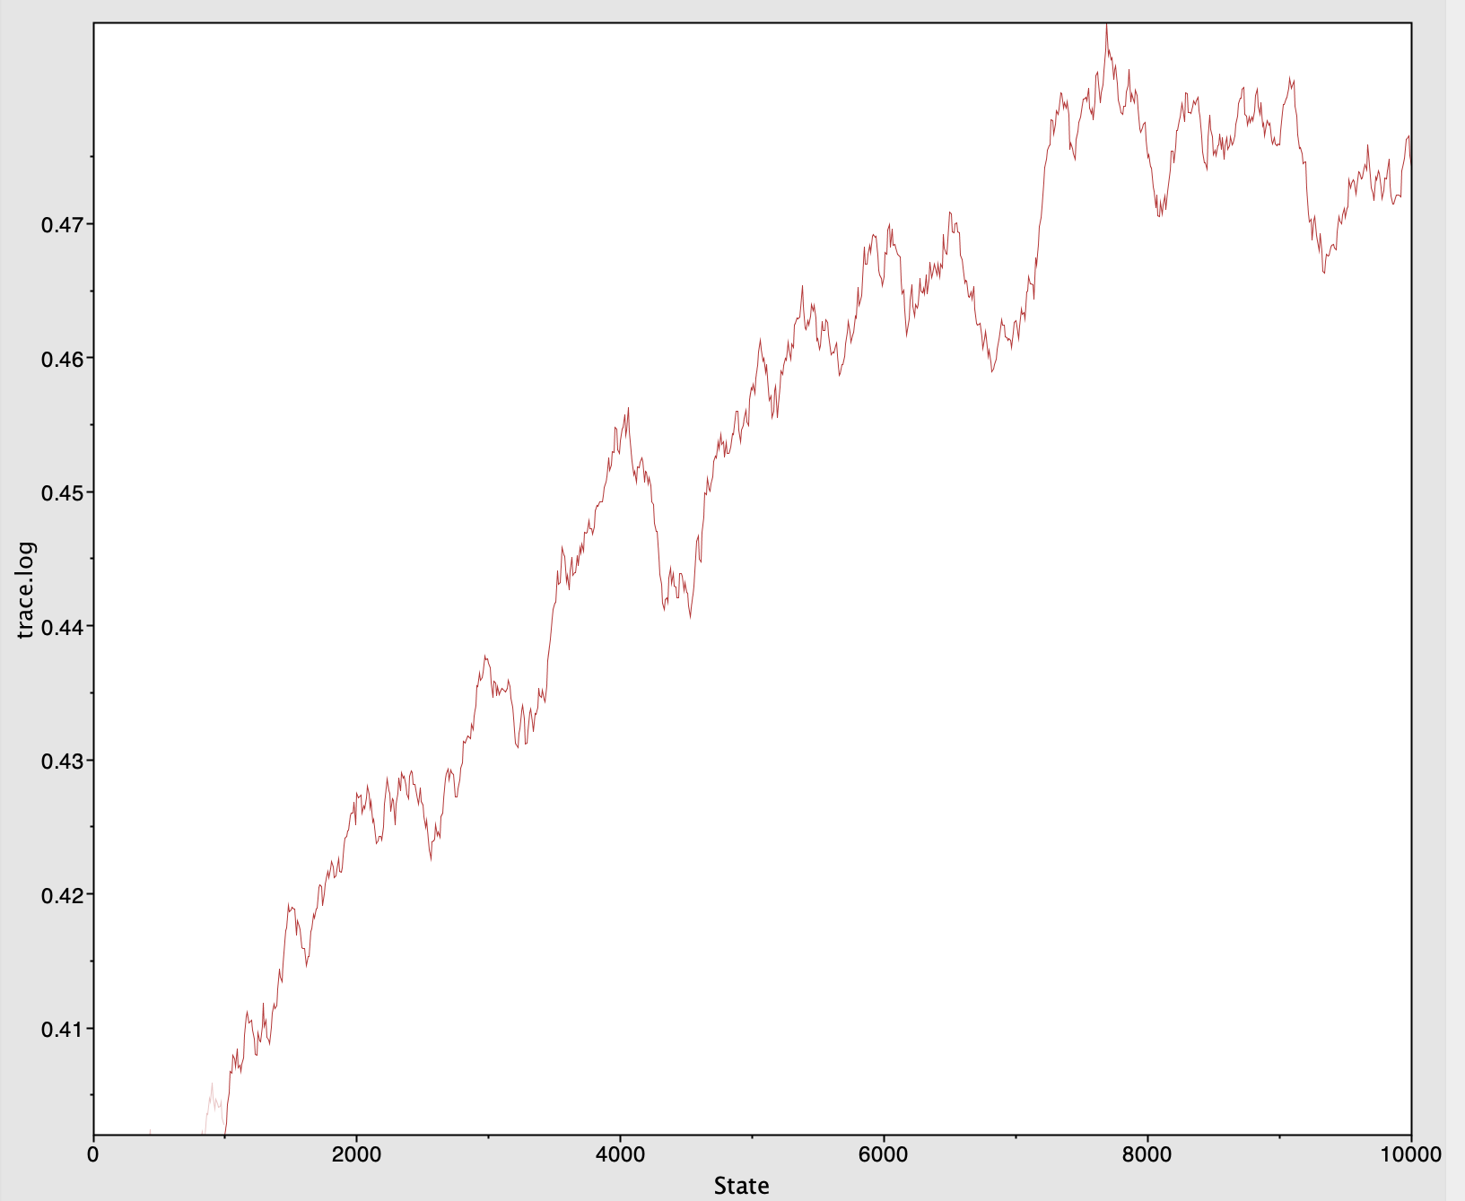

Slide 27
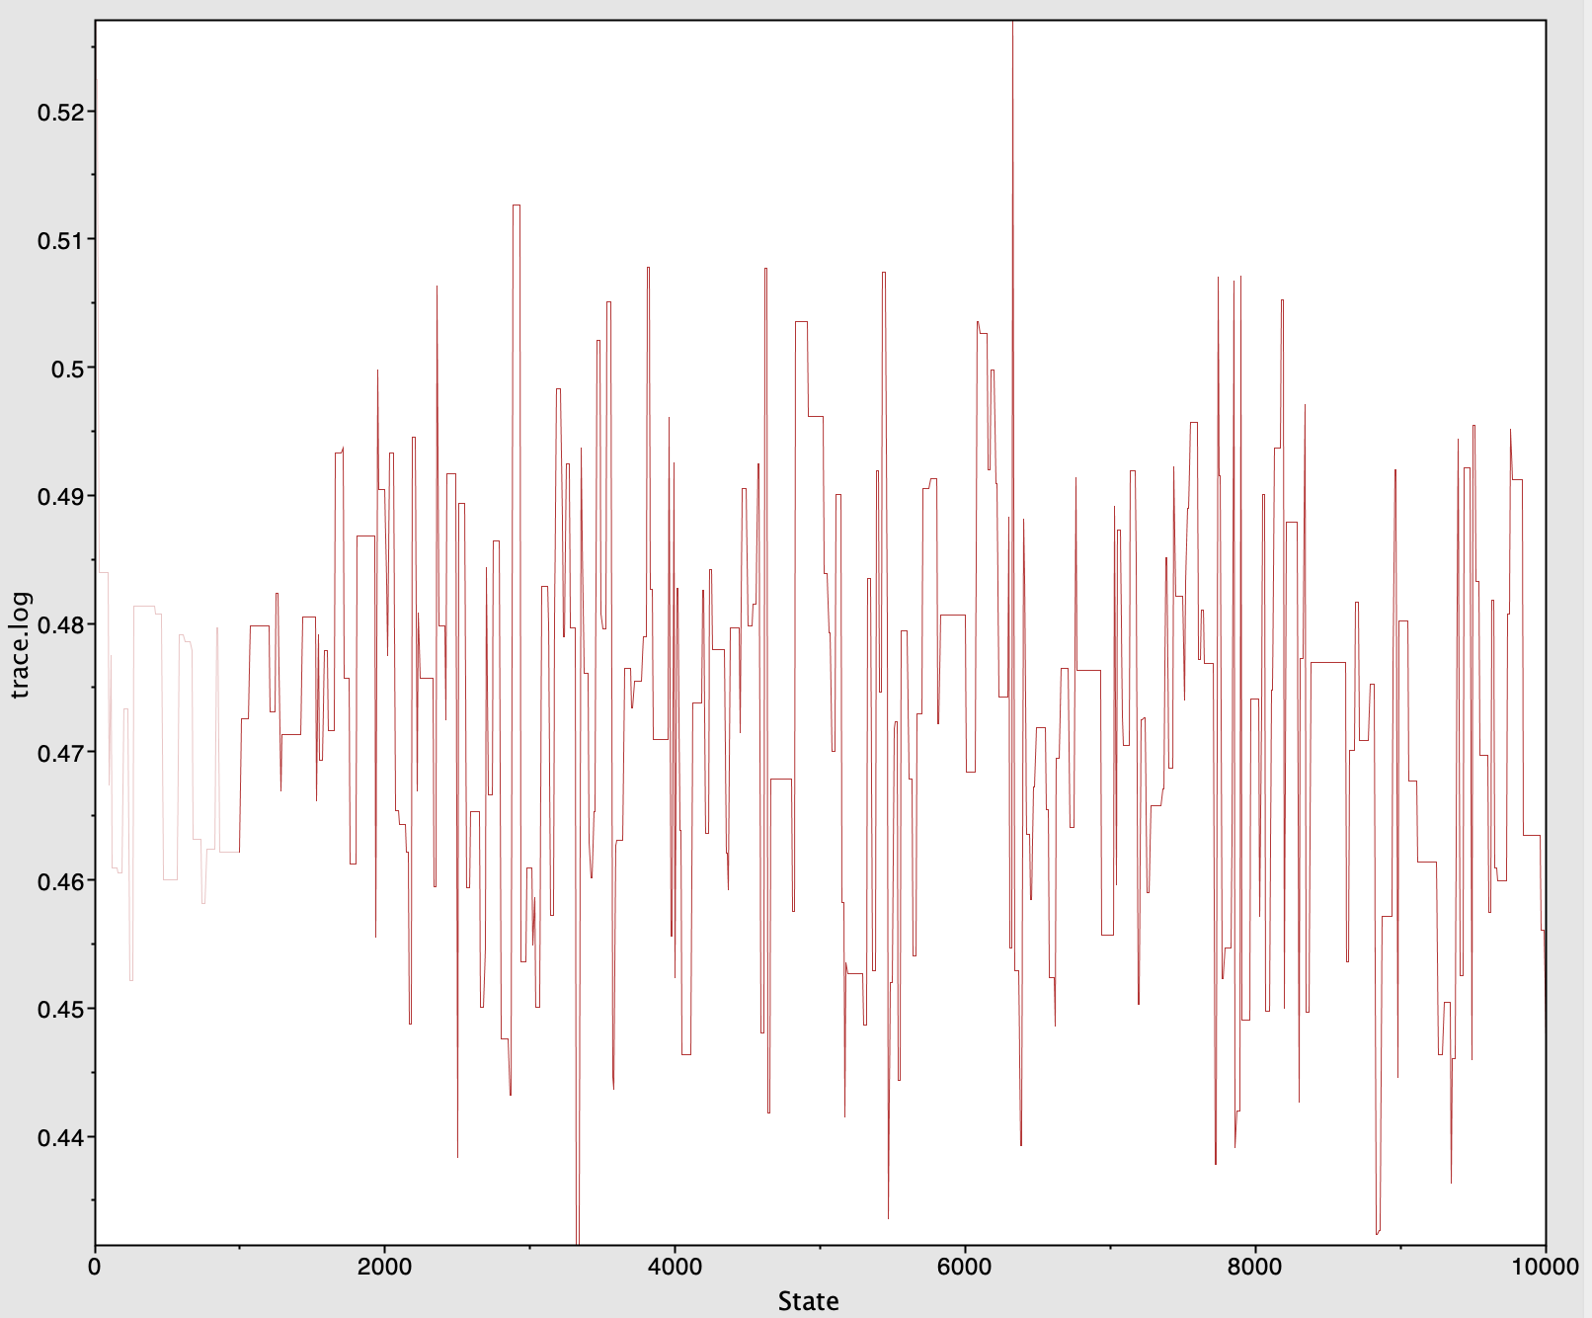

Slide 28
What can you do ?
Increase sampling frequency
Adjust operator weights
Increase chain length
Check for model misspecification
Check for prior incompatibility
Simplify the analysis setup
Run heated chains (MCMCMC)
Talk to the developers / BEAST2 support group

Slide 29
Adjusting operator weights

Slide 30
