Slide 1
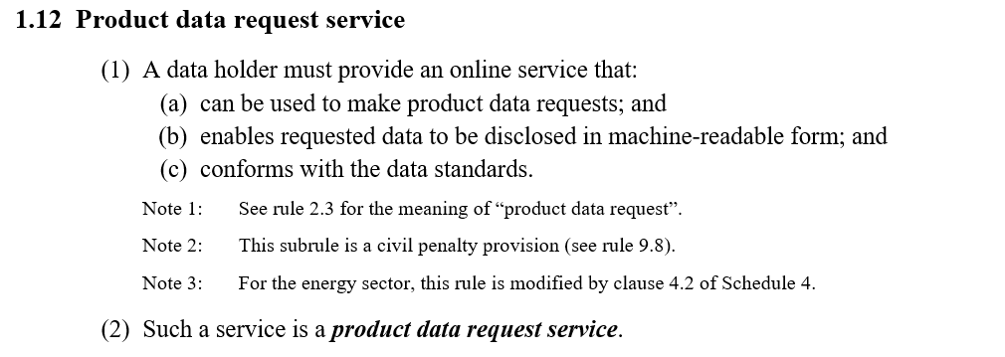
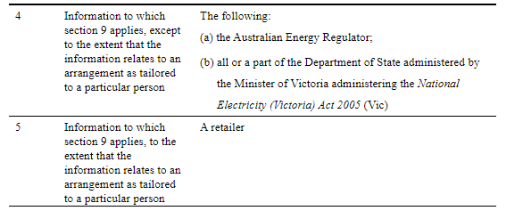
Product Reference Data (PRD) - Background
Background:
Following are the definitions of Product Data Request Service from the CDR Rules.
References:
Competition and Consumer (Consumer Data Right) Rules 2020 - https://www.legislation.gov.au/Details/F2022C00187
Consumer Data Right (Energy Sector) Designation 2020 - https://www.legislation.gov.au/Details/F2020L00833
A
A
A
B
A
B

Slide 2
Product Reference Data (PRD) – Scope & Options
Noting Paper 248: https://github.com/ConsumerDataStandardsAustralia/standards/issues/248
Noting Paper 248 proposes different short term and long-term options. Short term approaches are only valid from 1st Oct to 15th Nov.
Short term options requires data holder to
expose AER’s PRD end points directly or (Pattern 1 – Direct to AER)
redirect all PRD queries to AER’s PRD end points. (Pattern 2 – DNS Redirection)
Long term options requires data holder to host
PRD endpoints and act as a proxy between ADR and AER i.e., pass on the request & response without modification between ADR and AER as a mediator. (Pattern 3 – Proxy)
PDR endpoints directly as voluntary data by fully implementing product data request service. (Pattern 4 – Self Hosted)
another pattern 5 – a variation of pattern 3 which is more complex and is not being discussed. (Pattern 5 – Hybrid)

Slide 3
Product Reference Data (PRD) – Issues & Concerns
Rules vs Standards:
Data holders are not required to provide a product data request service, but noting paper suggests that we must host the service in some shape or form and there is work required to be done by data holder.
Schedule:
The AER endpoints need to go live by 1st Oct. Data holders now have a more compressed schedule and must be accredited by 1st Oct to achieve this. AGL plans do not align to 1st Oct go live.
Short Term options proposed by Noting paper 248
Pattern 1 & 2 are short-term interim solutions that is to be provided to meet the 1st Oct timelines of AER. These solutions will have to be replaced with one of the long-term options when data holders go live on 15th Nov.
In addition to the above scheduling constraints, there is rework for all data holders as a result of this.
Long term options proposed by Noting paper 248
Pattern 3 & 5 are the only viable long term solution options with Pattern 3 being the simplest to implement. However these options do have key trade-offs that need to be addressed such as NFR as these options introduces latency in the flow.
Patterns 4-5 require additional build by the data holders. Data holders anticipated these to be out of scope as it was an opt-in obligation under the energy rules (unlike in banking where it is a requirement).
Additional work is required to be carried out by data holder to do any of the long-term options and has not been planned for. Also, AGL do not have capacity to accommodate these changes at this stage of the program.

Slide 4
Product Reference Data (PRD) – AGL Position
The PRD noting paper 248 is in contradiction with rules & energy designation instrument. It has significantly expanded the scope of what is required to be done by data holder under the CDR Rules by including the facilitation of a product data request service. AGL’s position is that there is no legislative requirement in relation for data holders to provide a product data request service. AGL also does not consider the ‘Noting paper’ to be the appropriate vehicle to effectively make changes to requirements under the Rules.
Alternative Option Proposed:
Noting Paper 248 is a technical workaround addressing a capability gap that could be addressed through an enhancement within Registrar. It would more effective and economical for the registrar platform to support multiple base-URIs instead of asking multiple retailers to do short term and long-term options.

