Slide 1
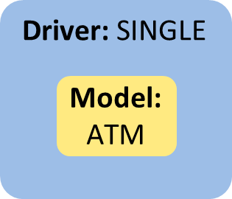
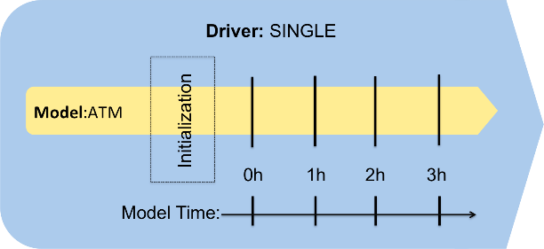
UM – NUOPC coupling feasibility
UM currently uses OASIS3-MCT
Try driving an atmosphere only configuration following NUOPC SingleModelProto example
  No coupling to anything, no fields imported or exported
Example model defines Initialize, ModelAdvance, Finalize routines which are called by driver
From NUOPC Interoperability Layer

Slide 2
UM high level structure
program um_main
call um_shell()
end program um_main
subroutine um_shell
mpi and oasis init
read namelists
define grid
call u_model()
close files
end subroutine um_shell
subroutine u_model
allocate memory
read restart
do
increment time
oasis send/recv
call atm_step()
end do
some cleanup
end subroutine u_model
Split um_shell -> um_shell_init & um_shell_final
Split u_model -> u_model_init, u_model_step & u_model_final

Slide 3
UM NUOPC high level structure
program um_main
Initialize ESMF
create driver
initialize driver
run driver
finalize driver
end program um_main
module model
subroutine initialize
set MPI communicator from ESMF
call um_shell_init()
call u_model_init()
end subroutine initialize
subroutine modeladvance
call u_model_step()
end subroutine modeladvance
subroutine finalize
call u_model_final()
call um_shell_final()
end subroutine finalize

Slide 4
Status
Builds with only minor changes to UM build configuration
  esmf/8.0.1 module on gadi
Runs with rose/cylc like normal UM
Both UM and ESMF set run start, end times, calendar and time step
Doesn’t work with IO server at the moment (though not usually used in climate runs)
Error handling needs to be integrated properly

Slide 5
Next steps
Try using CMEPS/CDEPS
  Model code in NUOPC examples is almost identical when using a mediator
  Haven’t found a simple CMEPS or CDEPS example yet
AMIP like configuration using data model ocean and ice

