Slide 1
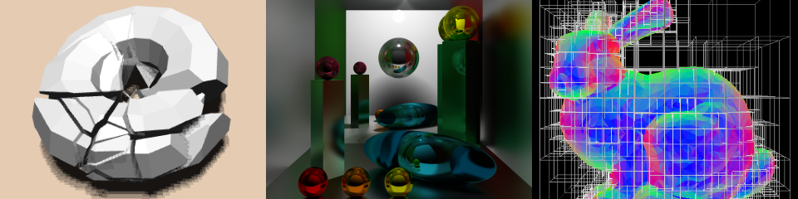
OpenGL and WebGL
Patrick Cozzi
University of Pennsylvania
CIS 565 - Fall 2015

Slide 2

OpenGL
Is a C-based API
Is cross platform
Is run by the ARB: Architecture Review Board
Hides the device driver details
OpenGL vs. Direct3D

Slide 3
OpenGL
We are core profile
  No fixed function vertex and fragment shading
  No legacy API calls:
    glBegin()
    glRotatef()
    glTexEnvf()
    AlphaFunc()
    …
Recall the fixed function light map
Why was the alpha test remove?

Slide 4
OpenGL
Software stack:
Application
OpenGL API
Device Driver
GPU

Slide 5
OpenGL
Major objects:
Shader Programs
Shader Objects
Array Buffers
Framebuffers
Element Buffers
Textures
Pixel Buffers
Renderbuffers
Fixed Function State
We are not covering everything. Just surveying the most relevant parts for writing GLSL shaders
Notes:
Array buffers = vertex buffers
Element buffers = index buffers

Slide 6
Shaders
Shader object: an individual vertex, fragment, etc. shader
  Are provided shader source code as a string
  Are compiled
Shader program: Multiple shader objects linked together

Slide 7
Shader Objects
Compile a shader object:
const char *source = // ...
GLint sourceLength = // ...
GLuint v = glCreateShader(GL_VERTEX_SHADER);
glShaderSource(v, 1, &source, &sourceLength);
glCompileShader(v);
GLint compiled;
glGetShaderiv(v, GL_COMPILE_STATUS, &compiled);
// success: compiled == GL_TRUE
// ...
glDeleteShader(v);
Notes:
Just like compiling an OpenCL kernel.

Slide 8
Shader Objects
Compile a shader object:
OpenGL functions start with gl. Why? How would you design this in C++?
const char *source = // ...
GLint sourceLength = // ...
GLuint v = glCreateShader(GL_VERTEX_SHADER);
glShaderSource(v, 1, &source, &sourceLength);
glCompileShader(v);
GLint compiled;
glGetShaderiv(v, GL_COMPILE_STATUS, &compiled);
// success: compiled == GL_TRUE
// ...
glDeleteShader(v);
v is an opaque object
What is it under the hood?
How would you design this in C++?
Notes:
Is it a pointer? Is it an index into an array? Is it a key into a map?

Slide 9
Shader Objects
Compile a shader object:
Provide the shader’s
source code
const char *source = // ...
GLint sourceLength = // ...
GLuint v = glCreateShader(GL_VERTEX_SHADER);
glShaderSource(v, 1, &source, &sourceLength);
glCompileShader(v);
GLint compiled;
glGetShaderiv(v, GL_COMPILE_STATUS, &compiled);
// success: compiled == GL_TRUE
// ...
glDeleteShader(v);
Where should the
source come from?
Why can we pass more than one string?

Slide 10
Shader Objects
Compile a shader object:
const char *source = // ...
GLint sourceLength = // ...
GLuint v = glCreateShader(GL_VERTEX_SHADER);
glShaderSource(v, 1, &source, &sourceLength);
glCompileShader(v);
GLint compiled;
glGetShaderiv(v, GL_COMPILE_STATUS, &compiled);
// success: compiled == GL_TRUE
// ...
glDeleteShader(v);
Compile, but what does the driver really do?

Slide 11
Shader Objects
Compile a shader object:
const char *source = // ...
GLint sourceLength = // ...
GLuint v = glCreateShader(GL_VERTEX_SHADER);
glShaderSource(v, 1, &source, &sourceLength);
glCompileShader(v);
GLint compiled;
glGetShaderiv(v, GL_COMPILE_STATUS, &compiled);
// success: compiled == GL_TRUE
// ...
glDeleteShader(v);
Good developers check for error. Again, how would you design this in C++?
Calling glGet* has performance implications. Why?

Slide 12
Shader Objects
Compile a shader object:
const char *source = // ...
GLint sourceLength = // ...
GLuint v = glCreateShader(GL_VERTEX_SHADER);
glShaderSource(v, 1, &source, &sourceLength);
glCompileShader(v);
GLint compiled;
glGetShaderiv(v, GL_COMPILE_STATUS, &compiled);
// success: compiled == GL_TRUE
// ...
glDeleteShader(v);
Good developers also cleanup resources

Slide 13
Shader Programs
Link a shader program:
GLuint v = glCreateShader(GL_VERTEX_SHADER);
GLuint f = glCreateShader(GL_FRAGMENT_SHADER);
// ...
GLuint p = glCreateProgram();
glAttachShader(p, v);
glAttachShader(p, f);
glLinkProgram(p);
GLint linked;
glGetShaderiv(p, GL_LINK_STATUS, &linked);
// success: linked == GL_TRUE
// ...
glDeleteProgram(v);

Slide 14
Shader Programs
Link a shader program:
A program needs a vertex and fragment shader
GLuint v = glCreateShader(GL_VERTEX_SHADER);
GLuint f = glCreateShader(GL_FRAGMENT_SHADER);
// ...
GLuint p = glCreateProgram();
glAttachShader(p, v);
glAttachShader(p, f);
glLinkProgram(p);
GLint linked;
glGetShaderiv(p, GL_LINK_STATUS, &linked);
// success: linked == GL_TRUE
// ...
glDeleteProgram(v);
Notes:
Moden desktop OpenGL has even more stages.
In old desktop OpenGL, we could mix fixed and programmable vertex/fragment shading.

Slide 15
Shader Programs
Link a shader program:
GLuint v = glCreateShader(GL_VERTEX_SHADER);
GLuint f = glCreateShader(GL_FRAGMENT_SHADER);
// ...
GLuint p = glCreateProgram();
glAttachShader(p, v);
glAttachShader(p, f);
glLinkProgram(p);
GLint linked;
glGetShaderiv(p, GL_LINK_STATUS, &linked);
// success: linked == GL_TRUE
// ...
glDeleteProgram(v);

Slide 16
Shader Programs
Link a shader program:
GLuint v = glCreateShader(GL_VERTEX_SHADER);
GLuint f = glCreateShader(GL_FRAGMENT_SHADER);
// ...
GLuint p = glCreateProgram();
glAttachShader(p, v);
glAttachShader(p, f);
glLinkProgram(p);
GLint linked;
glGetShaderiv(p, GL_LINK_STATUS, &linked);
// success: linked == GL_TRUE
// ...
glDeleteProgram(v);
Be a good developer again

Slide 17
Using Shader Programs
GLuint p = glCreateProgram();
// ...
glUseProgram(p);
glDraw*(); // * because there are lots of draw functions
Part of the current state
How do you draw different objects with different shaders?
What is the cost of using multiple shaders?
How do we reduce the cost?
  Hint: write more CPU code – really.

Slide 18
Uniforms
GLuint p = glCreateProgram();
// ...
glLinkProgram(p);
GLuint m = glGetUniformLocation(p, “u_modelViewMatrix”);
GLuint l = glGetUniformLocation(p, “u_lightMap”);
glUseProgram(p);
mat4 matrix = // ...
glUniformMatrix4fv(m, 1, GL_FALSE, &matrix[0][0]);
glUniform1i(l, 0);

Slide 19
Uniforms
Each active uniform has an integer index location.
GLuint p = glCreateProgram();
// ...
glLinkProgram(p);
GLuint m = glGetUniformLocation(p, “u_modelViewMatrix”);
GLuint l = glGetUniformLocation(p, “u_lightMap”);
glUseProgram(p);
mat4 matrix = // ...
glUniformMatrix4fv(m, 1, GL_FALSE, &matrix[0][0]);
glUniform1i(l, 0);

Slide 20
Uniforms
GLuint p = glCreateProgram();
// ...
glLinkProgram(p);
GLuint m = glGetUniformLocation(p, “u_modelViewMatrix”);
GLuint l = glGetUniformLocation(p, “u_lightMap”);
glUseProgram(p);
mat4 matrix = // ...
glUniformMatrix4fv(m, 1, GL_FALSE, &matrix[0][0]);
glUniform1i(l, 0);
mat4 is part of the C++ GLM library
GLM: http://www.g-truc.net/project-0016.html#menu

Slide 21
Uniforms
GLuint p = glCreateProgram();
// ...
glLinkProgram(p);
GLuint m = glGetUniformLocation(p, “u_modelViewMatrix”);
GLuint l = glGetUniformLocation(p, “u_lightMap”);
glUseProgram(p);
mat4 matrix = // ...
glUniformMatrix4fv(m, 1, GL_FALSE, &matrix[0][0]);
glUniform1i(l, 0);
glUniform* for all sorts of datatypes
Uniforms can be changed as often as needed, but are constant during a draw call
Not transposing the matrix

Slide 22
Uniforms
GLuint p = glCreateProgram();
// ...
glLinkProgram(p);
GLuint m = glGetUniformLocation(p, “u_modelViewMatrix”);
GLuint l = glGetUniformLocation(p, “u_lightMap”);
glUseProgram(p);
mat4 matrix = // ...
glUniformMatrix4fv(m, 1, GL_FALSE, &matrix[0][0]);
glUniform1i(l, 0);
Why not glUniform*(p, …)?

Slide 23





WebGL
The web has text, images, and video
  What is the next media-type?
We want to support
  Windows, Linux, Mac
  Desktop and mobile

Slide 24
Bring 3D to the Masses
Put it in on a webpage
  Does not require a plugin or install
  Does not require administrator rights
Make it run on most GPUs

Slide 25
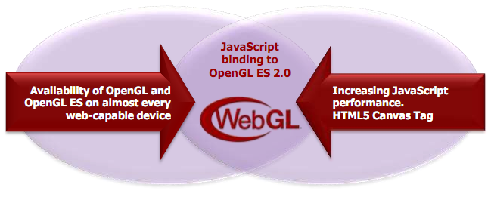
WebGL
OpenGL ES 2.0 for JavaScript
  Seriously, JavaScript
Image from http://www.khronos.org/assets/uploads/developers/library/2011-siggraph-mobile/Khronos-and-the-Mobile-Ecosystem_Aug-11.pdf

Slide 26
WebGL
Includes
  Vertex shaders
  Fragment shaders
  Vertex buffers
  Textures
  Framebuffers
  Render states
  …
Does not include
  Geometry shaders
  Tessellation shaders
  Vertex Array Objects
  Multiple render targets
  Floating-point textures
  Compressed textures
  FS depth writes
  …
See http://www.khronos.org/registry/webgl/specs/latest/

Slide 27
WebGL
If you know OpenGL, you already know WebGL
If you know C++, the real learning curve is JavaScript

Slide 28
WebGL
Creating a context is easy:
// HTML:
<canvas id="glCanvas" width="1024" height="768"></canvas>
// JavaScript:
var gl = document.getElementById("glCanvas").getContext("experimental-webgl");
Notes:
Try “webgl”, then “experimental-webgl”

Slide 29
WebGL
The rest is similar to desktop OpenGL:
// ...
gl.bindBuffer(/* ... */);
gl.vertexAttribPointer(/* ... */);
gl.useProgram(/* ... */);
gl.drawArrays(/* ... */);
Checkout http://learningwebgl.com/

Slide 30
WebGL
Create an animation loop:
(function tick(){
// ... GL calls to draw scene
window.requestAnimationFrame(tick);
})();
You want this to work cross-browser. See http://paulirish.com/2011/requestanimationframe-for-smart-animating/

Slide 31
WebGL Performance
Performance can be very good. Why?

Slide 32
WebGL Performance
Performance can be very good. Why?
  The GPU is still doing the rendering
  Batch!
    Draw multiple objects with one draw call
    Sort by texture
    Push work into shaders
    Push work into web workers
See http://www.youtube.com/watch?v=rfQ8rKGTVlg

Slide 33
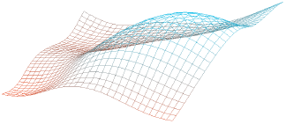
WebGL Performance (out dated)
 | 32x32 | 64x64 | 128x128
C++ | 1.9 ms | 6.25 ms | 58.82 ms
Chrome 18 | 27.77 ms | 111.11 ms | 454.54 ms
x slowdown | 14.62 | 17.78 | 7.73
CPU-intensive
 | 32x32 | 64x64 | 128x128
C++ | 3.33 ms | 9.43 ms | 37.03 ms
Chrome 18 | 12.82 ms | 22.72 ms | 41.66 ms
x slowdown | 3.85 | 2.41 | 1.13
GPU-intensive (256 draws per frame)
Image from http://openglinsights.com/
Notes:
A 32x32 grid evenly spaced in the xy plane; each point's z component is determined by a 3D noise function given the xy position and the current time.

Slide 34
WebGL and other APIs
Take advantage of other web APIs:
  HTML5 <video>
  2D <canvas>
  CSS transforms
  Composite UI elements
  Web workers
  Typed Arrays

Slide 35
HTML5 on Mobile
Touch events
Geolocation
Device orientation and motion
The future of HTML5 and WebGL on mobile is very promising
Notes:
Touch events: http://www.html5rocks.com/en/mobile/touch.html
Geolocation: http://diveintohtml5.org/geolocation.html
Orientation and motion: http://www.html5rocks.com/en/tutorials/device/orientation/

Slide 36
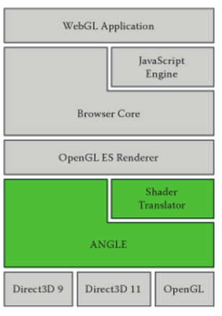
ANGLE
ANGLE – Almost Native Graphics Layer Engine
Image from WebGL Insights
Notes:
ANGLE
Implements GL ES API over D3D 9
Translates GLSL ES to HLSL

Slide 37
Tools Demos
WebGL Report
Chrome debugger
Chrome profiler
Firefox shader editor
Firefox canvas inspector
Web Tracing Framework

Slide 38
Performance Bottlenecks
Garbage collector (browser CPU overhead)
Shader compile and link (driver CPU overhead): compileShader, linkProgram, getProgramParameter, and friends. When is the performance hit?
Texture/buffer upload (driver CPU overhead): texImage2D, texSubImage2D, bufferData, bufferSubData, and friends
readPixels (stall CPU and starve GPU)
getParameter and other get* functions (stall CPU for inter-process communication)
drawElements/drawArrays - lack of view frustum culling and batching, i.e., doing a lot of calls to draw meshes that are not visible
uniform* - lack of batching
Notes:
Has to synchronize processes.

Slide 39
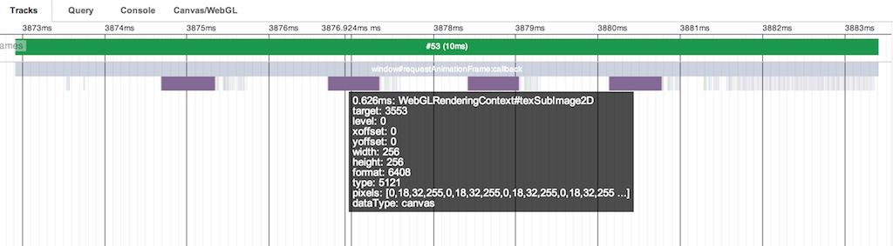
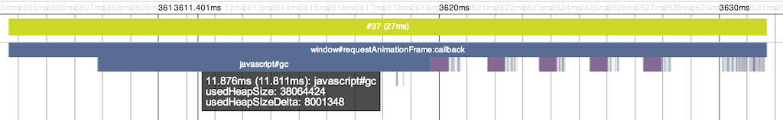
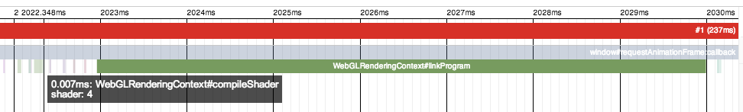
Performance Bottleneck

Slide 40
Cross-Origin Resource Sharing
Images can’t always be used as texture sources. Why?

Slide 41
Cross-Origin Resource Sharing
Same domain is OK:
var img = new Image();
img.onload = function() {
gl.texImage2D(/* ... */, img);
};
img.src = "image.png";

Slide 42
Cross-Origin Resource Sharing
Another domain requires CORS if supported:
var img = new Image();
img.onload = function() {
gl.texImage2D(/* ... */, img);
};
img.crossOrigin = "anonymous";
img.src =
"http://another-domain.com/image.png";

Slide 43
Cross-Origin Resource Sharing
Not all servers support CORS:
www.your-domain.com
www.another-domain.com
html/js/css
files
Images files
used for textures
Browser

Slide 44
Cross-Origin Resource Sharing
Use a proxy server:
www.another-domain.com
Images files
used for textures
www.your-domain.com
“proxy.php?http://another-domain.com/image.png"
html/js/css
files
Images files
used for textures
Browser
See http://resources.esri.com/help/9.3/arcgisserver/apis/javascript/arcgis/help/jshelp/ags_proxy.htm

Slide 45
Denial of Service Attacks
Long draw calls
  Complicated shaders
  Big vertex buffers
Solutions
  Kill long draw calls
  Forbid further rendering
Lots of WebGL security info: http://learningwebgl.com/blog/?p=3890
Notes:
Long draw calls were also used in early GPGPU days. These calls were killed by some operating systems (I think Windows Vista killed draw calls longer than two seconds).

Slide 46
WebGL Libraries
Three.js: https://github.com/mrdoob/three.js/
Cesium: http://cesium.agi.com/
Many more: http://www.khronos.org/webgl/wiki/User_Contributions

Slide 47
The Joys of JavaScript
Skip the next 30 slides if you already know JavaScript

Slide 48
JavaScript is weakly typed…

Slide 49
JavaScript Type System
short, int, float, double. Who needs them?
var n = 1;
Notes:
All numbers are 64-bit IEEE floating-point.

Slide 50
JavaScript Type System
JavaScript has numbers, strings, and booleans:
var n = 1;
var s = “WebGL”;
var b = true;
Notes:
All numbers are 64-bit IEEE floating-point.

Slide 51
JavaScript Type System
This compiles:
var n = 1;
var s = “WebGL”;
var b = true;
var sum = n + s + b;
Notes:
Output is “1WebGLtrue”

Slide 52
JavaScript is a functional language…

Slide 53
JavaScript Functions
Looks familiar:
Functions are first-class objects, so…
function add(x, y) {
return x + y;
}
var sum = add(1, 2);

Slide 54
JavaScript Functions
Functions are objects:
var add = function(x, y) {
return x + y;
};
var sum = add(1, 2);

Slide 55
JavaScript Functions
Pass functions to functions:
var add = function // ...
function execute(op, x, y) {
return op(x, y);
}
var sum = execute(add, 1, 2);

Slide 56
JavaScript Anonymous Functions
Why name functions?
function execute(op, x, y) // ...
var sum = execute(function(x, y) {
return x + y;
}, 1, 2);
Notes:
Anonymous functions are also in C#, etc.

Slide 57
JavaScript Closures
Why limit scope?
var z = 3;
var sum = execute(function(x, y) {
return x + y + z;
}, 1, 2);
Notes:
Anonymous functions are also in C#, etc.

Slide 58
JavaScript is a dynamic language…

Slide 59
JavaScript Object Literals
Who needs struct? Create objects on the fly:
var position = {
x : 1.0,
y : 2.0
};

Slide 60
JavaScript Object Literals
Why not add fields on the fly too?
var position = {
x : 1.0,
y : 2.0
};
position.z = 3.0;

Slide 61
JavaScript Object Literals
Who needs class?

Slide 62
JavaScript Object Literals
Who needs class? Create functions too:
var position = {
x : 1.0,
y : 2.0,
min : function() {
return Math.min(this.x, this.y);
}
};

Slide 63
JavaScript Object Literals
Why not change min()?
position.z = 3.0;
position.min = function() {
return Math.min(this.x, this.y,
this.z);
};

Slide 64
JavaScript Object Literals
Useful for passing to functions. Why?

Slide 65
JavaScript Object Literals
Useful for passing to functions. Why?
What do these arguments mean?
pick(322, 40, 5, 4);

Slide 66
JavaScript Object Literals
Useful for passing to functions. Why?
What do these arguments mean?
pick({
x : 322,
y : 40,
width : 5,
height : 4
});
Notes:
Self-documenting code.
Also, you can pass arguments in any order.

Slide 67
JavaScript does object-oriented…
Notes:
But there are no classes

Slide 68
JavaScript Constructor Functions
function Vector(x, y) {
this.x = x;
this.y = y;
}
var v = new Vector(1, 2);
Notes:
Constructor functions start with a capital letter by convention.

Slide 69
JavaScript Constructor Functions
Objects can have functions:
function Vector(x, y) {
this.x = x;
this.y = y;
this.min = function() {
return Math.min(this.x, this.y);
};
}
Notes:
Constructor functions start with a capital letter by convention.

Slide 70
JavaScript Constructor Functions
Objects have prototypes:
function Vector(x, y) {
this.x = x;
this.y = y;
}
Vector.prototype.min = function() {
return Math.min(this.x, this.y);
};
Notes:
Prototype functions can’t access closures in the constructor function.

Slide 71
JavaScript Polymorphism
No need for virtual functions
function draw(model) {
model.setRenderState();
model.render();
}
Notes:
“Duck typing”
Kind of like C# templates.

Slide 72
JavaScript Polymorphism
No need for virtual functions
var level = {
setRenderState : function() // ...
render : function() // ...
};
draw(level); // Just works
Notes:
“Duck typing”
Kind of like C# templates.

Slide 73
JavaScript Build Pipeline
Different than C++
Goal: fast downloads
Common:
Alternative: fine-grain modules
How do you deploy shaders?
.js
files
Concatenate
One
.js file
Minify
“Compressed”
.js file
See http://www.julienlecomte.net/blog/2007/09/16/
Notes:
Example minified javascript, and then beautifying it with http://jsbeautifier.org/
Shader source can be put into HTML script tags, into separate glsl files downloaded with XMLHttpRequest, or put into JavaScript literals as part of the build process.

Slide 74
JavaScript Advice
Use JSHint
Have excellent test coverage
Use the Chrome and Firefox debuggers

