Slide 1
Stochastic Gradient Descent with
Hyperbolic-Tangent Decay
Presenter: Wei Li
Advisor: I-Chen Wu

Slide 2
Reference
CGI Samba
  Convolutional Neural Network Architectures (Wei Li 20170908)
    BIGBALLON/cifar-10-cnn
  Optimization (Bo Yang 20180209)
  SGD or ADAM (Wei Li 20180309)
  Stochastic Gradient Descent with Warm Restarts (Bo Yang 20180330)
  HTD (Bo Yang)
    More experiments
    More reference paper
Paper’s arXiv: 1806.01593

Slide 3
Outline
Introduction
Background & Recap
Hyperbolic-Tangent Decay
Experiments
Discussion
Research Process

Slide 4
Introduction

Slide 5
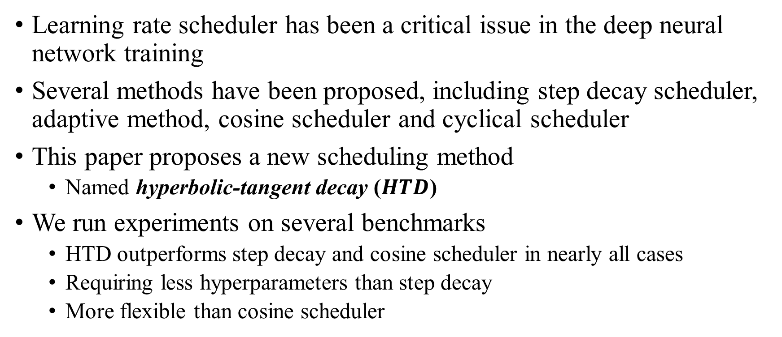
Introduction
Learning rate scheduler has been a critical issue in the deep neural network training
Several methods have been proposed, including step decay scheduler, adaptive method, cosine scheduler and cyclical scheduler
This paper proposes a new scheduling method
  Named hyperbolic-tangent decay ($HTD$)
We run experiments on several benchmarks
  HTD outperforms step decay and cosine scheduler in nearly all cases
  Requiring less hyperparameters than step decay
  More flexible than cosine scheduler

Slide 6
Background & Recap

Slide 7
Background & Recap
Deep neural networks are the basis of state-of-the-art results on many areas
  Image recognition
  Object detection
  Machine translation
  Natural Language Processing
  …

Slide 8
Background & Recap (cont.)
Training DNN is usually considered as non-convex optimization problem
Many different optimizers
  Newton method & Quasi-Newton method
    hard to implement and need to handle the problem of large cost on computing and storage
  Gradient Descent(or Steepest descent) method
    Batch Gradient Descent(BGD)
    Stochastic Gradient Descent(SGD)
    Mini-Batch Gradient Descent(MBGD)
      Which is called SGD in Deep learning

Slide 9
Background & Recap (cont.)
A critical issue in DNN training: “Hard to tune the learning rate”
  A large learning rate makes the training diverge
  A small learning rate makes the training converge slowly
Many different learning rate schedulers:
  Step decay
  Exponential decay
  Adaptive Methods
  CLR
  SGDR (cosine)
  ES-Learning

Slide 10
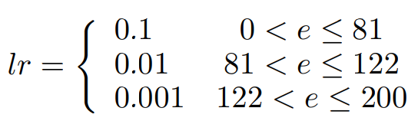
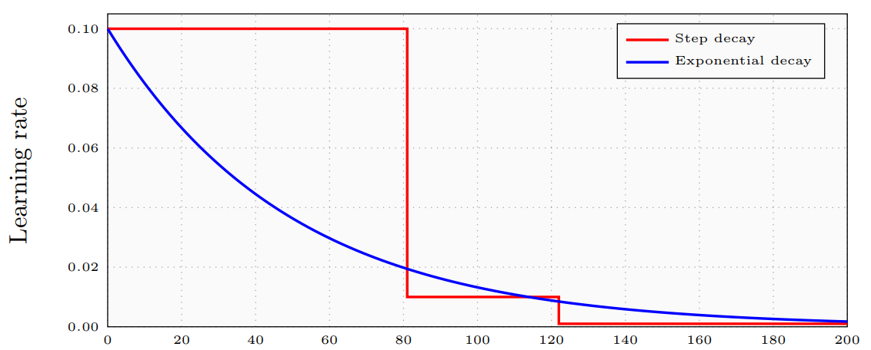

Background & Recap (cont.)
Step decay
Exponential decay
Adaptive Methods
  Adam , RMSProp , Adadelta, etc.

Slide 11
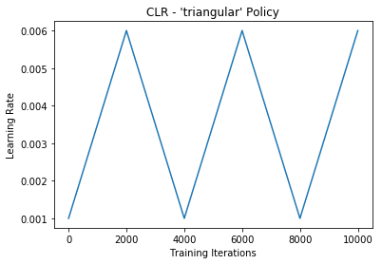
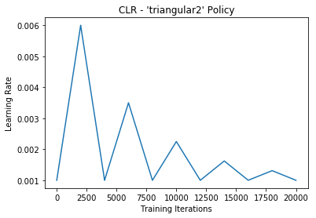
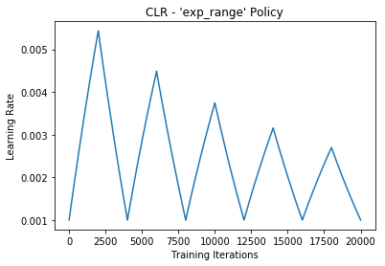
Background & Recap (cont.)
  Cyclical Learning Rates (bckenstler/CLR)

Slide 12
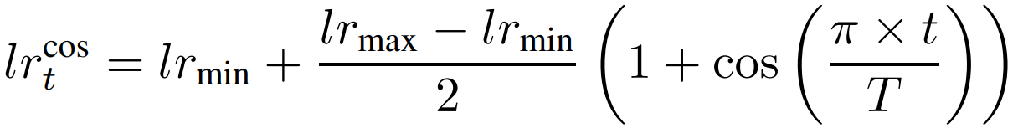
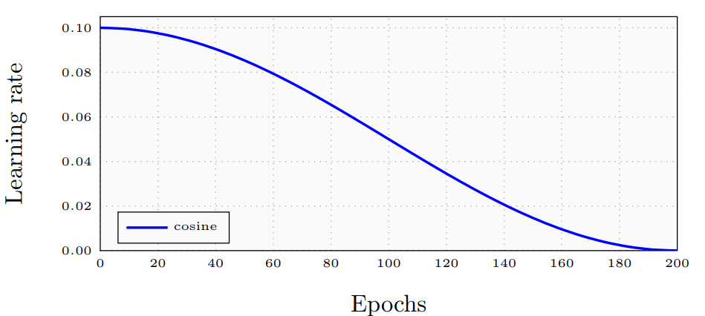
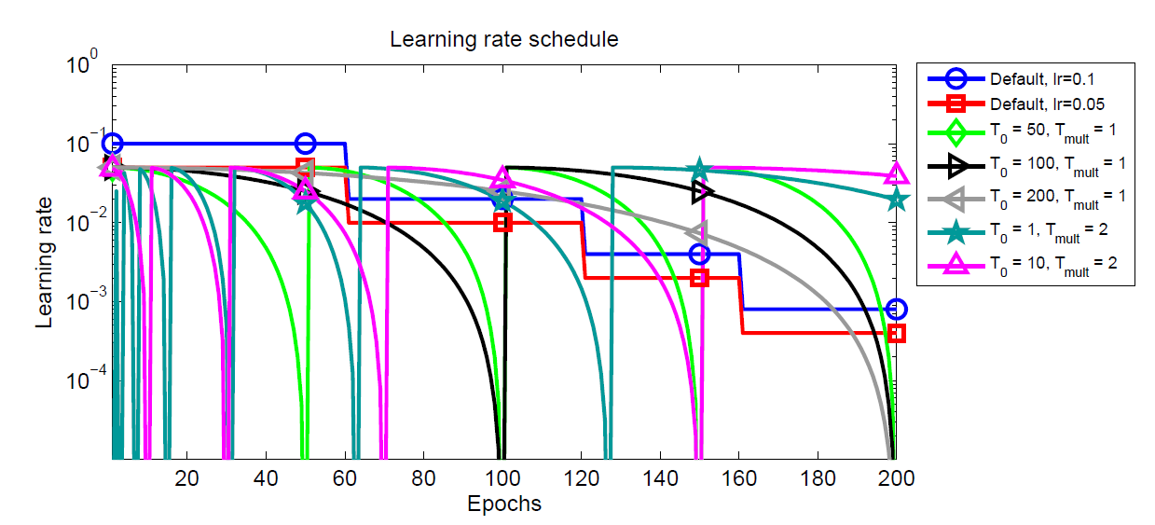

Background & Recap (cont.)
  SGDR (cosine)
    ${lr}_{min}$ and ${lr}_{max}$ are the minimum and maximum learning rate respectively
    $T$ is the total number of training epochs(or iterations),
    $t$ is the index of the current epoch(or iteration).

Slide 13
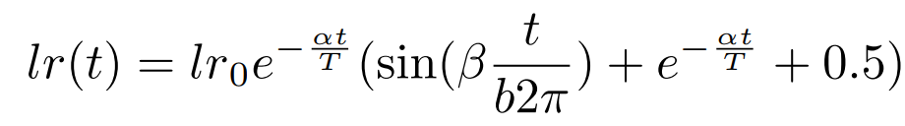
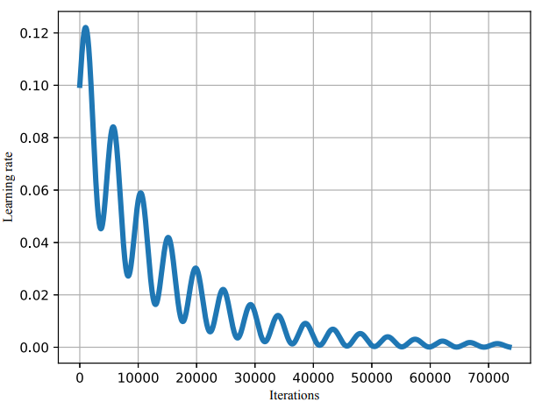
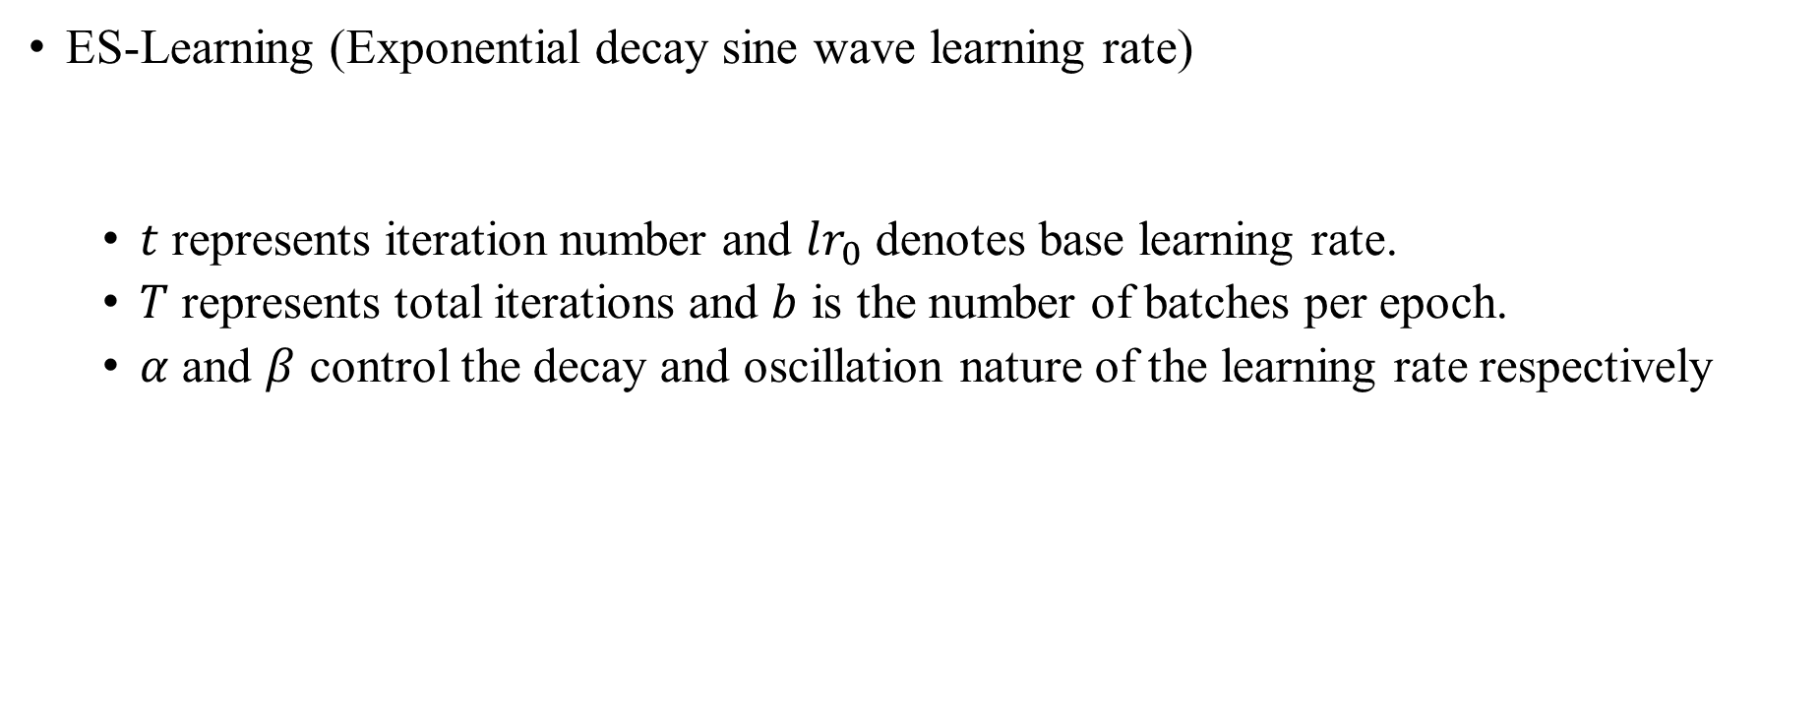
Background & Recap (cont.)
  ES-Learning (Exponential decay sine wave learning rate)
  $t$ represents iteration number and $lr_{0}$ denotes base learning rate.
  $T$ represents total iterations and $b$ is the number of batches per epoch.
  $α$ and $β$ control the decay and oscillation nature of the learning rate respectively

Slide 14
Hyperbolic-Tangent Decay
Step decay
Exponential decay
Hyperbolic-Tangent Decay (HTD)

Slide 15
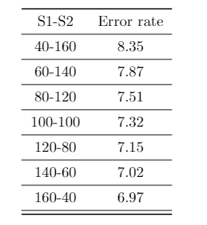
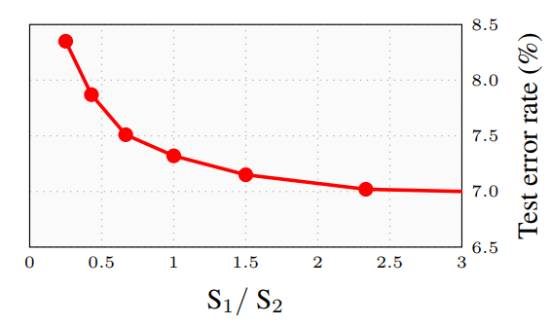
Hyperbolic-Tangent Decay
Step decay
  ResNet-32 on CIFAR-10
  Learning rate setting
    0.1 for the first S1 epochs
    0.01 for the next S2 epochs.
    S1 + S2 = 200
    Averaged error rates of 4 runs.
It is important for a scheduler to choose the ratio flexibly for training.

Slide 16
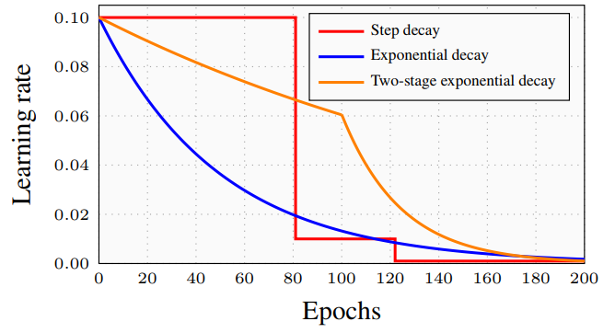
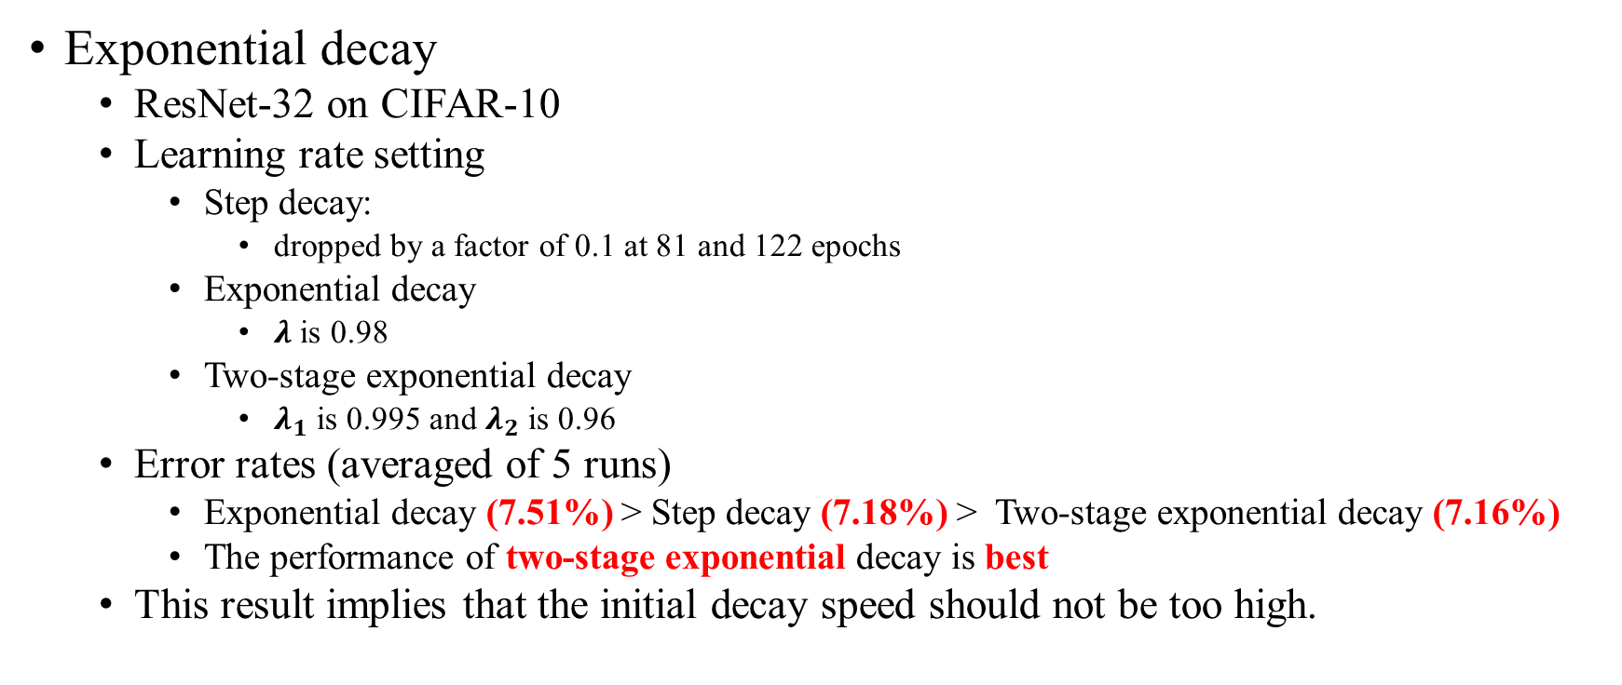
Hyperbolic-Tangent Decay (cont.)
Exponential decay
  ResNet-32 on CIFAR-10
  Learning rate setting
    Step decay:
      dropped by a factor of 0.1 at 81 and 122 epochs
    Exponential decay
      $λ$is 0.98
    Two-stage exponential decay
      $λ_{1}$ is 0.995 and $λ_{2}$ is 0.96
  Error rates (averaged of 5 runs)
    Exponential decay (7.51%) > Step decay (7.18%) > Two-stage exponential decay (7.16%)
    The performance of two-stage exponential decay is best
  This result implies that the initial decay speed should not be too high.

Slide 17
Hyperbolic-Tangent Decay (cont.)
From the empirical results in the previous subsections
Can we find a function:
  exponential decay like
  change training epochs radio flexibly
Our work:
  Hyperbolic-Tangent Decay (called HTD)

Slide 18
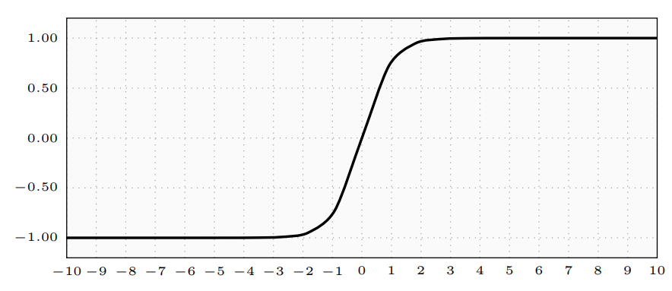
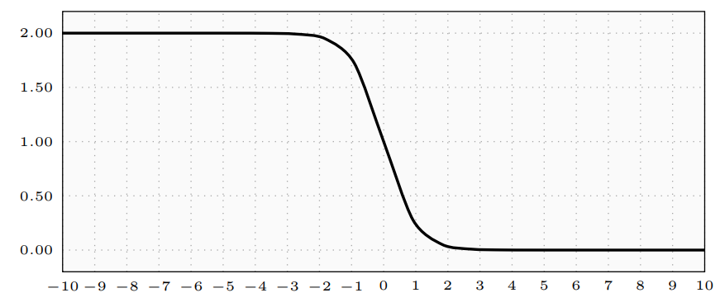

Hyperbolic-Tangent Decay (cont.)
$tanh\left(x\right)$
$1−tanh\left(x\right)$

Slide 19
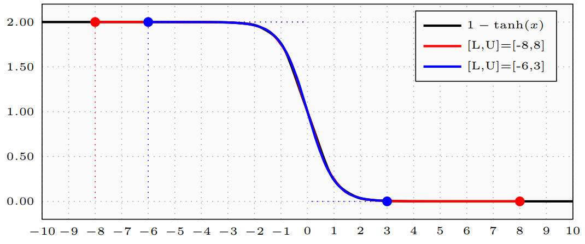

Hyperbolic-Tangent Decay (cont.)
$1−tanh\left(x\right)$
L & U : indicates the lower and upper bounds of the interval $[L, U]$

Slide 20
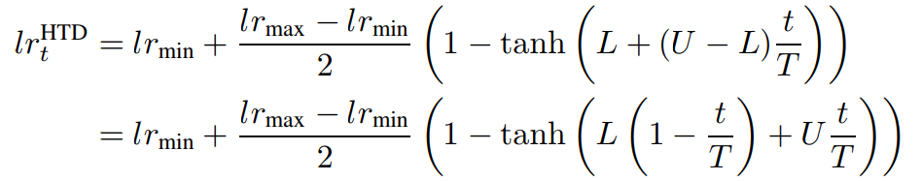
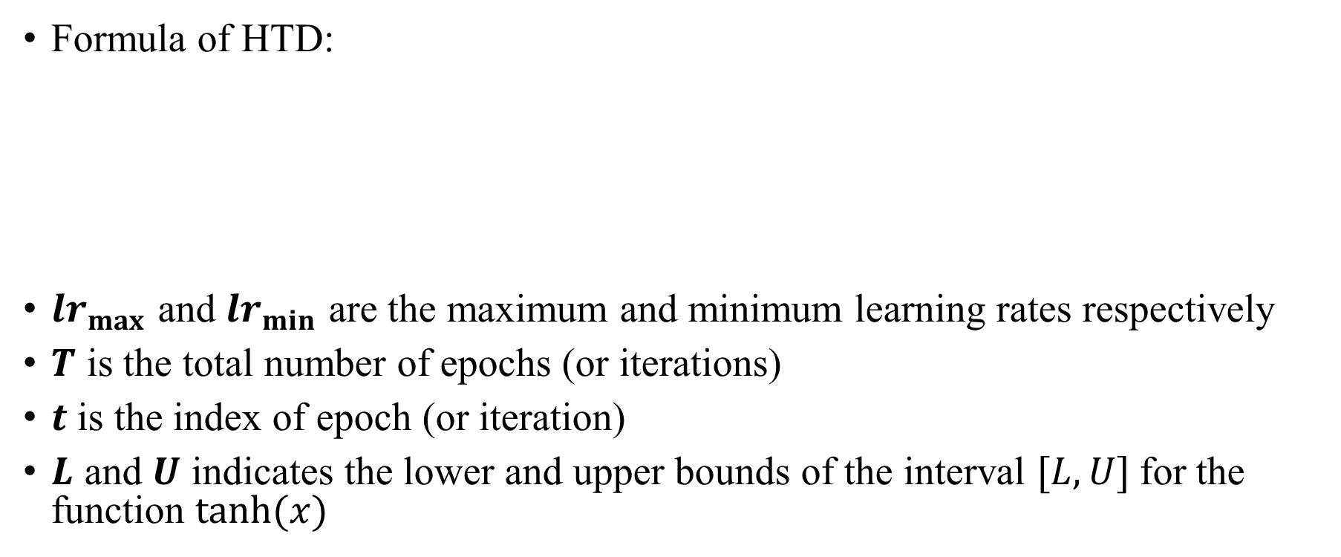
Hyperbolic-Tangent Decay (cont.)
Formula of HTD:
$lr_{max}$ and $lr_{min}$ are the maximum and minimum learning rates respectively
$T$ is the total number of epochs (or iterations)
$t$is the index of epoch (or iteration)
$L$ and $U$ indicates the lower and upper bounds of the interval $[L, U]$for the function $tanh(x)⁡$

Slide 21
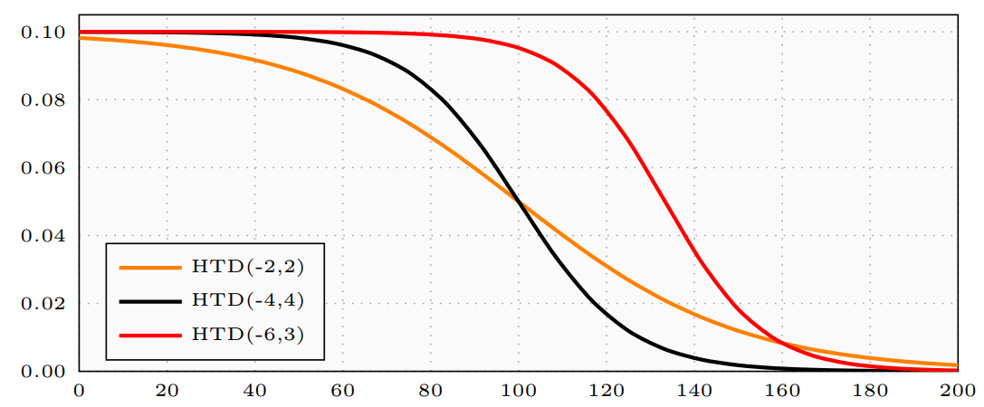

Hyperbolic-Tangent Decay (cont.)
Let $HTD(L, U,lr_{max},lr_{min})$denote the scheduler
For simplicity, let $HTD(L, U)$ denote the scheduler.
  $lr_{min}=0$ and $lr_{max}=\text{initial}$ learning rate

Slide 22
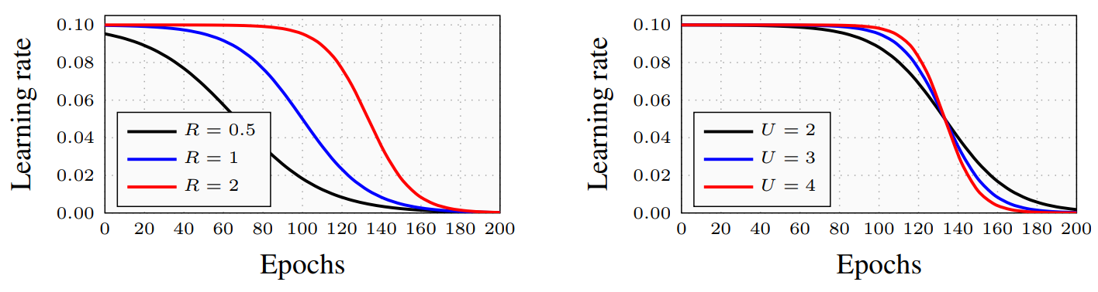

Hyperbolic-Tangent Decay (cont.)
Importance of $L, U$and their ratio
  In $HTD(L, U)$, the hyperparameters $U$ affects the final learning rate
  The ratio $R = |L|/|U|$indicates the ratio of training times before and after the inflection point
    The ratio R is larger, the training time before the inflection point is longer.

Slide 23
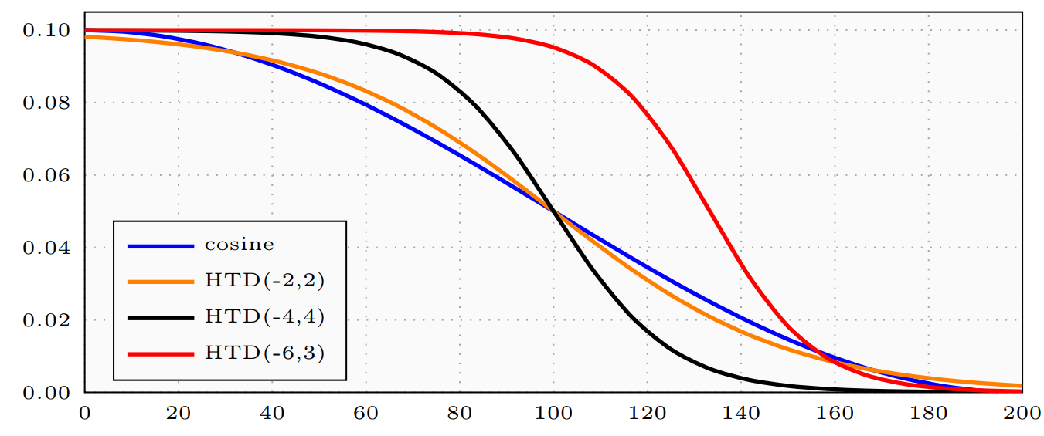

Hyperbolic-Tangent Decay (cont.)
Compared to cosine
  The hyperparameters of cosine scheduler include $lr_{max}$ and $lr_{min}$
  The hyperparameters of HTD include $lr_{max}$, $lr_{min}$, $L$ and $U$
  $L$ and $U$ make HTD more flexible than cosine scheduler
  We also find that $HTD(−2,2)$is close to the cosine scheduler

Slide 24
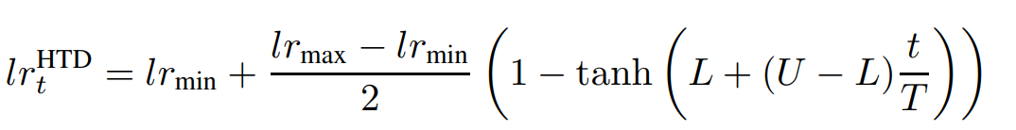
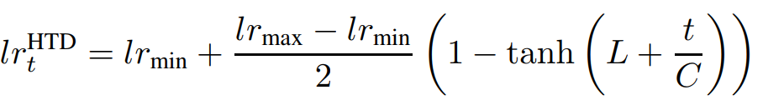

Hyperbolic-Tangent Decay (cont.)
A variation of $HTD$ without $U$ and $T$

Slide 25
Experiments
Different Networks for CIFAR
Other Data Sets
The effect of ratio in HTD

Slide 26
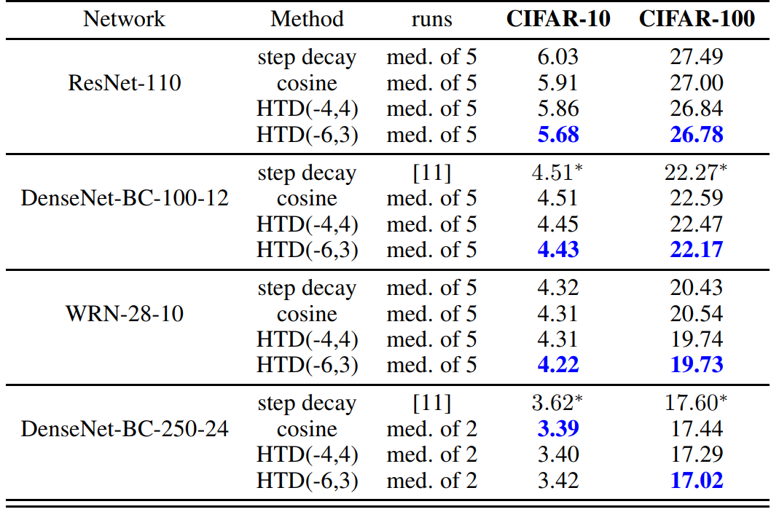
CIFAR 10
CIFRA 100

Slide 27
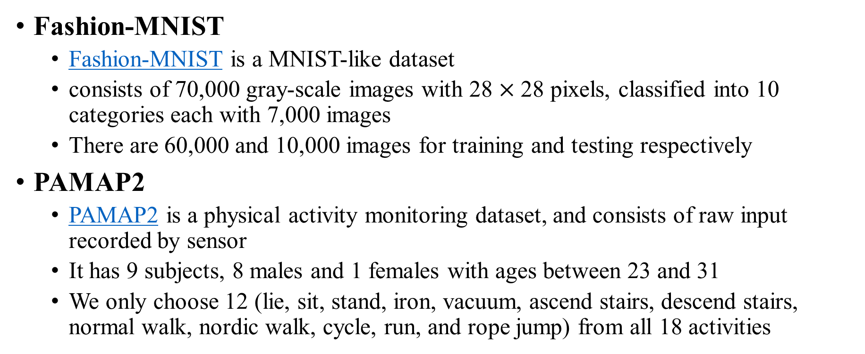
Experiments (cont.)
Fashion-MNIST
  Fashion-MNIST is a MNIST-like dataset
  consists of 70,000 gray-scale images with 28 $×$28 pixels, classified into 10 categories each with 7,000 images
  There are 60,000 and 10,000 images for training and testing respectively
PAMAP2
  PAMAP2 is a physical activity monitoring dataset, and consists of raw input recorded by sensor
  It has 9 subjects, 8 males and 1 females with ages between 23 and 31
  We only choose 12 (lie, sit, stand, iron, vacuum, ascend stairs, descend stairs, normal walk, nordic walk, cycle, run, and rope jump) from all 18 activities

Slide 28
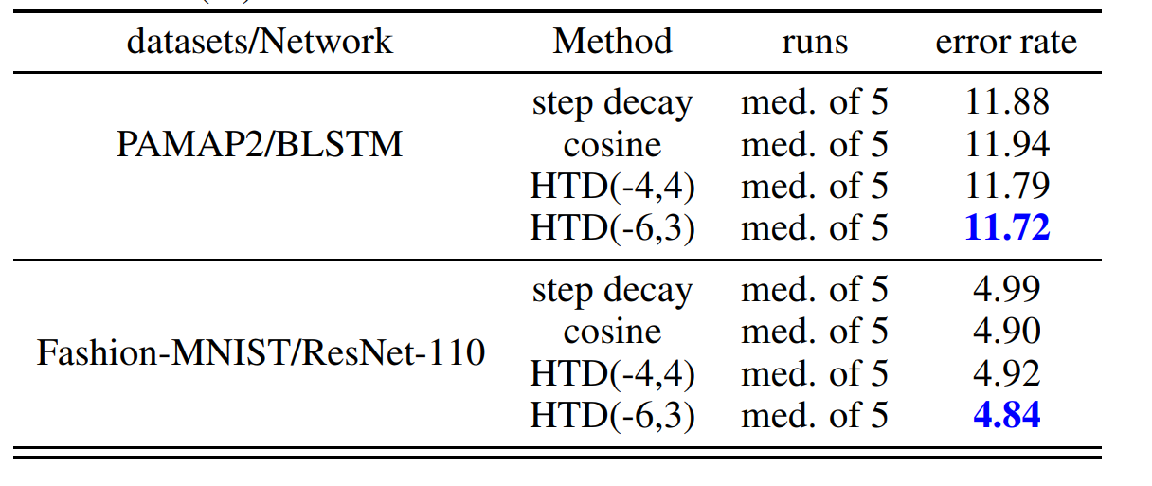
Experiments (cont.)
The error rates (%) on PAMAP2 and Fashion-MNIST
  Best results are written in blue

Slide 29
Experiments (cont.)
ImageNet
  ILSVRC datasets consists of 1000 classes
    1.28 million training images (138GB)
    50k validation images (6.3GB)
    100k testing images (12.7GB)
    We only evaluate the ResNet-18 and ResNet-34 by using the source code of facebook/fb.resnet.torch, since it takes a large amount of time to train ImageNet

Slide 30
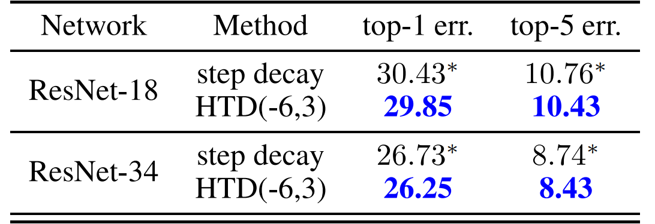
Experiments (cont.)
The error rates (%) on ImageNet
  Best results are written in blue
  The character * indicates results are directly obtained from the original paper
  It’s pretty good if we can finish all the training of cosine, HTD(-4,4) and DenseNet

Slide 31
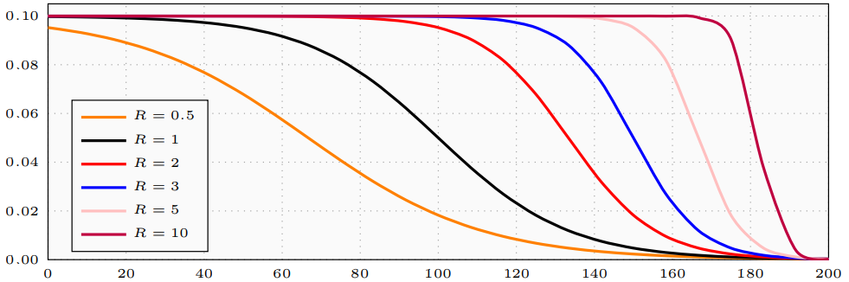

Experiments (cont.)
The effect of ratio in $HTD$
  To demonstrate the importance of adjusting the ratio $R$
    $L=−1.5, −3, −6, −9, −15, −30$ and Fix $U = 3$
  ResNet-32 on CIFAR datasets with 200 / 400 epochs
  Averaged test error rate of 4 runs

Slide 32
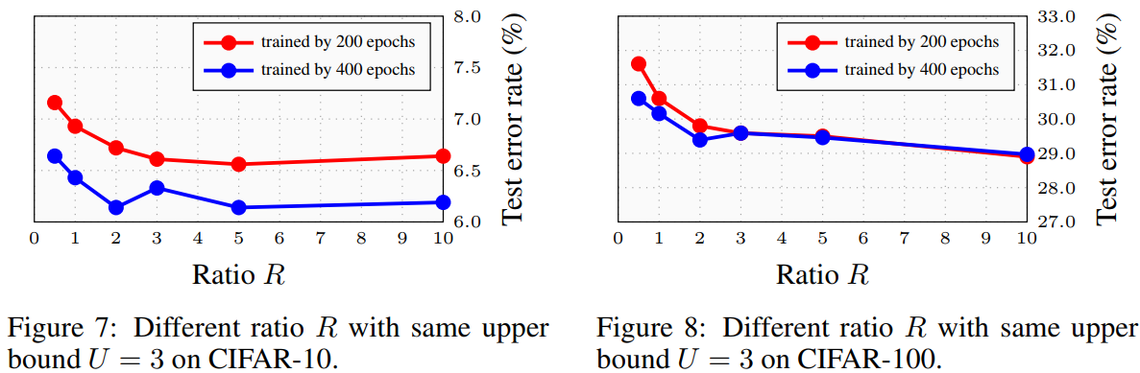

Experiments (cont.)
The effect of ratio in $HTD$

Slide 33
Discussion

Slide 34
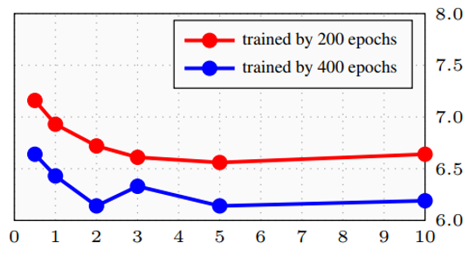
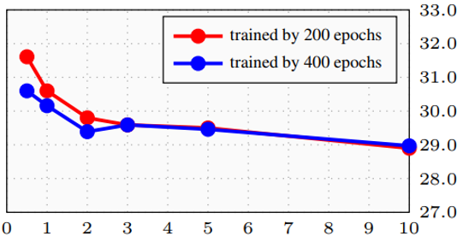
Discussion
We still haven't found a good way to change the learning rate
  Why 200 epoch for CIFAR and 90 epochs for ImageNet? Is this enough?
    Maybe not
  How many epochs should we choose for different datasets?
    We don’t know
  How many epochs should we choose for different stage (step decay)?
    We still don’t know

Slide 35
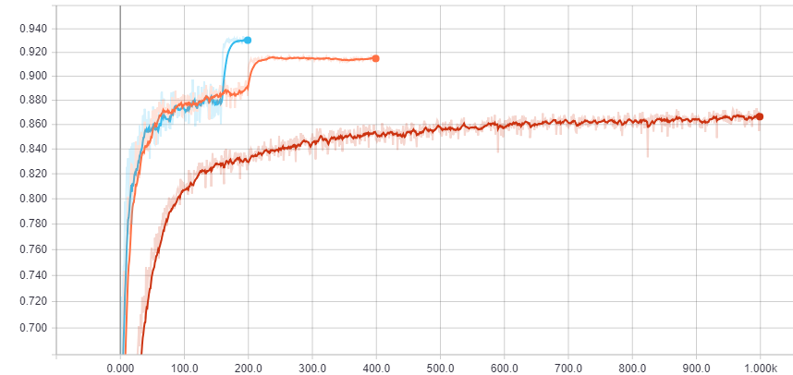
Discussion (cont.)
Common training tips
  Start from a large learning rate
blue 1-160 : 0.1 161-200 : 0.01
orange 1-200 : 0.01 201-400 : 0.001
red 1-1000 : 0.001

Slide 36
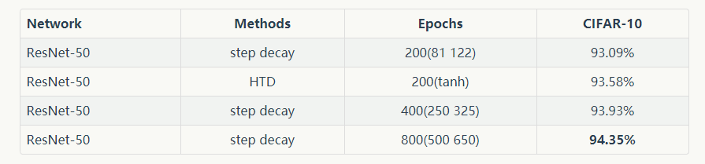
Discussion (cont.)
Common training tips
  Start from a large learning rate
  Enough epochs is necessary

Slide 37
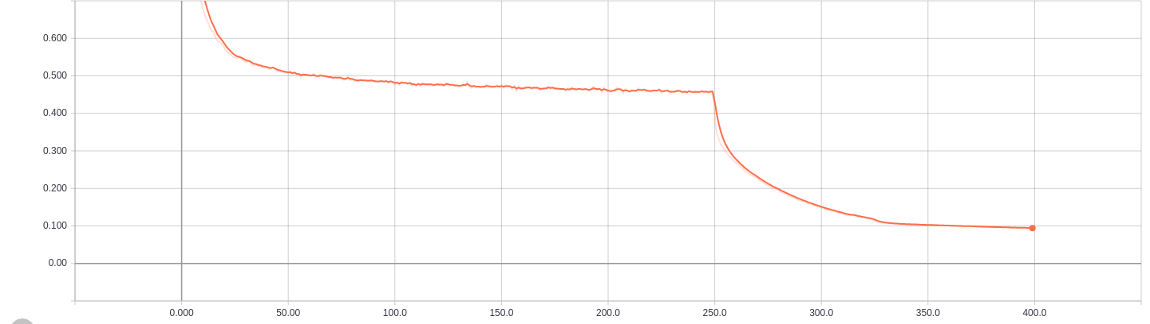
Discussion (cont.)
Common training tips
  Start from a large learning rate
  Enough epochs is necessary
  Neural networks are still learning although loss does not decrease quickly

Slide 38
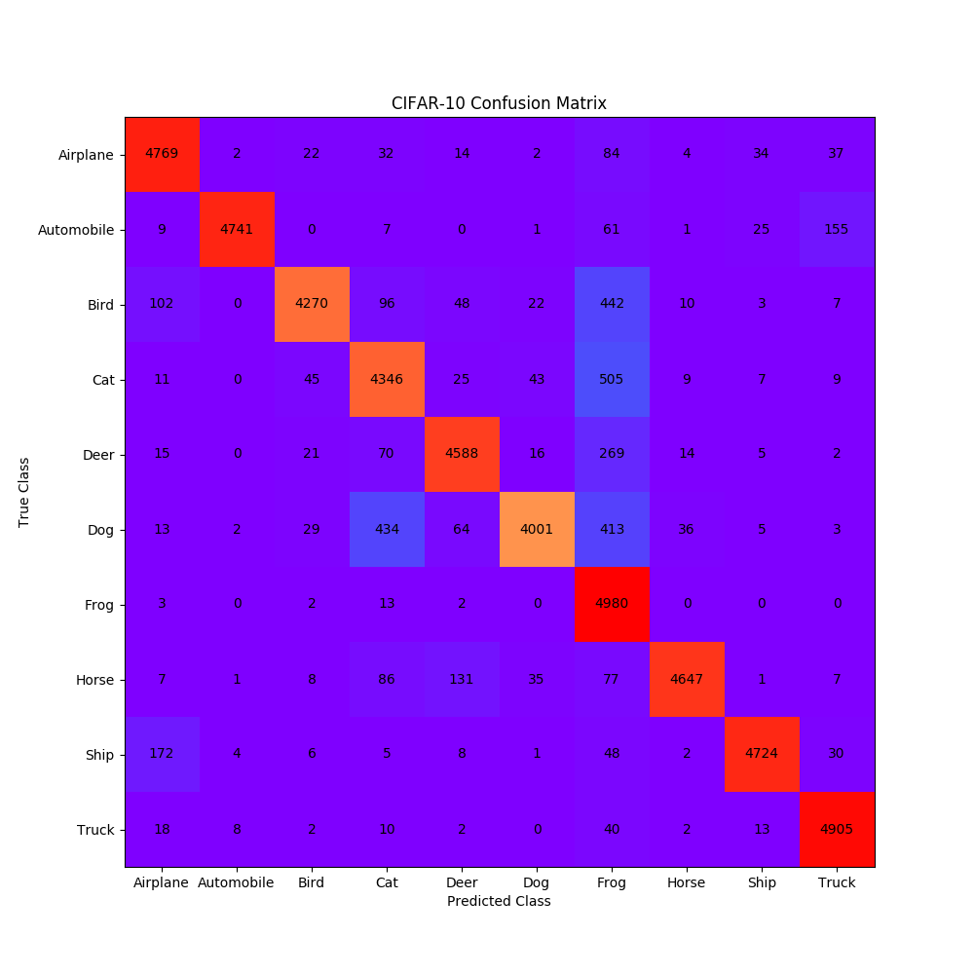
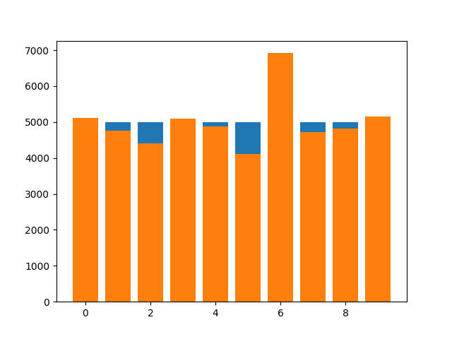
Epoch 246

Slide 39
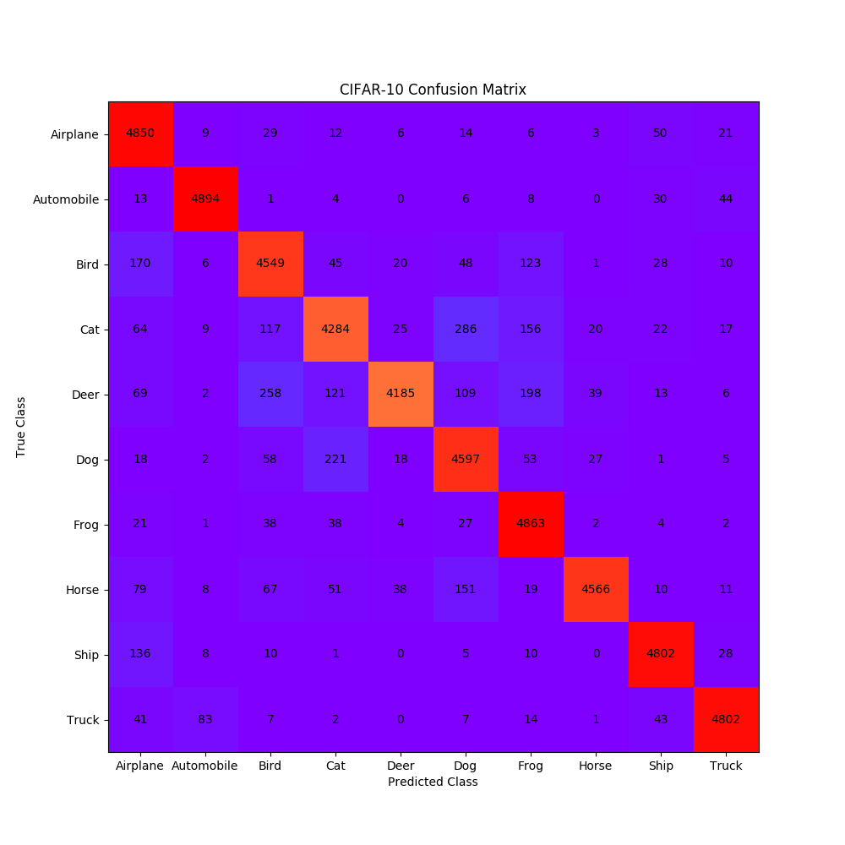
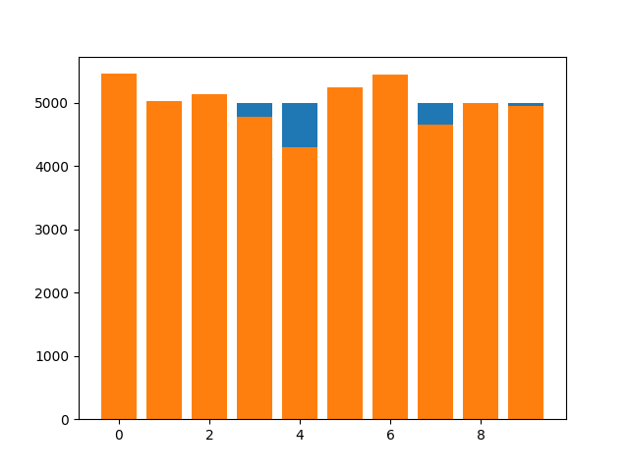
Epoch 247

Slide 40


Epoch 248

Slide 41


Epoch 249

Slide 42


Epoch 250

Slide 43
Discussion (cont.)
Common training method
  Find a large learning rate (make sure the training run normally)
  Training (enough time)
  Decay the learning rate
  Training (enough time)
  Decay the learning rate
  …
  …
  Get a good model

Slide 44
Research Process

Slide 45


Research Process
Adam vs. Step decay
Cosine & Step decay & Tanh
  $α$ cosine + $β$ tanh…
SGDR with consine/tanh
  Iteration & epochs
  Shift consine
  100K vs. 50K training data
CIFAR10 & CIFAR100
  LeNet & ResNet (32,110 layers)
  WRN & ResNeXt
    Find bugs & fixed (OMG)
Medium of 5 runs
200 epochs & 50 epochs
Focus on Tanh(called HTLR)
  HTLR(-2,2) & (-4,4)
  PAMAP2 (trained with BLSTM)
  Step decay $S_{1}:S_{2}:S_{3}$ Radio
    two stage / three stage
    two stage exponential decay
  HTLR’s flexible
    HTLR(-3.5,2.5) & (-6,3)
  Tiny ImageNet & Fashion MNIST
    ResNet (32,110 layers)
  PAMAP2 retrain
  DenseNet for CIFAR datasets
  HTLR to HTD
  ImageNet
    6 machines with 24 GPUs
    ResNet & DenseNet

Slide 46


Research Process (cont.)
Adam vs. Step decay
Cosine & Step decay & Tanh
  $α$ cosine + $β$ tanh…
SGDR with consine/tanh
  Iteration & epochs
  Shift consine
  100K vs. 50K training data
CIFAR10 & CIFAR100
  LeNet & ResNet (32,110 layers)
  WRN & ResNeXt
    Find bugs & fixed (OMG)
Medium of 5 runs
200 epochs & 50 epochs
Focus on Tanh(called HTLR)
  HTLR(-2,2) & (-4,4)
  PAMAP2 (trained with BLSTM)
  Step decay $S_{1}:S_{2}:S_{3}$ Radio
    two stage / three stage
    two stage exponential decay
  HTLR’s flexible
    HTLR(-3.5,2.5) & (-6,3)
  Tiny ImageNet & Fashion MNIST
    ResNet (32,110 layers)
  PAMAP2 retrain
  DenseNet for CIFAR datasets
  HTLR to HTD
  ImageNet
    6 machines with 24 GPUs
    ResNet & DenseNet

Slide 47
Research Process (cont.)
Some experiences (my personal opinion)
  Have a thorough and careful survey before starting your research
    Avoid unnecessary work
    Learn more about related work
  Find partners if you think that is helpful
    Not too much
    Interested in your research
  Pay attention to the details and check your code before starting your training
    Save time & resource
    Check carefully if you use other people’s code (sgdr, swa)

Slide 48





Research Process (cont.)
Check carefully if you use other people’s code (sgdr, swa)
  SGDR (100k vs. 50k)
  SWA (wrong resnet layers)

Slide 49
Research Process (cont.)
Some experiences (my personal opinion)
  Have a thorough and careful survey before starting your research
    Avoid unnecessary work
    Learn more about related work
  Find partners if you think that is helpful
    Not too much
    Interested in your research
  Pay attention to the details and check your code before starting your training
    Save time & resource
    Check carefully if you use other people’s code (sgdr, swa)
  Start writing your paper as early as possible
    Maybe PPT (outline) first
    Control uncertainties in the process of writing your paper

Slide 50

Research Process (cont.)
Anyway, we proposed a flexible and practical learning rate scheduler
  Try it if you are Deep Learning newbie
  Try it if you don’t know how to set learning rate in a new classification task
  Try it if you want get a good performance in classification tasks
We hope this method will help you somehow !!

Slide 51

Thank you!

