Slide 1
BayDAG Update
October 24, 2023

Slide 2
Background
MTC and SANDAG (with WSP and RSG) have collaborated on a number of models to convert their old CT-RAMP models to ActivitySim
Converting CT-RAMP UEC’s to ActivitySim Configs
Adding ActivitySim functionality to replicate some CT-RAMP features
Collaboration has been dubbed BayDAG = San Fransisco Bay + SANDAG
Has been ongoing for the last year-ish
First set of contributions were merged in March. Updates included:
Joint tour extension to CDAP
New joint tour frequency and composition model
“Relative” trip scheduling
Assortment of other minor changes
See this pull request: https://github.com/ActivitySim/activitysim/pull/657

Slide 3
Context
Previous contribution was the initial model results
Focus was on reproducing CT-RAMP results
Models were still being stood-up and implemented
Since then, much more focus on model estimation and refinement
Estimation mode testing not performed on a lot of new models
Running a large sample (~40k households) of estimation data found edge cases, slow spots, and user headaches
Code updates in order to get some new estimation variables into the data

Slide 4
Example Story: Disaggregate Accessibilities
Disaggregate accessibilities initial design was to:
Create workplace location, shopping, and other discretionary accessibilities for three auto ownership levels 0, 1, and 2+ cars
Accessibilities merged onto synthetic population according to the initial seed value of auto ownership
Now, want to estimate auto ownership with accessibilities matching the auto ownership alternative
E.g. zero auto alternative has a coefficient on the 0 auto accessibility to workplace
All three accessibilitity levels now need to be included in the household table for each household → necessitates a code change to melt and merge accessibilites
Example shows how estimation can bring up things not originally considered or implemented in the initial design of a model

Slide 5
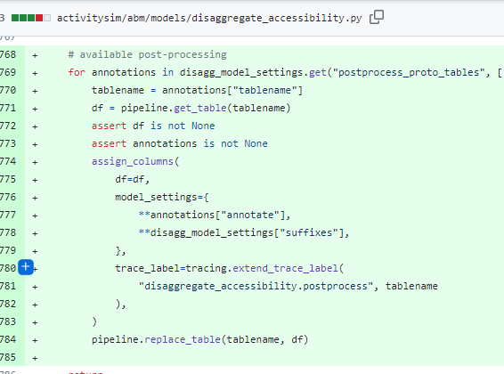
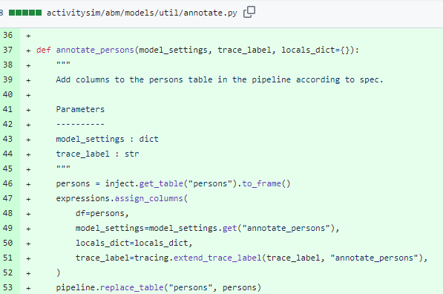
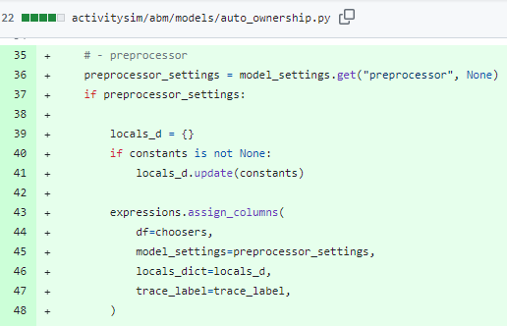
List of Enhancements: pt1
Adding pre-processors and annotate functionality to some models
Auto ownership model didn’t have a pre-processor
Perform operations on disaggregate accessibilities
Added utility for annotating tables

Slide 6
List of Enhancements: pt2
Workplace location model now produces two logsums
1. Currently only produces the workplace location logsum (sum location choice utility across all workplace destinations)
2. Want to also have the workplace modechoice logsum (sum mode choice utility from origin to selected workplace across all modes)
Code now provides the user the ability to return both to the person table

Slide 7
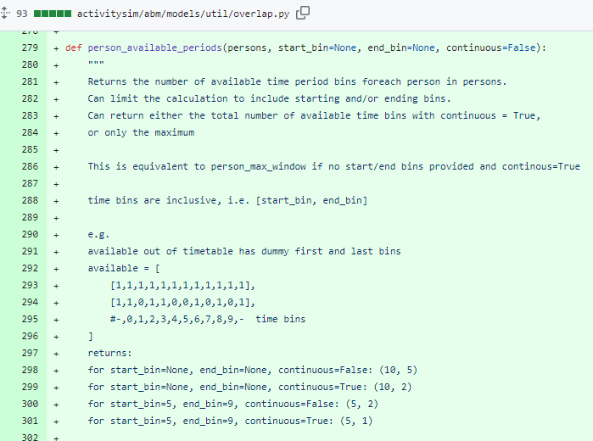
List of Enhancements: pt3
Wanted more flexibility in person time windows in tour models
Current code only returns the total number of available time periods for each person
Want to allow the user to be able to choose continuous vs total and start / end bins
E.g. a person might take more eatout tours if they have 2+ free hours in the evening

Slide 8
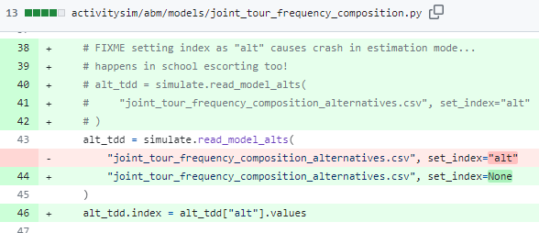
List of Enhancements: pt4
Bugs encountered in estimation mode
Model would crash if school escorting was run but no households actually had school escorting due to the handling of empty tables
ActivitySim estimator expects alternatives files to have specific format for “interation simulate” models – school escorting and new joint tour frequency and composition model needed tweaking
Joint tour participation would get stuck in an infinite loop if it can’t force household members to satisfy joint tour requirements (only happened for weird survey data cases)

Slide 9
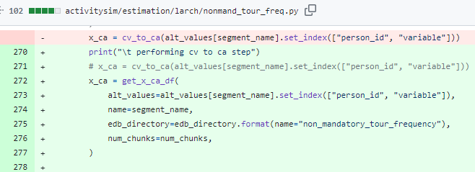
List of Enhancements: pt5
Estimation mode usability improvements
Can select only certain models to output EDBs for
Location choice models can now include sampling. Code will check whether the surveyed alternative is included, and if not, add it to the available alternatives. (Saves a LOT of runtime for 2-zone models to not include all MAZs in estimation)
Decreased the read time of models into larch. Broke up the “cv_to_ca” computationally intensive step into portions and pickled the results for quick re-loading.
Added some assert statements so that errors would not be run into again.

Slide 10
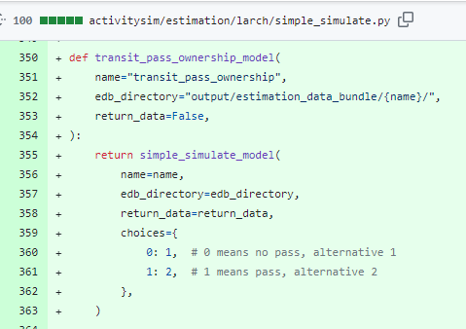
List of Enhancements: pt6
Adding interface to larch for additional models
ActivitySim models include work from home, telecommute frequency, transit pass ownership & subsidy
Extension models include the external worker and tour identification and location models, transponder ownership

Slide 11
Review of Enhancements
Disaggregate accessibility handling
Adding pre-processor and annotate functionality to some models
Mandatory location modechoice logsum
Person time window configurability
Estimation mode bug fixes and enhancements
Model interfaces into larch

Slide 12
Next Steps
Merge with Orca-removal code base
Not a trivial exercise considering the entire code base has changed
Open pull request back into ActivitySim for review
A lot needs to be decided here:
What do we need to include in the CI testing?
Do we generalize some of these improvements now or wait for phase 9? Enhancements were made to just keep SANDAG moving.
What additions do we want to keep for things like external models that aren’t part of the ActivitySim code base?
See the open SANDAG-internal draft pull request here: https://github.com/SANDAG/activitysim/pull/58/files

Slide 13
Questions/Discussion

Slide 14
Joel Freedman
Senior Director
Joel.Freedman@rsginc.com
David Hensle
Senior Analyst
David.Hensle@rsginc.com

